Slide 1
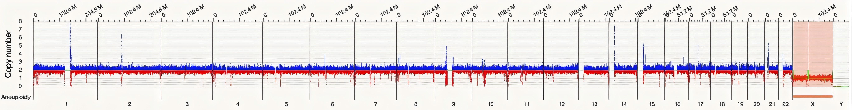
Supplementary Figure 1: schematic diagram of chromosomal copy number

Slide 2
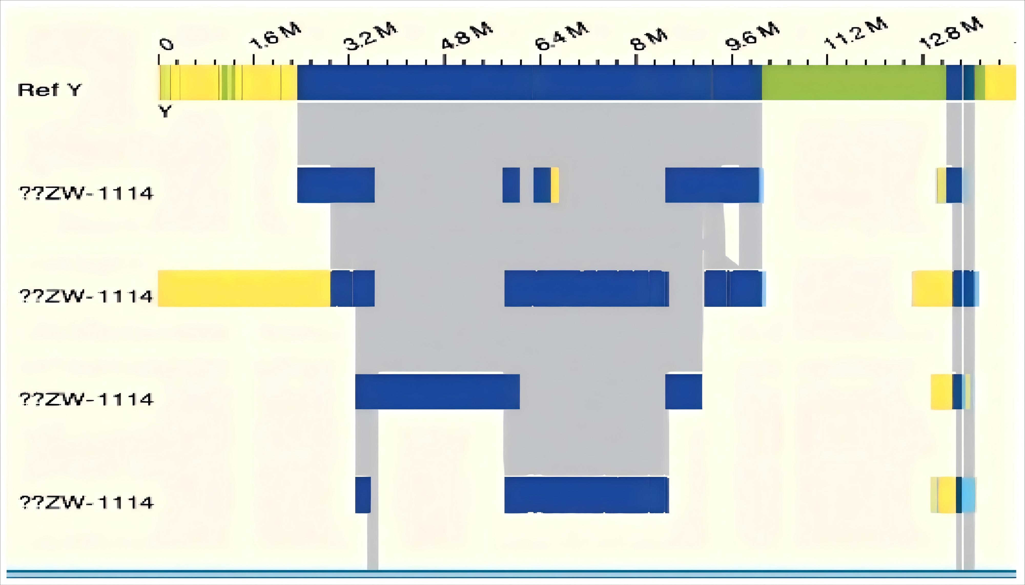
Supplementary Figure 2: Schematic diagram of the Y chromosome signals by OGM

Slide 3
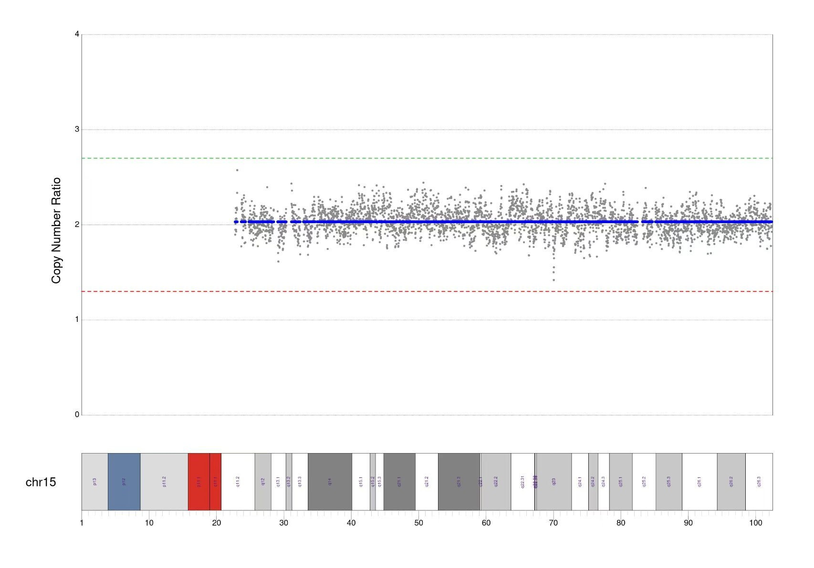
Supplementary Figure 3: the local CNV plot of chr15

