Slide 1
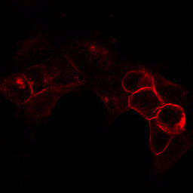
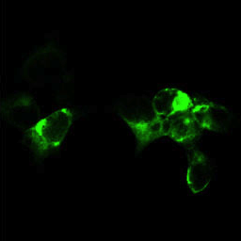
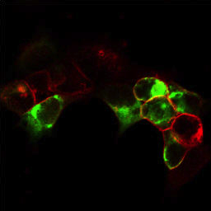
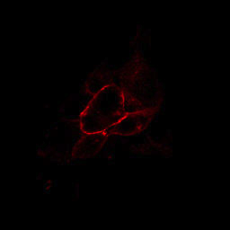
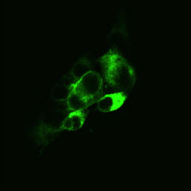

Figure S2. Confocal images of HeLa cells expressing wild-type or p.Arg1715His mutant Cav3.1.
NaK-ATPase
CACNA1G
Merge
Wild-type
Mutant
HeLa cells were transiently transfected with wild-type or p.Arg1715His mutant human Cav3.1 and immunostained with anti-Cav3.1 antibodies (green) and anti-NaK-ATPase antibodies (red) as a membrane marker. Scale bar is 20 µm.

