Slide 1
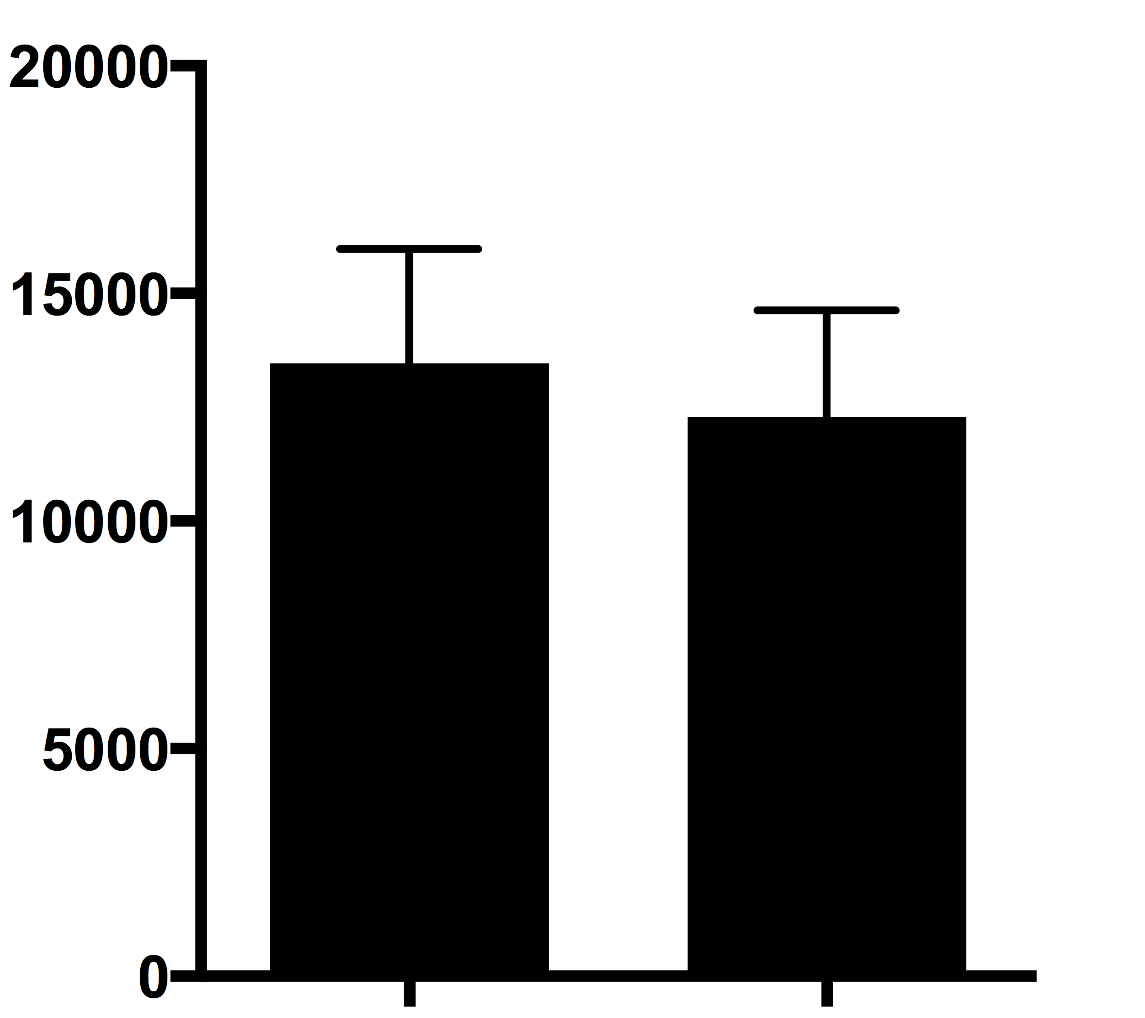
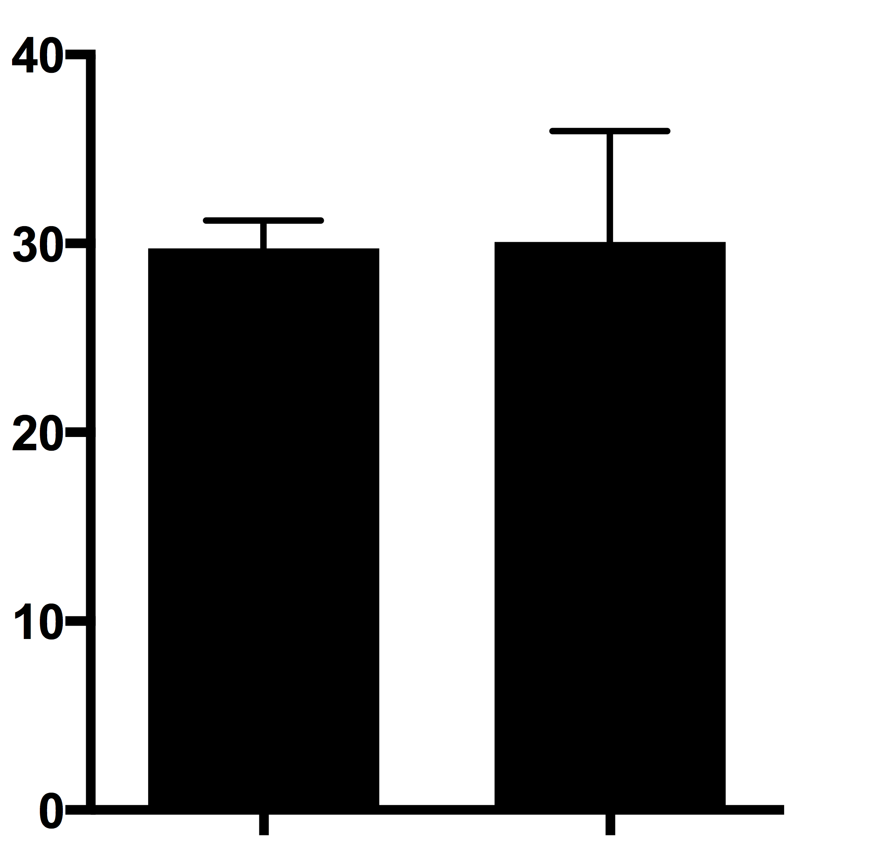
Figure S3. Morphological measurement of differentiated Purkinje cells.
A
B
Dendritic field area (µm²)
Diameter of cell soma (µm)
Control
2-III-1
Control
2-III-1
Dendritic field area (A) and diameter of cell soma (B) were measured in differentiated Purkinje cells. Data are presented as the mean ± SD. Statistical significance was assessed by unpaired t-test.

