Slide 1
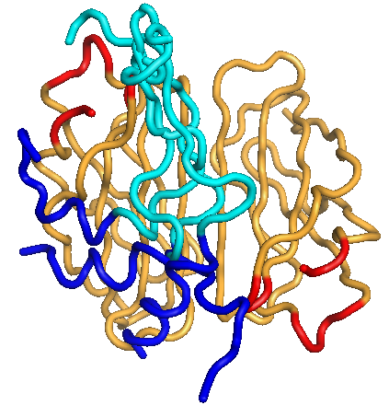
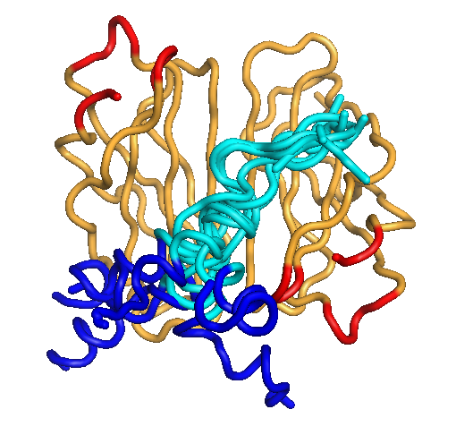
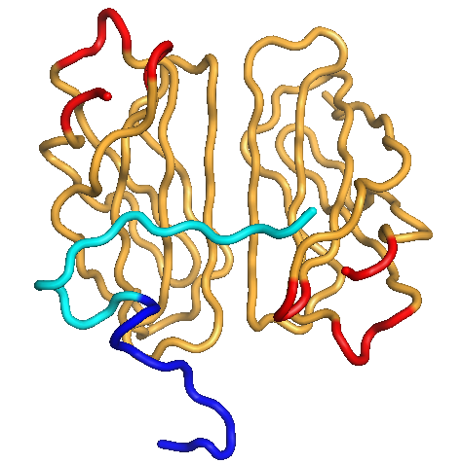
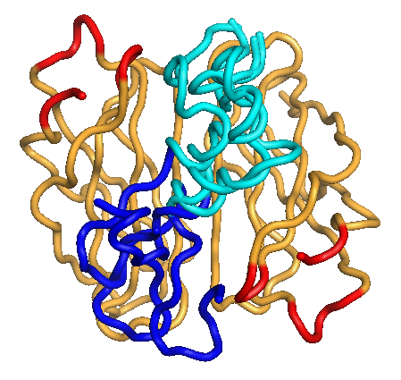
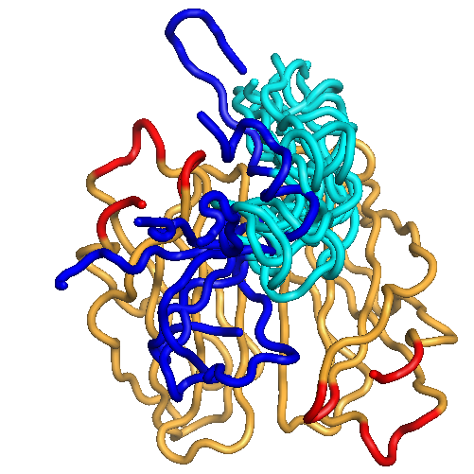
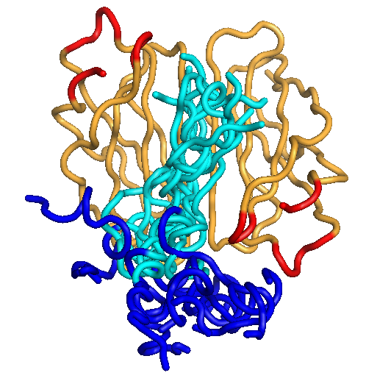
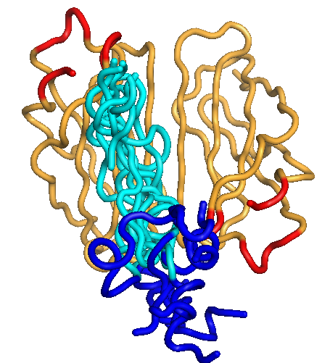
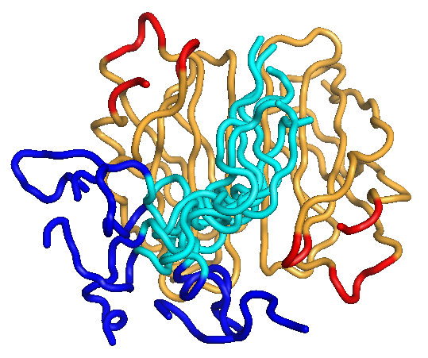
TOP1
TOP2
TOP3
TOP4
ΔG: -26.3 ± 7.8 (kcal/mol)
ΔG: -23.7 ± 9.6 (kcal/mol)
ΔG: -22.5 ± 0.0 (kcal/mol)
ΔG: -22.4 ± 8.6 (kcal/mol)
TOP5
TOP6
TOP7
TOP8
ΔG: -19.8 ± 12.5 (kcal/mol)
ΔG: -18.8 ± 7.7 (kcal/mol)
ΔG: -18.3 ± 7.3 (kcal/mol)
ΔG: -16.4 ± 7.2 (kcal/mol)

Slide 2
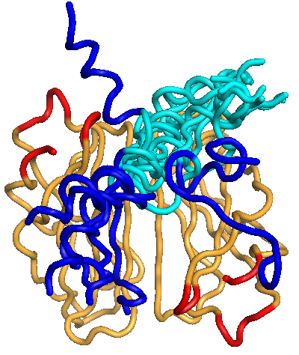
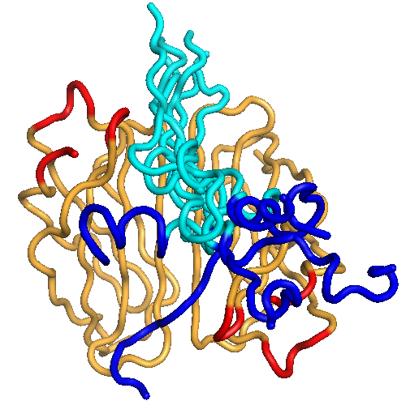
TOP9
TOP10
ΔG: -14.6 ± 11.3 (kcal/mol)
ΔG: -14.6 ± 9.0 (kcal/mol)

