Slide 1
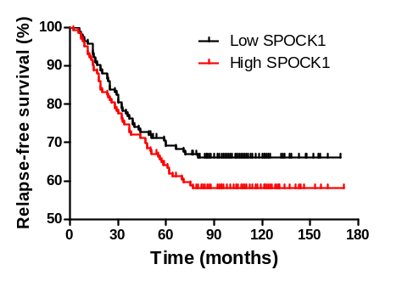
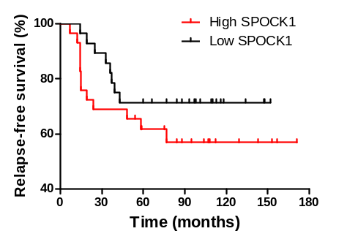
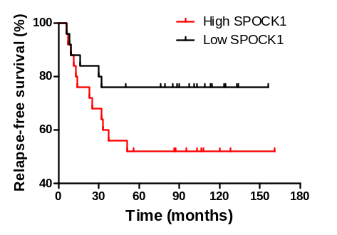
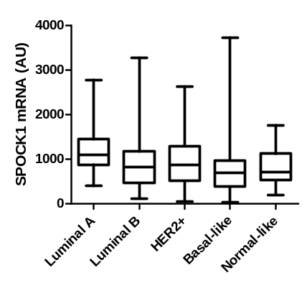
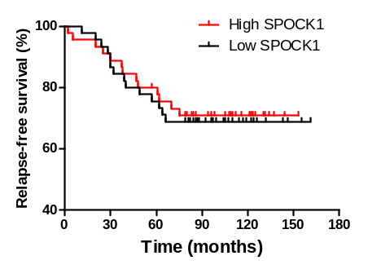
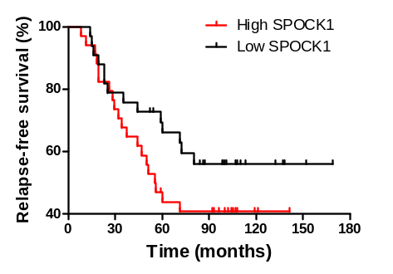
A
C
HER2, n=57 (20%)
Basal, n=50 (17%)
p = 0.18
p = 0.24
p = 0.10
B
Luminal A, n=90 (32%)
Luminal B, n=67 (23%)
ns
p = 0.17
Perurena N et al.
Sup Fig. 9

