Slide 1
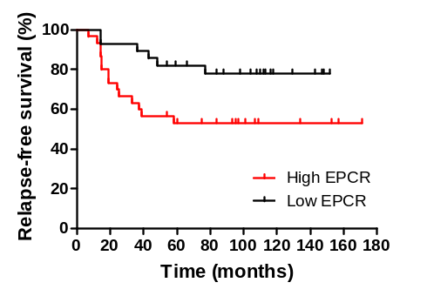
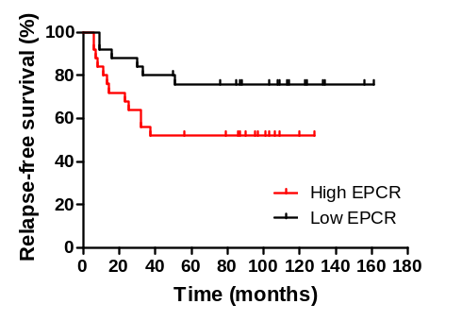
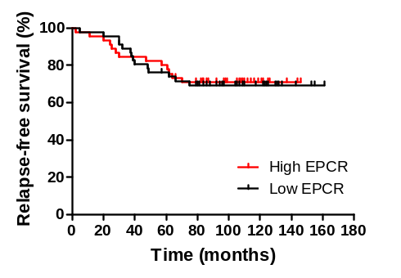
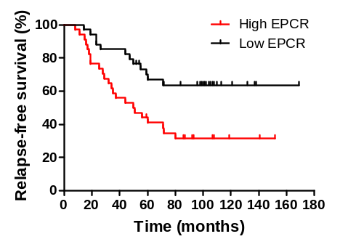
HER2, n=57 (20%)
Basal, n=50 (17%)
p = 0.030
p = 0.051
Luminal A, n=90 (32%)
Luminal B, n=67 (23%)
ns
p = 0.007
Perurena N et al.
Sup Fig. 1

