Slide 1
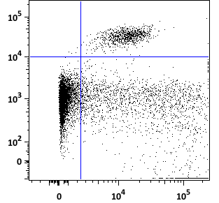
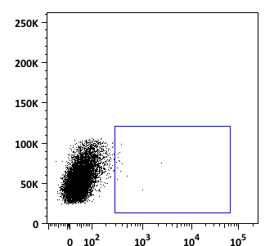
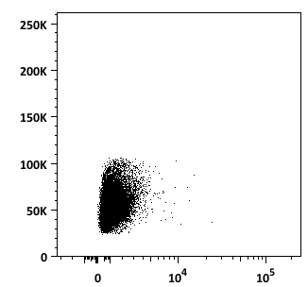
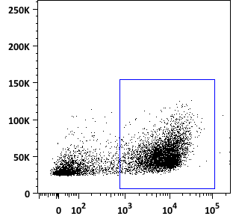
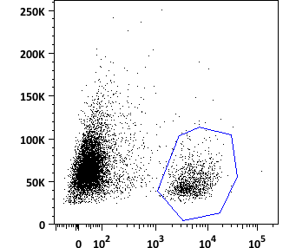
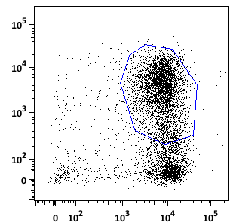
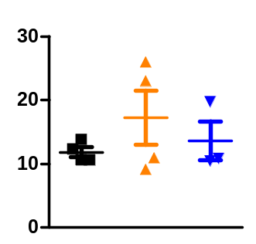
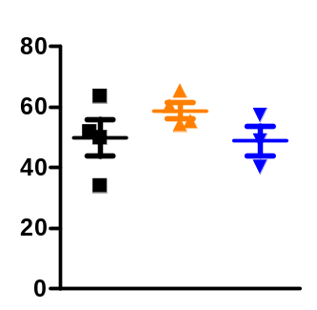
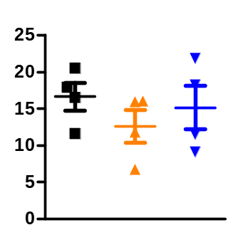
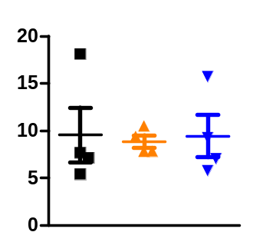
A
Neutrophils
MDSCs
Ly6G
SSC
NK cells
SSC
B cells
Monocytes
Ly6C
Nkp46
CD19
DCs and macrophages
Myeloid cells
Leukocytes
MHCII
SSC
SSC
CD11b
CD45
CD11b
B
Leukocytes
(CD45⁺)
DCs and macrophages
(CD45⁺ CD11b⁺ MHCII⁺)
Monocytes
(CD45⁺ CD11b⁺ Ly6C⁺ Ly6G⁻)
MDSCs
(CD45⁺ CD11b⁺ Ly6C⁺ Ly6G⁺)
% of cells
Perurena N et al.
Sup Fig. 5

