Slide 1
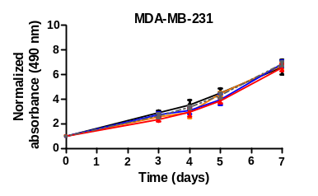
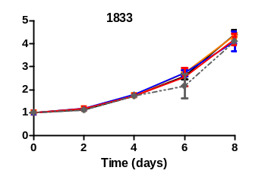
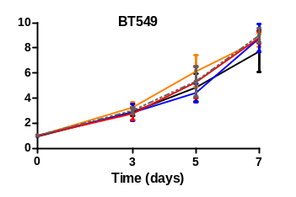
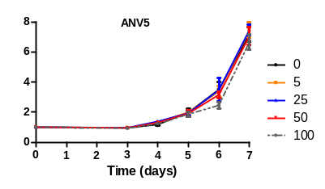
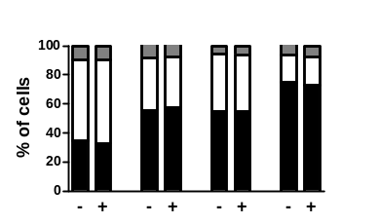
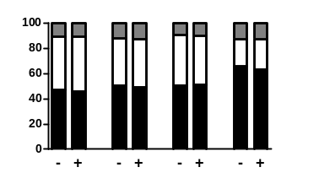
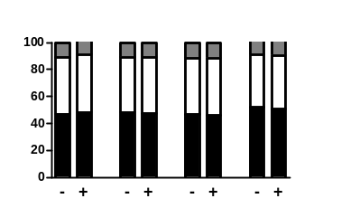
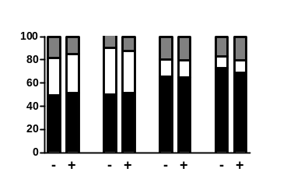
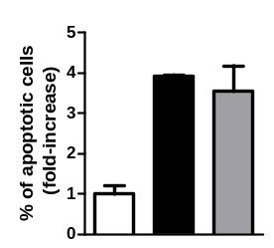
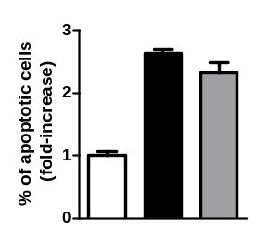
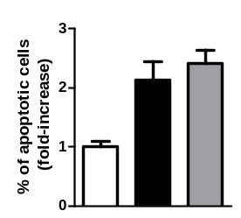
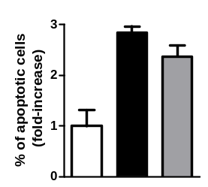
A
APC (nM)
B
4% FBS
0% FBS
4% FBS
0% FBS
4% FBS
0% FBS
4% FBS
0% FBS
24 h
48 h
24 h
48 h
24 h
48 h
24 h
48 h
24 h
48 h
24 h
48 h
24 h
48 h
24 h
48 h
APC ( 50 nM)
C
- + +
- + +
- + +
- + +
STA (2 uM)
- - +
- - +
- - +
- - +
APC (50 nM)
Perurena N et al.
Sup Fig. 7

