Slide 1
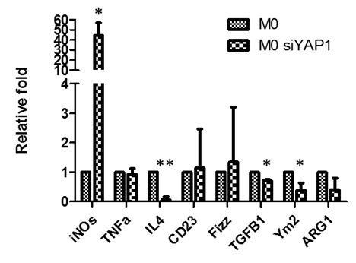
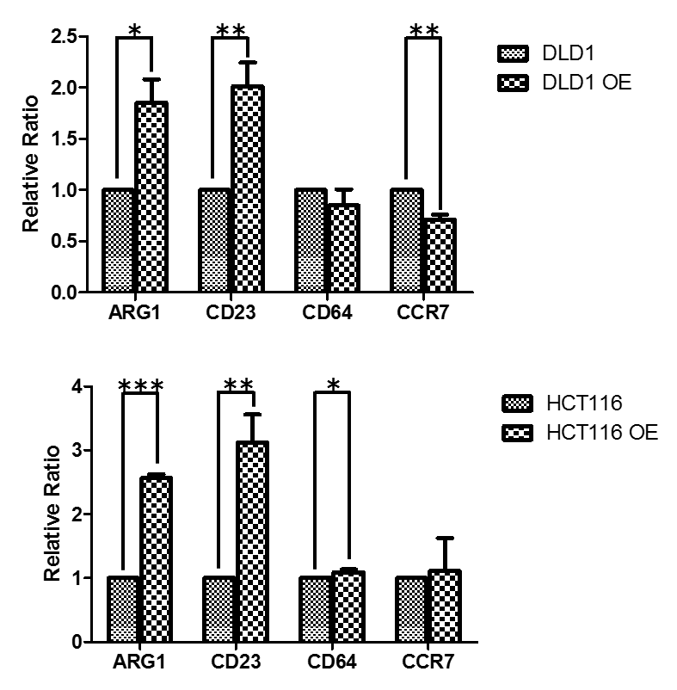
A
B
Genes | qPCR Primer sequences
ARG1 | CAGAAGAATGGAAGAGTCAG CAGATATGCAGGGAGTCACC
Fizz | GGTCCCAGTGCATATGGATGAGACCATAGA CACCTCTTCACTCGAGGGACAGTTGGCAGC
IL-6 | GAGGATACCACTCCCAACAGACC AAGTGCATCATCGTTGTTCATACA
IL-4 | ACTTTGAACAGCCTCACAGAG TTGGAGGCAGCAAAGATGTC
iNOS | TTTGCTTCCATGCTAATGCGAAAG GCTCTGTTGAGGTCTAAAGGCTCCG
TNF-α | CCTGTAGCCCACGTCGTAGC AGCAATGACTCCAAAGTAGACC
Ym2 | CAGAACCGTCAGACATTCATTA ATGGTCCTTCCAGTAGGTAATA
CD23 | GGGAGAATCCAAGCAGGAC GGAAGCTCCTCGATCTCTGA
TGFB1 | CACCCGCGTGCTAATGG TGTGTACTCTGCTTGAACTTGTCAT
Notes:
Supplementary Figure 2. YAP1 expression is associated with M1-M2 polarization. (A) YAP1 silencing in macrophages (M0) leads to decreased M2 polarization. Real-time PCR analysis demonstrates that M2 markers, TGF-b1 and Ym2 were significantly reduced while one of the M1 marker iNOS was significantly increased, in the macrophages generated in the presence of DLD-1 cells. (B) YAP1-overexpressing colon cancer cells also promote the polarization of M2 genotype in THP-1 cells.
Experiments were performed at least three times. *p< 0.05, **p<0.01, ***p<0.001. The primer sequences used in the qPCR experiments are shown.

