Slide 1
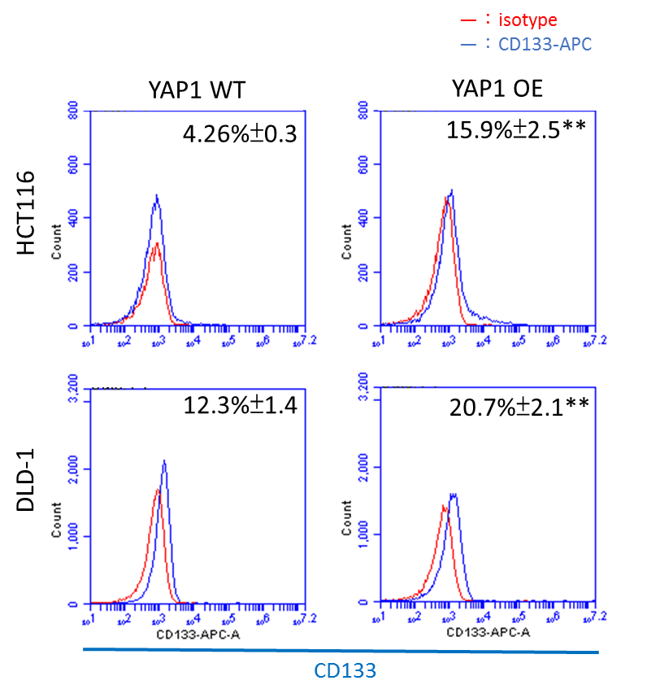
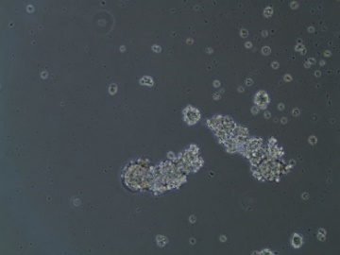
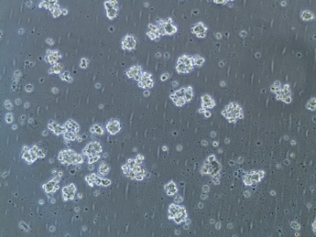
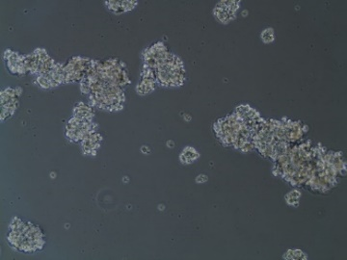
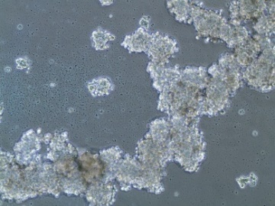
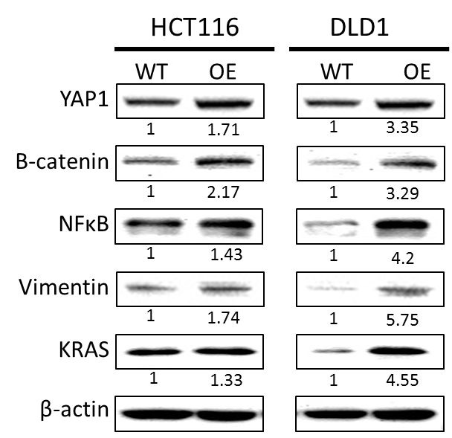
A
B
HCT116
DLD-1
parental
YAP1 OE


C
Notes:
Supplementary Figure 1. YAP1 overexpression leads to increased stemness in colon cancer cells. (A) A significantly increased CD133+ cell percentage was found in the YAP1 OE cells as compared to their wild-type counterparts as demonstrated by our flow cytometric analysis. (B) YAP1-overexpressing HCT116 and DLD-1 cells were found to form a significantly higher number of tumor spheres (*p<0.05, **p<0.01). (C) Comparative western blots of wild-type and YAP1 overexpressing HCT116 and DLD-1 cells. An increased expression of β-catenin, NF-kB, vimentin and Kras is associated with YAP1 overexpression.

