Slide 1
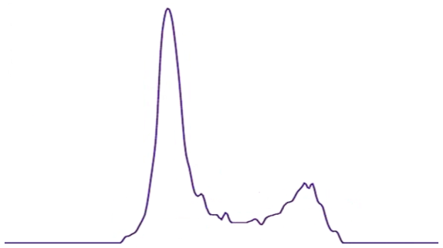
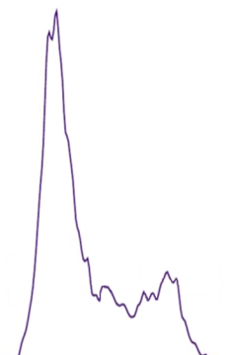
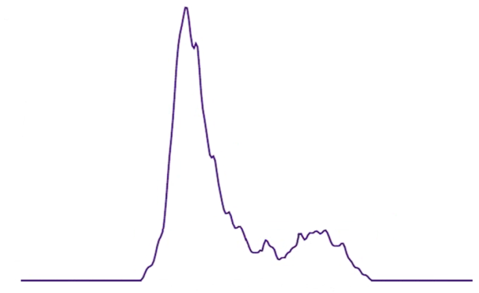
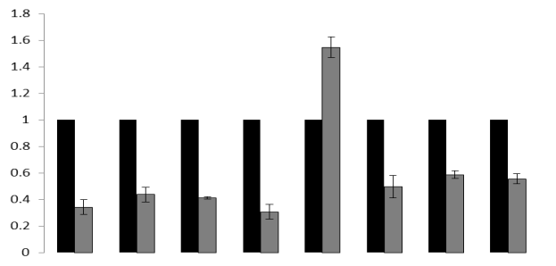
a
MTT- Viability assay
b
Colony Formation Assay
1.8
MCF7
1.8
MDA-MB-231
MCF7
MDA-MB-231
1.6
NC shRNA
shRNA3
shRNA4
1.6
NC shRNA
shRNA3
shRNA4
1.4
1.4
700
700
1.2
1.2
600
NCshRNA
600
NC shRNA
**
shRNA3
shRNA3
1.0
1.0
**
500
shRNA4
500
shRNA4
Absorbance
Absorbance
*
**
**
400
Number of colonies formed
Number of colonies formed
0.8
**
0.8
*
400
0.6
*
0.6
**
300
300
*
**
***
***
0.4
**
0.4
200
*
***
200
**
***
*
**
*
***
0.2
0.2
100
*
100
*
0h
24h
48h
72h
0h
24h
48h
72h
0
400 cells
800 cells
1200 cells
0
400 cells
800 cells
1200 cells
c
d
NC shRNA
shRNA3
shRNA4
150
150
150
2.0
NCshRNA
shRNA4
100
100
100
1.5
Counts
Counts
P1
Counts
*
1.0
P1
P2
P1
Relative mRNA Expression
50
P2
P3
50
P3
50
P2
0.5
**
**
***
*
**
**
P3
**
50
100
250
50
100
150
200
250
50
100
150
200
250
0
150
200
x1000
Propidium Iodide-A
x1000
Propidium Iodide-A
x1000
CDK1
CDK2
CDK4
CDK6
p21
Cyclin D1
Propidium Iodide-A
Cyclin B1
Cyclin E

