Slide 1
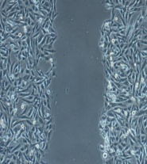
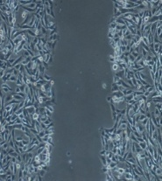
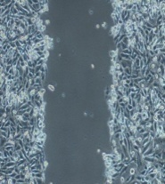
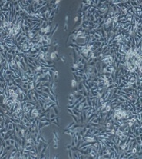
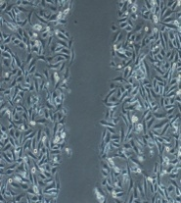
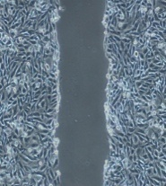
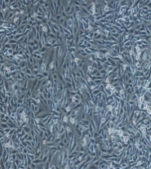
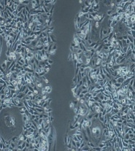
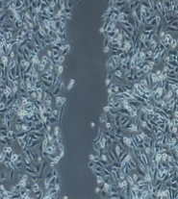
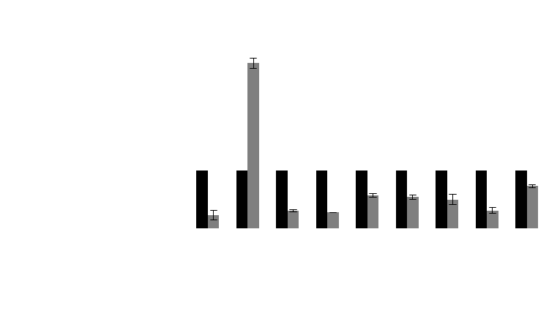
a
MCF7
MDA-MB-231
NCshRNA
shRNA3
shRNA4
NCshRNA
shRNA3
shRNA4
0h
0h
0h
0h
0h
0h
12h
12h
12h
12h
12h
12h
24h
48h
48h
24h
48h
48h
b
4.0
NC shRNA
shRNA4
3.5
3.0
**
2.5
2.0
Relative mRNA Expression
1.5
1.0
**
**
*
**
0.5
*
***
***
**
0
MMP2
SLUG
SMA
SNAIL
P-Cadherin
Vimentin
E-Cadherin
MMP3
N-Cadherin

