Slide 1
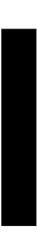
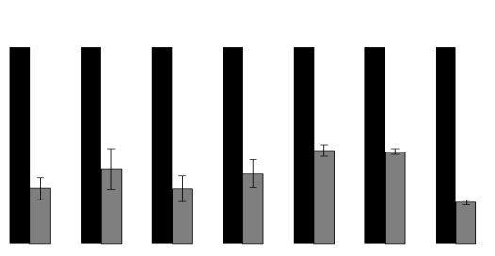
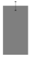
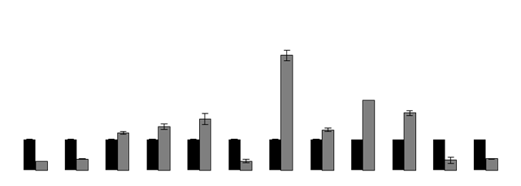
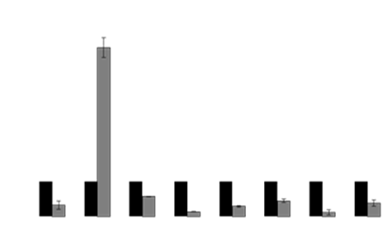
a
1.4
NCshRNA
shRNA4
b
1.4
NCshRNA
shRNA4
1.2
1.2
1.0
1.0
0.8
0.8
Relative mRNA Expression
Relative mRNA Expression
0.6
0.6
0.4
***
0.4
0.2
0.2
0
0
HSP70-2
CDK1
CDK2
CDK4
CDK6
Cyclin E
Cyclin D1
Cyclin B1
c
4.0
**
NCshRNA
shRNA4
3.5
3.0
Relative mRNA Expression
2.5
*
***
***
2.0
**
**
1.5
*
1.0
***
**
*
0.5
***
***
0
BAD
NOXA
cIAP2
BCL2
MCL1
PUMA
Survivin
Caspase 9
Caspase 7
Caspase 6
BCL-x_{L}
Cytochrome-C
5.0
***
d
4.5
4.0
3.5
NCshRNA
3.0
shRNA4
2.5
*
Relative mRNA Expression
2.0
1.5
1.0
***
*
*
0.5
*
***
***
**
0
P-Cadherin
MMP3
SNAIL
MMP9
E-Cadherin
SLUG
SMA
N-Cadherin

