Slide 1
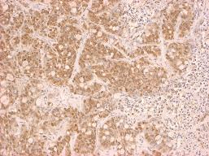
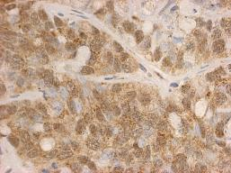
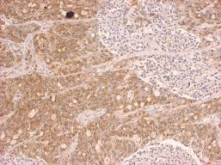
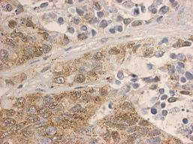
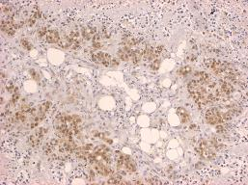
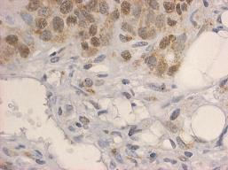
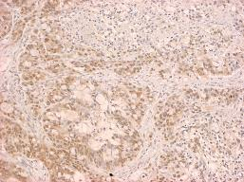
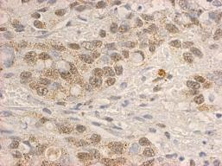
VEGF
HCT116
10x
40x
Vehicle
ONC201
Regorafenib
Regorafenib +ONC201
Wagner et al., Supplemental Figure 4
Notes:
Supplemental 4: VEGF expression in HCT116 xenografts. Representative IHC staining of VEGF expression from mice treated with indicated drugs. Tumors harvested and placed in paraffin. ONC201: 50mg/kg every week. Regorafenib: 5mg/kg daily. N=5 tumors, minimum of 3 sections per tumor stained.

