Slide 1
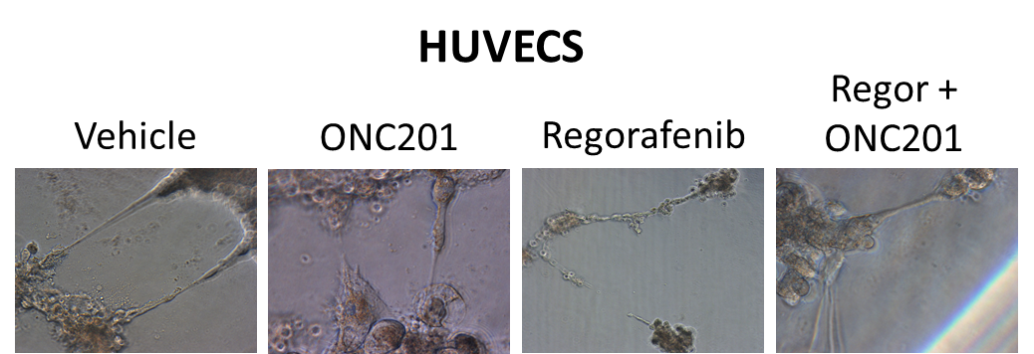


A
B
C
HCT116 48h
V O R O+R
CHOP
Actin
Notes:
Supplemental 5: Analysis of Regorafenib and ONC201 mechanism in combination. A) HUVEC representative images of sprouting from HUVECs grown on Matrigel. B) Quantitation of HUVEC sprouting and branching after 12 hours. C) HCT116 cells from live cell imaging using CHOP-800 and Actin-700 on LiCor Odyssey. Cells treated for 48 hours. ONC201: 5uM. HUVECS n=4, ONC201 treatment 5uM, Regorafenib 1mg/ml.

