Slide 1
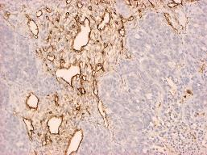
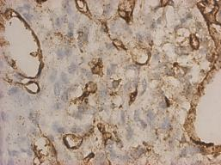
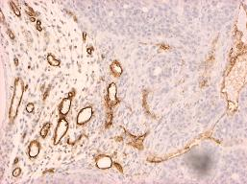
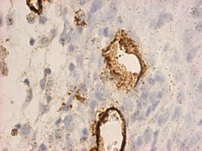
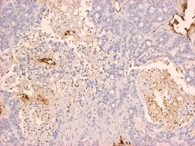
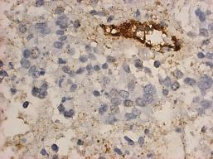
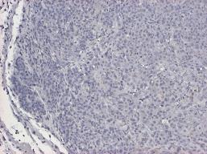
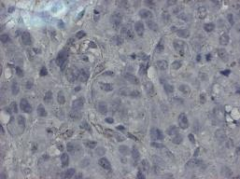
CD31
HT29
10x
40x
Vehicle
ONC201
Bevacizumab
Bevacizumab + ONC201
Wagner et al., Supplemental Figure 7
Notes:
Supplemental 7: CD31 expression in HT29 xenografts. Representative IHC staining of CD31 expression from mice treated with indicated drugs. Tumors harvested and placed in paraffin. ONC201: 50mg/kg every week. Bevacizumab: 5mg/kg every other week. N=5 tumors, minimum of 3 sections per tumor stained.

