Slide 1
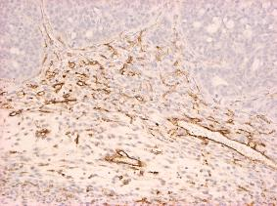
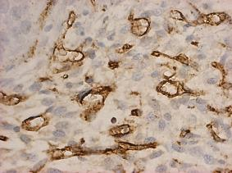
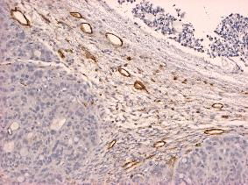
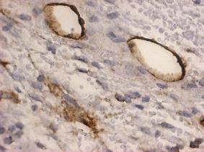
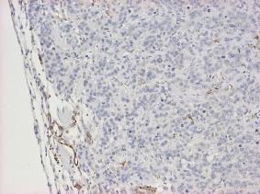
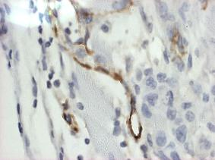
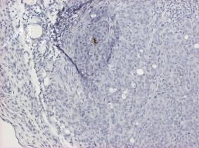
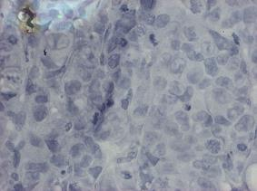
CD31
MC38
10x
40x
Vehicle
ONC201
VEGF inhibitor
VEGF inhibitor + ONC201
Wagner et al., Supplemental Figure 8
Notes:
Supplemental 8: CD31 expression in MC38 CRC tumors. Representative IHC staining of CD31 expression from mice treated with indicated drugs. Tumors harvested and placed in paraffin. ONC201: 50mg/kg every week. VEGF-A: 10ug twice weekly. N=6 tumors, minimum of 3 sections per tumor stained.

