Slide 1
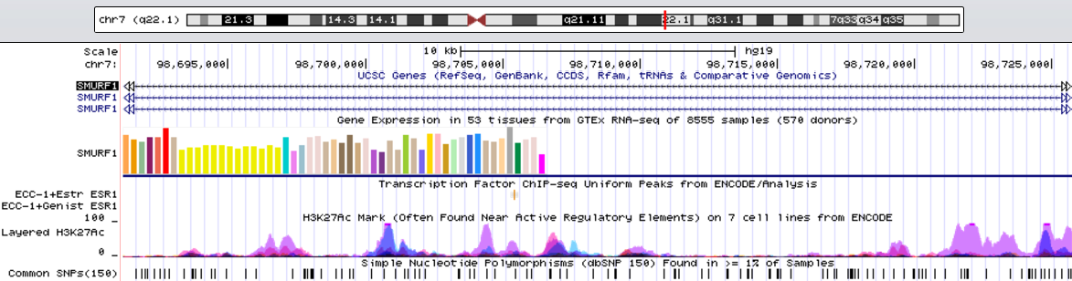

Figure S1
A
B
ChIP
Input Ig G ERα H3K27AC
SMURF1 promoter

Slide 2
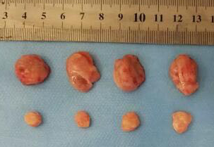
Figure S2
A
Relative cell viability
**
*
**
*
B
Sh Control
Sh SMURF1
Tumor Size (mm³)
Time(Days)

Slide 3
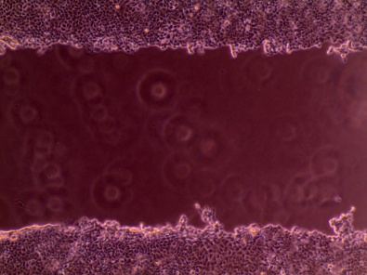
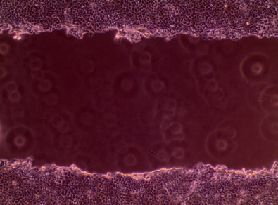
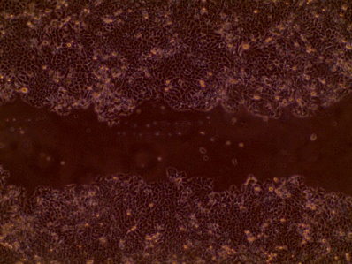
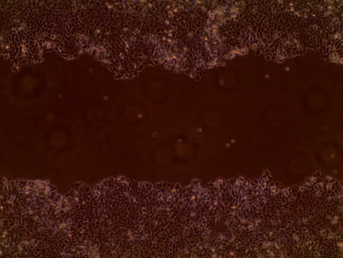
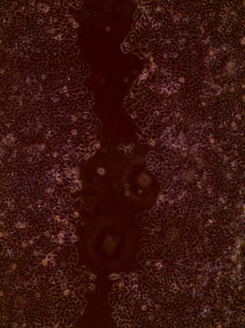
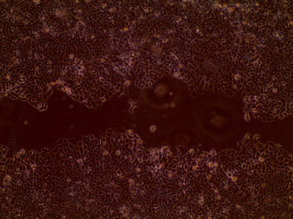
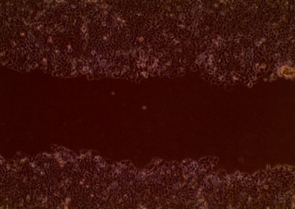
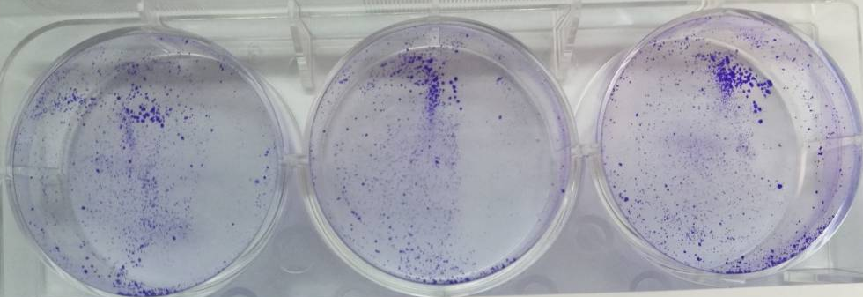
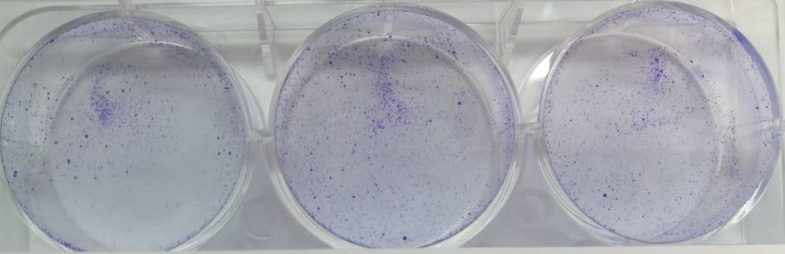
Figure S3
A
siControl
siSMURF1
0h
Wound closure （％）
24h
48h
B
***
siControl
Number of clones
siSMURF1

Slide 4


Figure S4
A
**
**
**
**
*
*
*
*
*
*
*
*
B
C
Relative gene expression level
Relative gene expression level
***
***
**
**
***
***
*
*
*
*
*
*

Slide 5
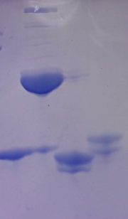
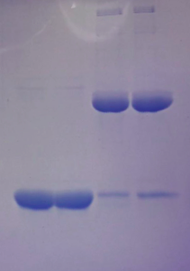
Figure S5
Pulldown:GST
Input
GST + + - -
GST-SMURF1 - - + +
GST
GST-SMURF1
His-ER alpha
1-300
His-ER alpha
294-595
ER alpha 1-300 - - + -
ER alpha 294-595 - - - +
SMURF1
ER alpha 1-300
ER alpha 1-300
ER alpha 294-595
ER alpha 294-595

Slide 6
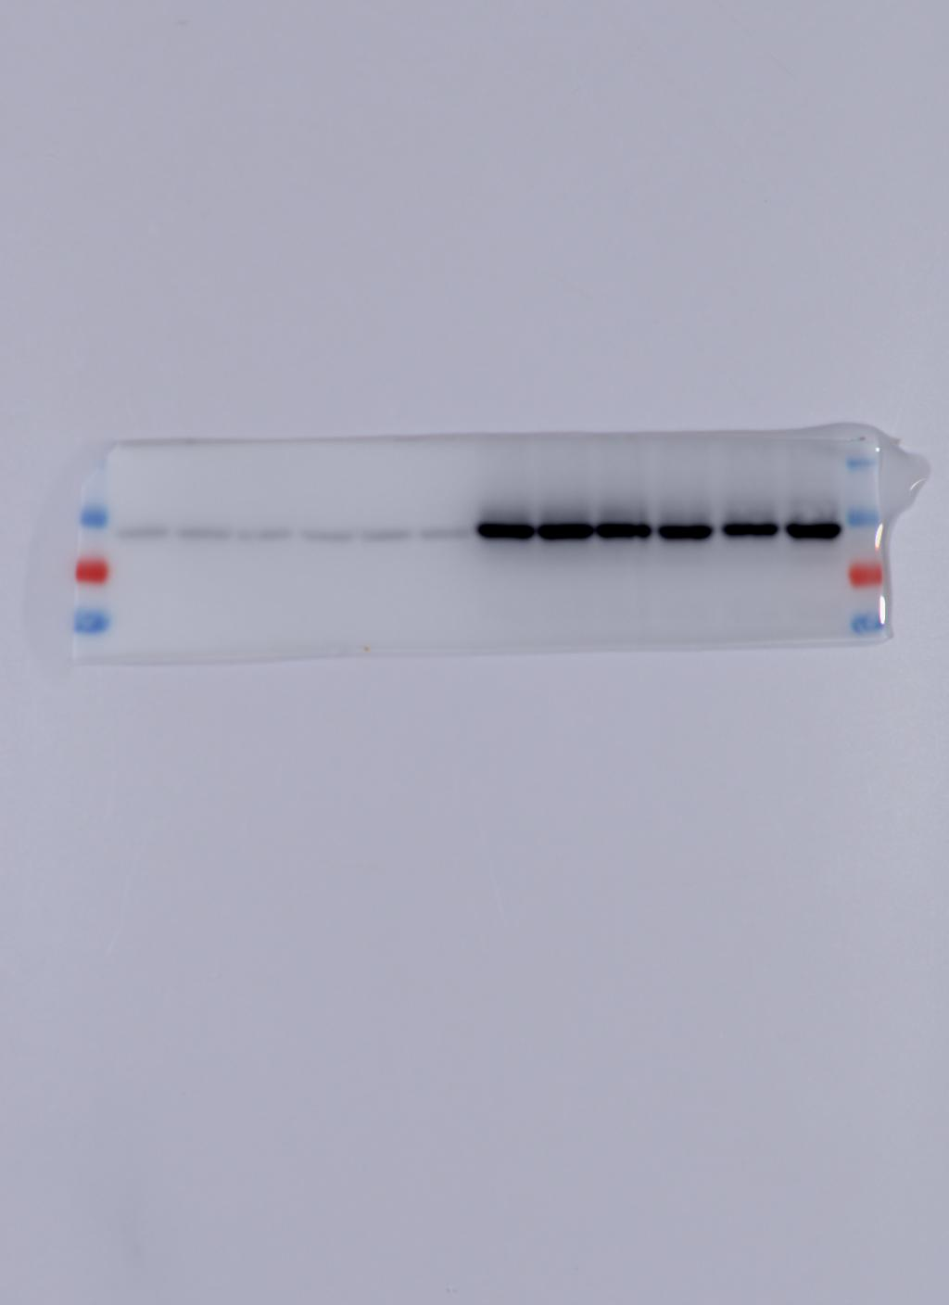
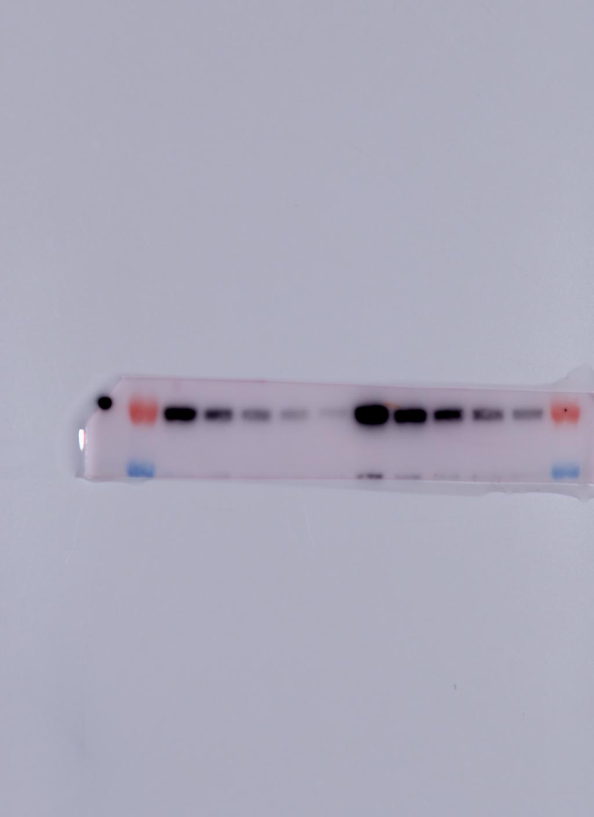
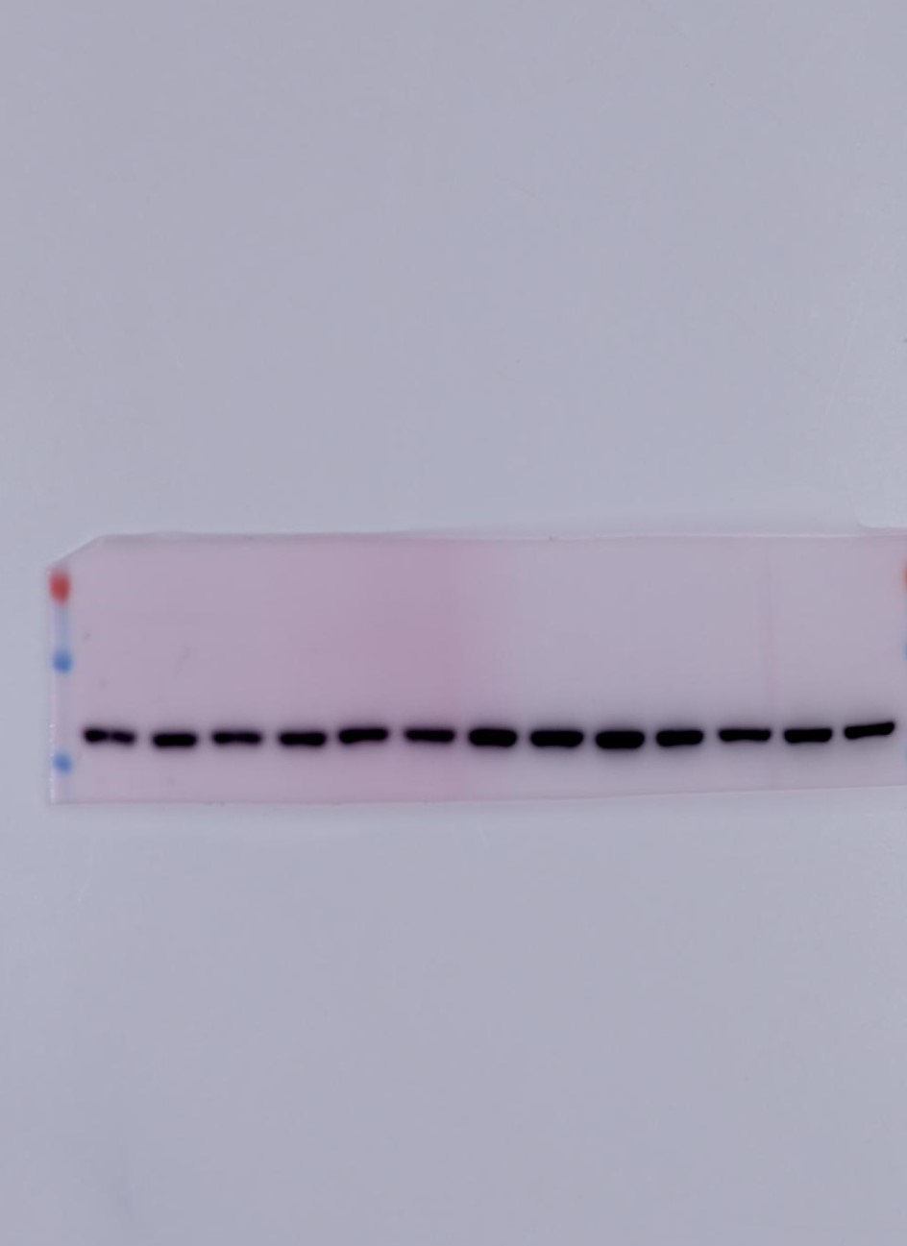
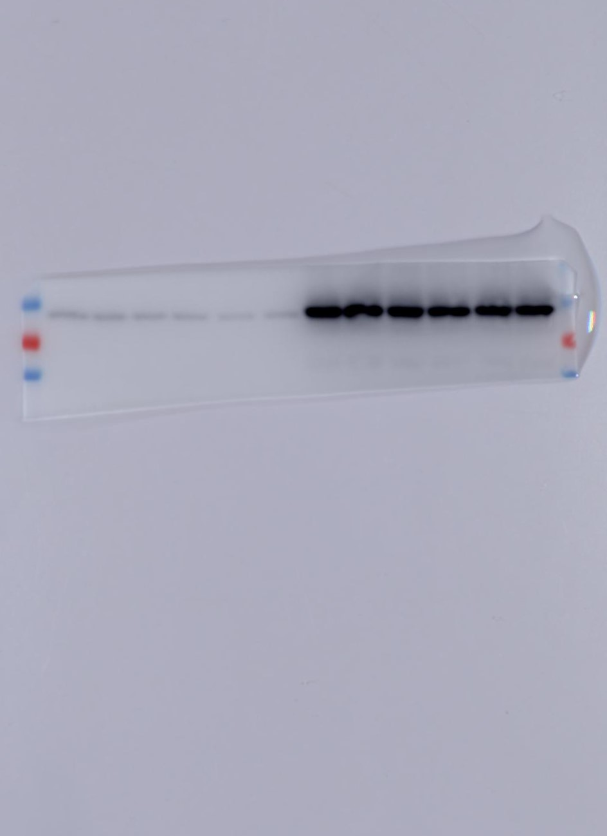
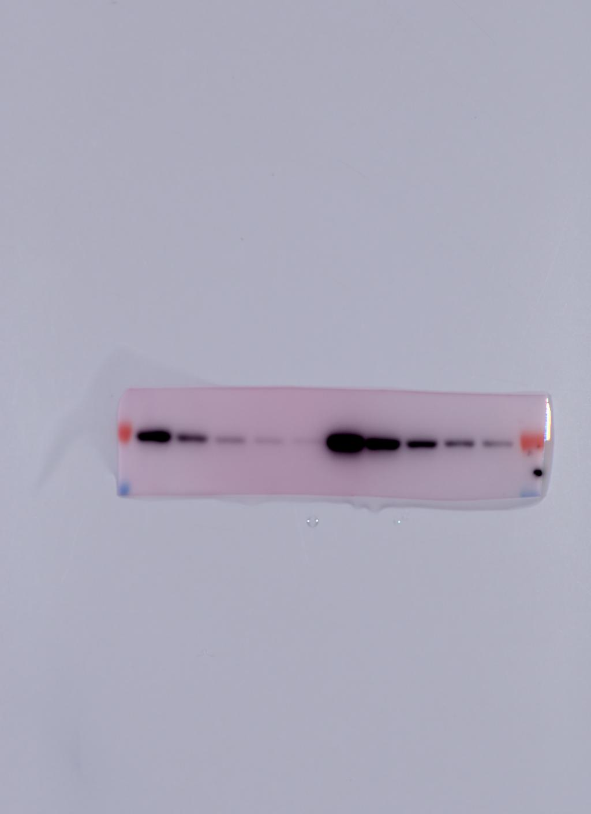

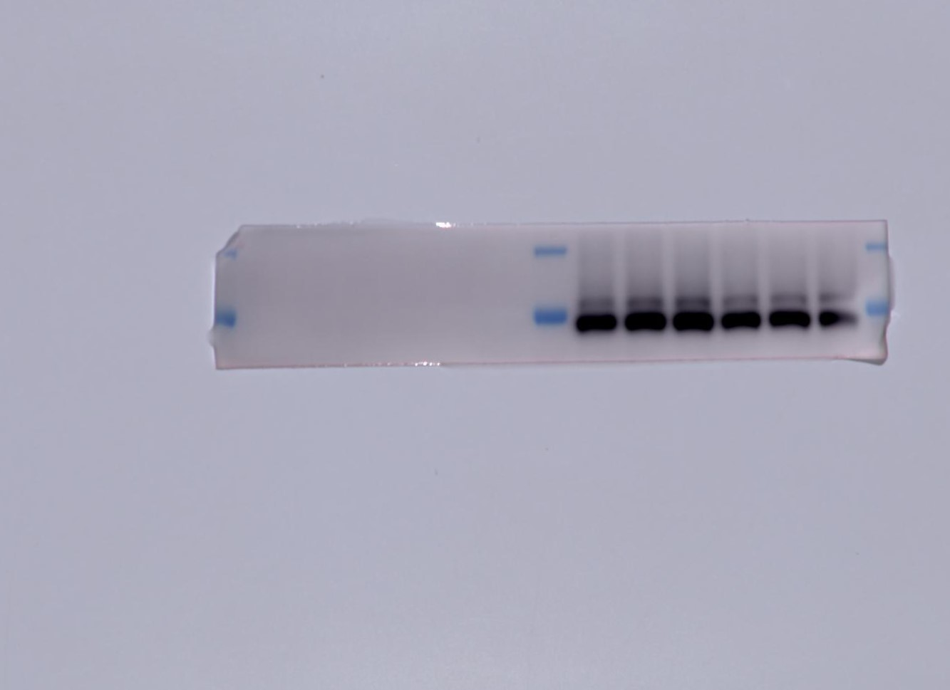
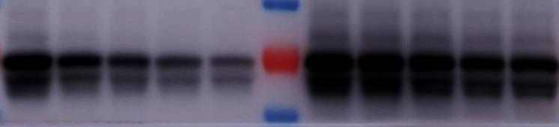

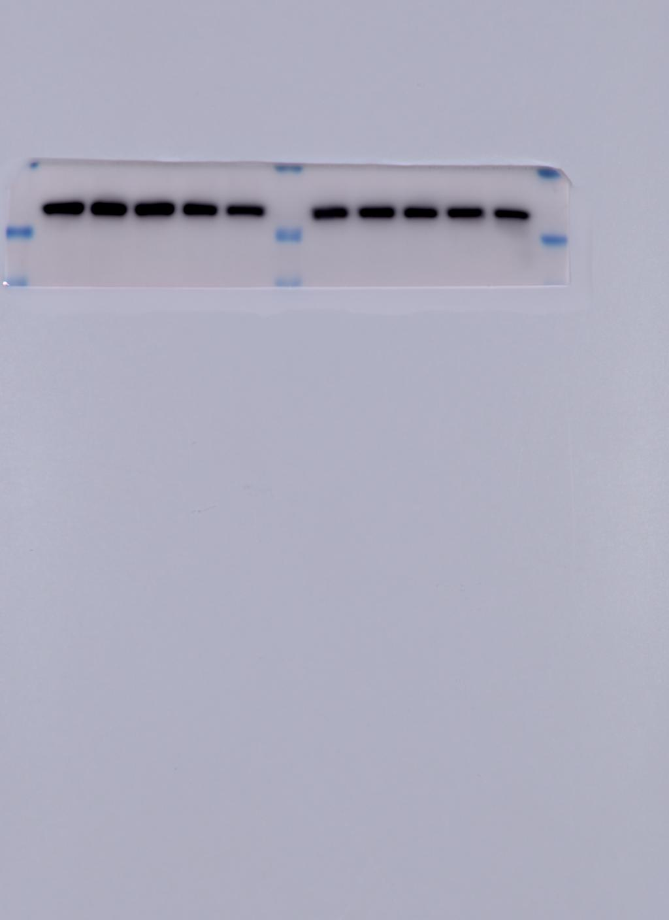

Figure S6
Myc
Myc-SMURF1
A
D
0 4 8 12 16 0 4 8 12 16
Relative ERα protein
SMURF1
ER alpha
β-actin
Myc
Myc-SMURF1
B
0 4 8 12 16 0 4 8 12 16
SMURF1
ER alpha
β-actin
C
Myc
Myc-SMURF1
CHX
0 4 8 12 16 0 4 8 12 16
Myc
ER alpha
β-actin

Slide 7
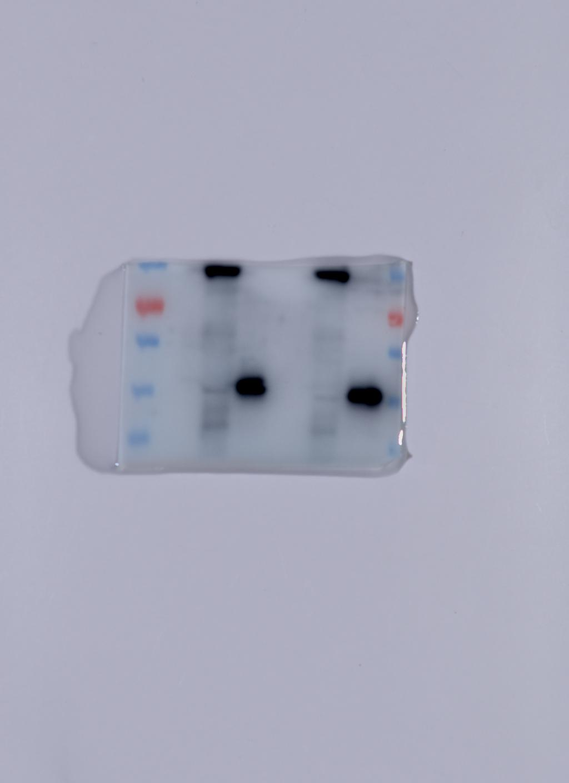
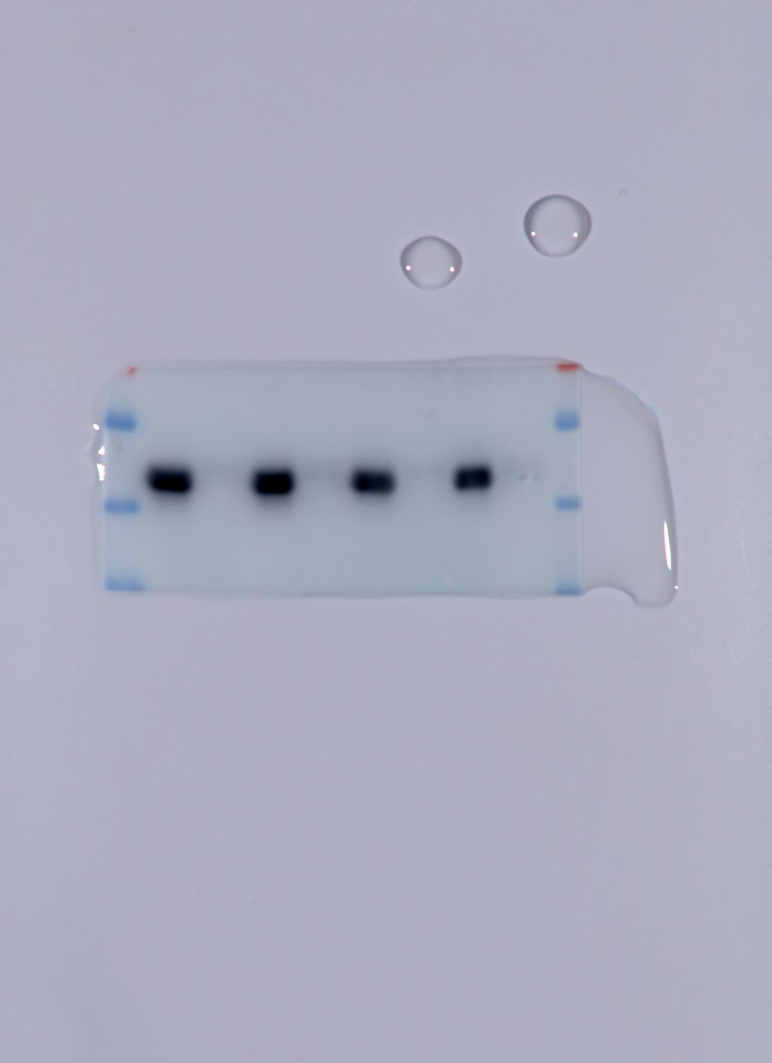
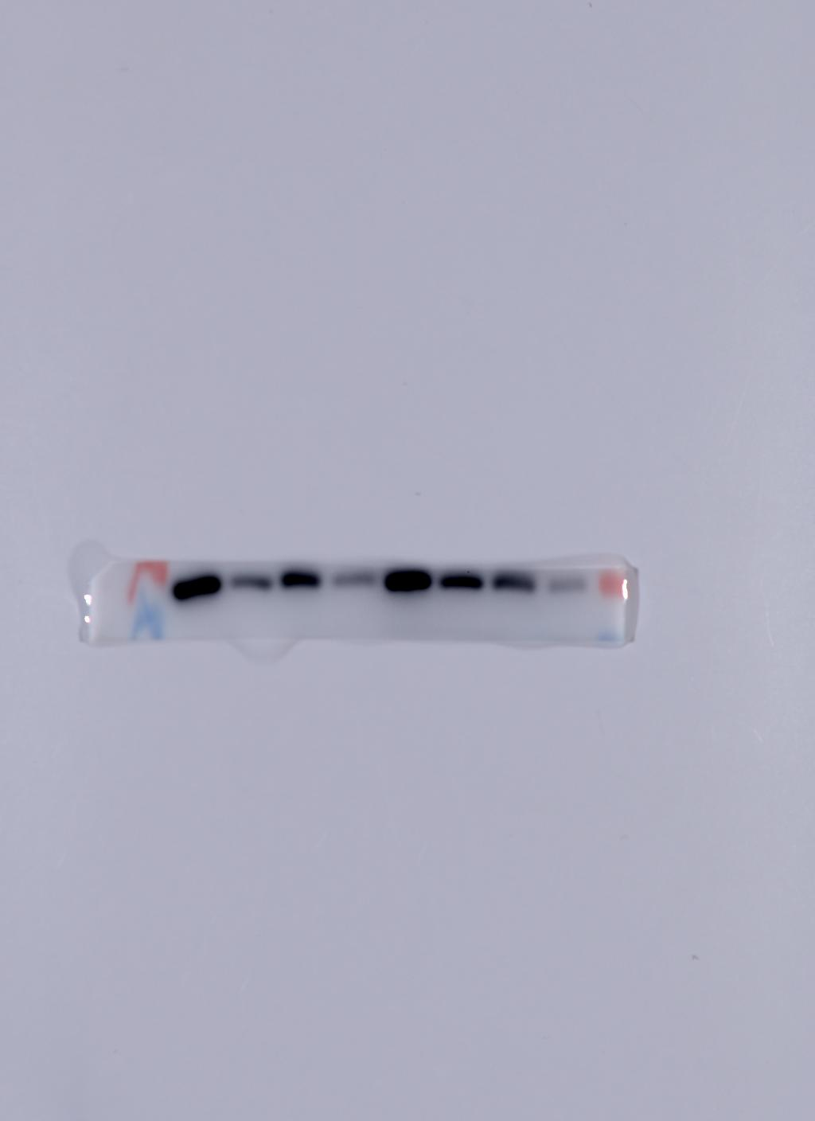
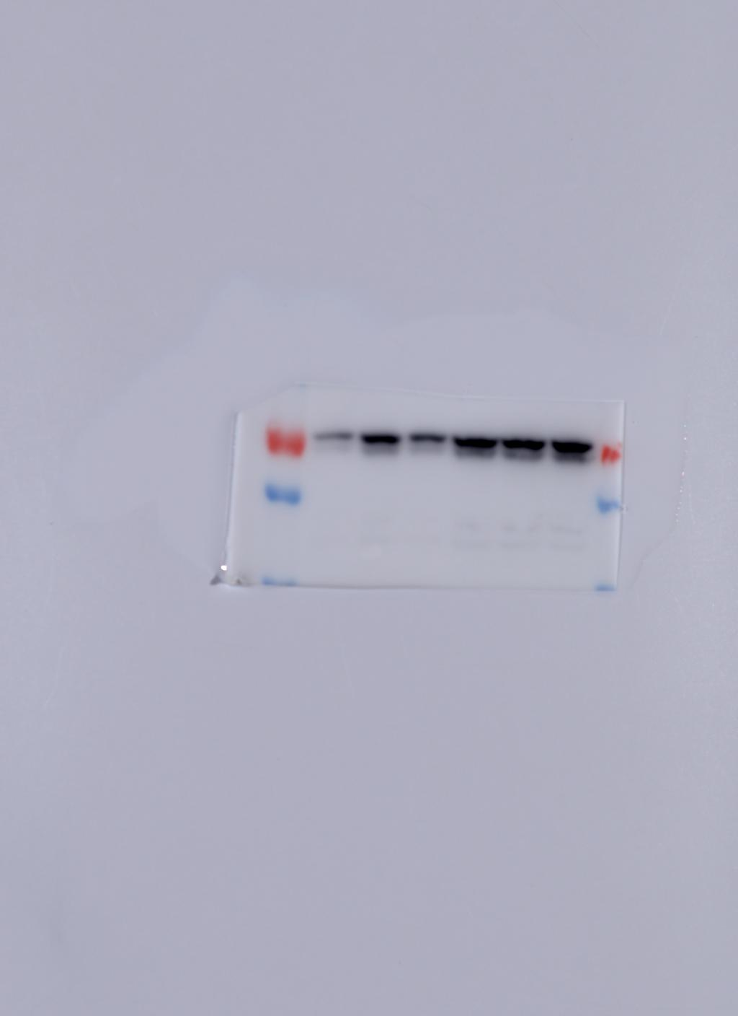
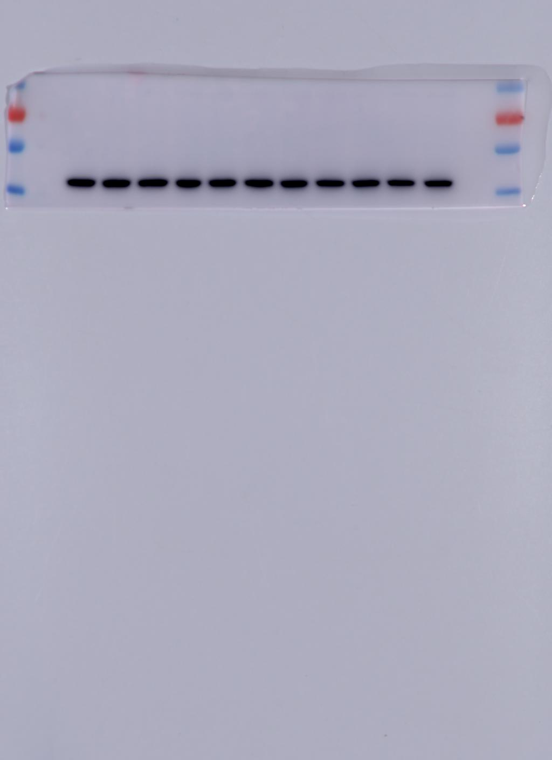
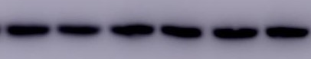
Figure S7
A
Myc
Myc-SMURF1 FL
Myc-SMURF1 FL
Myc-SMURF1 △HECT
Myc
B
Myc-SMURF1 △HECT
siSMURF1
- + - + - + - +
TGFβ
MG132
- - - + + +
- - - - + + + +
E2
- - + + - - + +
SMURF1
SMURF1
ERalpha
ERalpha
β-actin
β-actin

Slide 8
Table S1
Primer sequence
GREB1 | Forward | cgt gtg gtg act gga gta gc
 | Reverse | acc tct tca aag cgt gtc gt
PS2 | Forward | cat cga cgt ccc tcc aga aga g
 | Reverse | ctc tgg gac taa tca ccg tgc tg
PDZK1 | Forward | gcc agg ctc att cat caa aga
 | Reverse | cct cta gcc cag cca agt ca
ERα | Forward | gct acg aag tgg gaa tga tga aag
 | Reverse | tct ggc gct tgt gtt tca ac
36B4 | Forward | ggc gac ctg gaa gtc caa ct
 | Reverse | cca tca gca cca cag cct tc
SMURF1 | Forward | aga tcc gtc tga cag tgt tat gt
 | Reverse | ccc atc cac gac aat ctt tgc

Slide 9
Table S2
gene_short_name | p-value | diff_zcore | diff_norm
BMP7 | 2.56608E-06 | -0.249261561 | -5.566582144
OLFM1 | 5.66306E-06 | -0.127775567 | -2.874784036
GREB1 | 1.26565E-06 | -0.257791935 | -5.766397238
ZMIZ1 | 1.44767E-05 | -0.247965744 | -5.550250385
INHBB | 2.13469E-05 | -0.163624616 | -3.676603626
FRAS1 | 3.84202E-05 | -0.0837867 | -1.915640343
PITPNC1 | 3.89589E-05 | -0.056200524 | -1.279249959
ABAT | 4.62134E-05 | -0.143703125 | -3.235426696
CELSR2 | 4.6859E-05 | -0.170408791 | -3.828433785
RHOD | 4.87637E-05 | -0.233526704 | -5.220622124
ITPK1 | 4.8886E-05 | -0.134596958 | -3.007243509
XBP1 | 5.40678E-05 | -0.177651409 | -3.954180449
EGR3 | 5.89731E-05 | -0.169205246 | -3.810784164
ELOVL5 | 6.38779E-05 | -0.130909707 | -2.937949581
ETNK2 | 6.41658E-05 | -0.153775321 | -3.440863076
TFF1 | 6.94095E-05 | -0.286873813 | -6.382654771
DERL1 | 8.12633E-05 | -0.152493847 | -3.412671553
IGFBP4 | 8.43213E-05 | -0.152662489 | -3.425292266
ARL3 | 9.45727E-05 | -0.100616826 | -2.268723635
VASN | 9.93304E-05 | -0.077165414 | -1.758032463
ZNF703 | 0.000125321 | -0.162351032 | -3.639230209
PDZK1 | 0.000129592 | -0.335826819 | -7.518146063
CTBP1 | 0.00013168 | -0.092791452 | -2.07688675
CTSD | 0.00014442 | -0.069799982 | -1.555451644
SNX10 | 0.000148519 | -0.143538668 | -3.241737326
DUSP4 | 0.000160564 | -0.057525797 | -1.326479716
SIAH2 | 0.000169835 | -0.102538022 | -2.294253642
CHST11 | 0.000170994 | -0.141580001 | -3.194000205
CISH | 0.000195303 | -0.104287244 | -2.362836416
DHRS3 | 0.000202491 | -0.124670618 | -2.82272027
PPP2R2C | 0.000241909 | -0.082121505 | -1.852665406
TARS | 0.00025976 | -0.059112735 | -1.331883676
SNX24 | 0.000262512 | -0.159358324 | -3.585715727
AK4 | 0.000263608 | -0.097673034 | -2.215767798
HIVEP3 | 0.000268125 | -0.122688552 | -2.771907798
KCNK5 | 0.000289825 | -0.102061535 | -2.31661916
MBOAT1 | 0.000290058 | -0.131646013 | -2.97774439
MLPH | 0.000290249 | -0.201534029 | -4.508430756
LFNG | 0.000356516 | -0.077575131 | -1.769598104
CRMP1 | 0.000357715 | -0.156531282 | -3.536806144
BCL2 | 0.000367678 | -0.136832562 | -3.07552038
TEX14 | 0.000376797 | -0.130535538 | -2.947937127
JAK2 | 0.000423498 | -0.152349804 | -3.440118872
CXCL12 | 0.000446072 | -0.126838734 | -2.853119536
RET | 0.000452523 | -0.101364673 | -2.300079953
PLXND1 | 0.000469746 | -0.21808379 | -4.891106139
PREX1 | 0.000552607 | -0.095493513 | -2.149655227
SSR3 | 0.000572144 | -0.03732061 | -0.83898082
OTUD7B | 0.000581357 | -0.036334217 | -0.844827304
MYB | 0.000591161 | -0.119044972 | -2.686186248
FUT8 | 0.000597525 | -0.102079974 | -2.300894612
MED13L | 0.000599266 | -0.037822349 | -0.865587317
VTCN1 | 0.000649374 | -0.108615415 | -2.469524755
JAK1 | 0.000656342 | -0.117082494 | -2.641397776
THBS1 | 0.000667039 | -0.117730474 | -2.657503492
ZNF185 | 0.0006896 | -0.110227013 | -2.496634391
SLC24A3 | 0.000690586 | -0.093807282 | -2.142029916
PADI3 | 0.000737777 | -0.072288404 | -1.65515866
HAAO | 0.000746458 | -0.188534538 | -4.247697714
TPD52L1 | 0.000864252 | -0.084823687 | -1.894064335
NRIP1 | 0.000913525 | -0.10030492 | -2.279703335
ABCA3 | 0.000945994 | -0.081639466 | -1.845814513
GAB2 | 0.000955123 | -0.109341537 | -2.481864594

