Slide 1


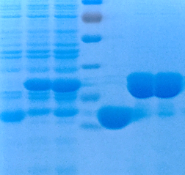
Supplementary Fig 1
a
b
c
Purified (Arg)₉-GST-SH2 TrM
Purified (Arg)₉-GST-SH2 Wt
(Arg)₉-GST-SH2 TrM lysis
(Arg)₉-GST-SH2 Wt lysis
Purified (Arg)₉-GST
(Arg)₉-GST lysis
Marker
bp
bp
kDa
500
10000
70
400
8000
300
6000
5000
55
200
4000
3000
40
SH2 TrM
35
25
pGEX-4T3-
(Arg)9-SH2 TrM

