Slide 1
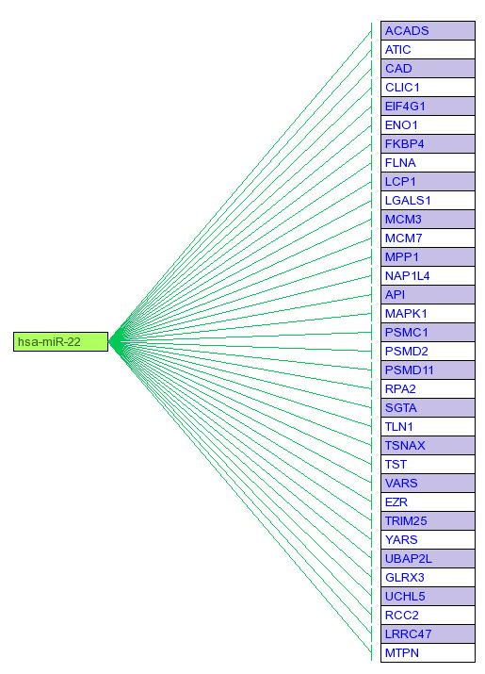
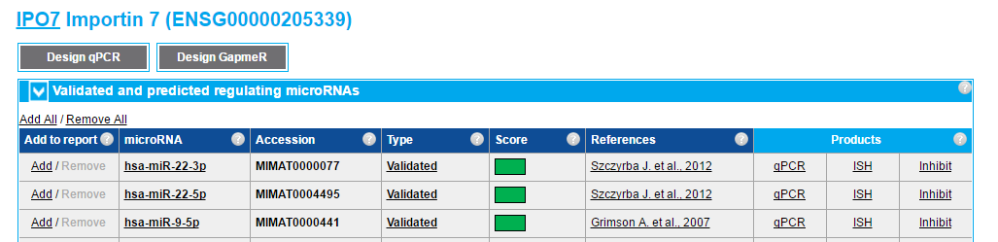
b
a
Figure S6. IPO7/miRNAs correlation. a Analysis performed by using microRNA target prediction software miRSearch V3.0 showed that IPO7 is a validated target of miR-22 and miR-9. b Analysis of predicted multiple targets performed by MicroRNA Target prediction (miRTar) tool (http://mirtar.mbc.nctu.edu.tw/human/) revealed within the CurcuDown-Regulated dataset the presence of several of miR-22 targets beside IPO7. No target of miR-9 was found.

