Slide 1
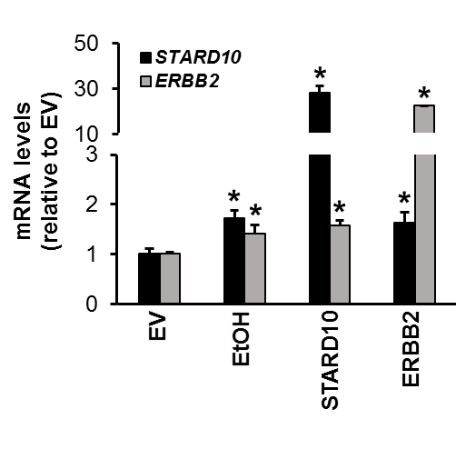
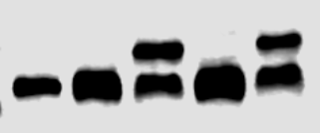

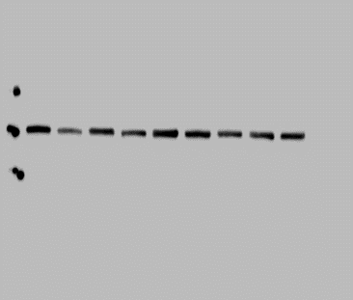

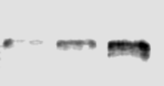
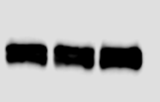
A.
ERBB2
EV
STARD10
EtOH
-DDK
STARD10
1.0±0.2 2.3±0.3* 3.2±0.2* 3.2±0.3*
ERBB2
1.0±0.1 2.7±0.5* 1.8±0.2* 2.0±0.5*
ACTIN
B.
†
*
*
‡
‡
†
†
†
†
*
*
*
†
*
mRNA levels
(relative to EV)
*
*
‡
‡
*
‡
†
†
†
*
‡
‡
†
‡
*
*
*
*
*
*
*
*
*
*
Sc+EV
EtOH+ STARD10
EtOH
STARD10
EtOH+
siERBB2#1
EtOH+
siERBB2#2
STARD10+
siERBB2#1
siERBB2#1
STARD10+
siERBB2#2
siERBB2#2
EtOH+STARD10+
siERBB2#1
EtOH+STARD10+
siERBB2#2
C.
D.
% of promoter activity
(relative to EV)
*
EV
EtOH
p65
STARD10
ERBB2
*
*
*
STARD10
*
mRNA levels
(relative to EV)
1.0±0.2 2.5±0.1* 1.6±0.1*
*
*
*
ERBB2
*
1.0±0.1 1.9±0.1* 3.1±0.3*
*
p65
1.0±0.2 1.8±0.2* 3.5±0.2*
ACTIN
Supplementary Figure S1

