Slide 1
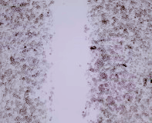
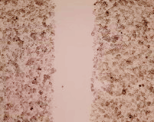
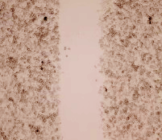
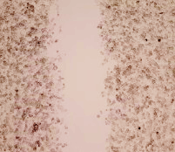
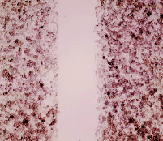
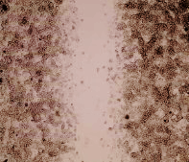
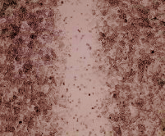
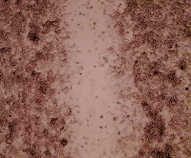
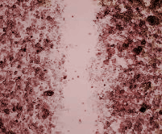
A.
B.
*
*
*
*
*
*
OD at 450nm
(relative to EV)
*
OD at 450nm
(relative to EV+Sc)
†
†
‡
‡
*
*
*
‡
‡
†
*
*
*
†
*
EV
EtOH
ERBB2
STARD10
STARD10+ERBB2
C.
*
*
*
*
Wound closure
(relative to EV)
STARD10
+ERBB2
EV
EtOH
STARD10
ERBB2
0h
48h
Supplementary Figure S4

