Slide 1
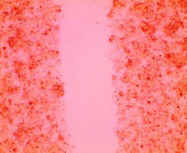
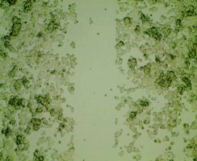
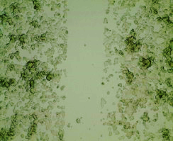
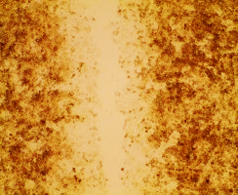
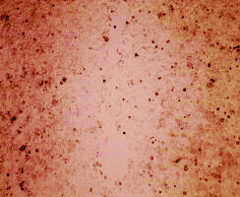
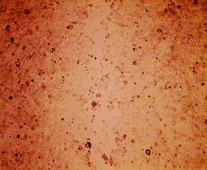
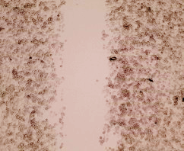
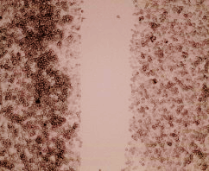
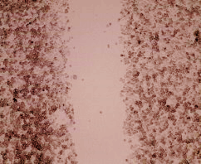
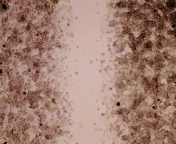
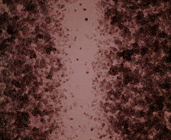
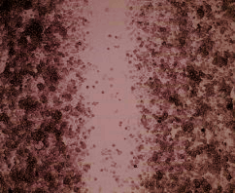
A.
B.
STARD10 mRNA level
(relative to Sc)
*
*
OD at 450nm
(relative to Sc)
*
*
Sc #1 #2
Sc #1 #2
siSTARD10
siSTARD10
C.
siSTARD10
†
Sc #1 #2
*
% of Wound width
(relative to Sc)
*
*
0h
48h
Sc
#1 #2
D.
siSTARD10
E.
*
*
STARD10 mRNA level
(relative to Sc)
OD at 450nm
(relative to Sc)
*
*
Sc #1 #2
Sc #1 #2
F.
siSTARD10
siSTARD10
siSTARD10
†
Sc #1 #2
*
†
% of Wound width
(relative to Sc)
*
*
0h
48h
Sc
#1 #2
siSTARD10
Supplementary Figure S5

