Slide 1
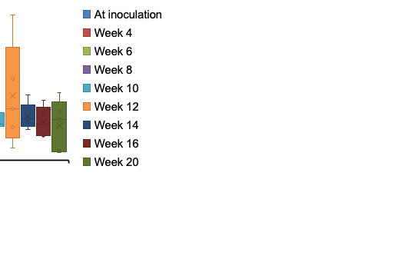
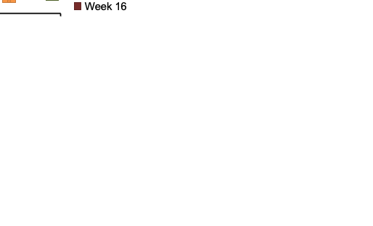
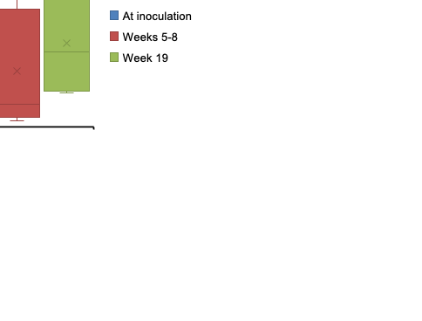
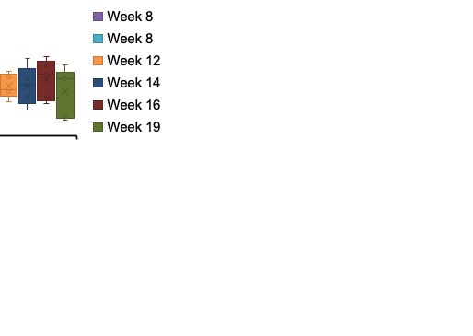
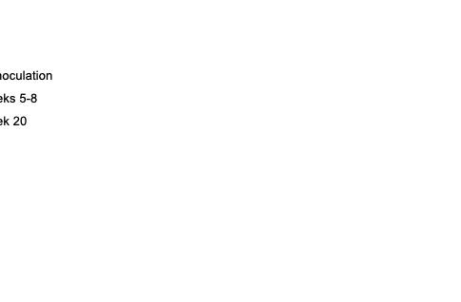
A. Group 1_Plasma
D. Group 1_Aqueous humor
F.
r = -0.045
P = 0.63
Total DNA (ng/25uL)
G.
ctDNA (molecules/mL)
r = -0.149
P = 0.39
B. Group 2_Plasma
E. Group 2_Aqueous humor
Total DNA (ng/25uL)
I.
Tumor size category
r = 0.087
P = 0.67
Total DNA (ng/25uL)
C. Group 3_Plasma
H.
Tumor size category
r = -0.015
P = 0.94
Total DNA (ng/25uL)
0 1 2 3 4
ctDNA (molecules/300uL)

