Slide 1
Supplementary Fig. 1
a
b
1.0
Overall survival
1.0
Overall survival
0.8
P=0.042
(log-rank test)
0.8
P=0.0013
(log-rank test)
0.6
0.6
Accumulative rate
Accumulative rate
0.4
0.4
0.2
0.2
0.0
0.0
0
20
40
60
0
20
40
60
Time after surgery (months)
Time after surgery (months)
High stromal CD40 (n=89)
Low stromal CD40 (n=82)
High CD8⁺ expression (n=94)
Low CD8⁺ expression (n=77)
c
C4BPA
αSMA
DAPI/C4BPA/αSMA

Slide 2
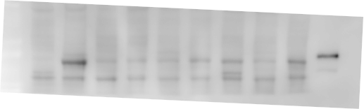



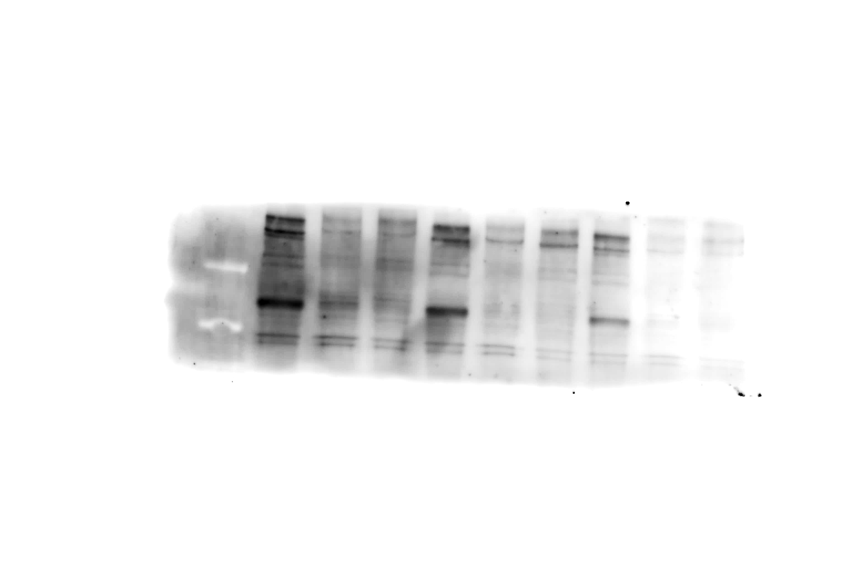
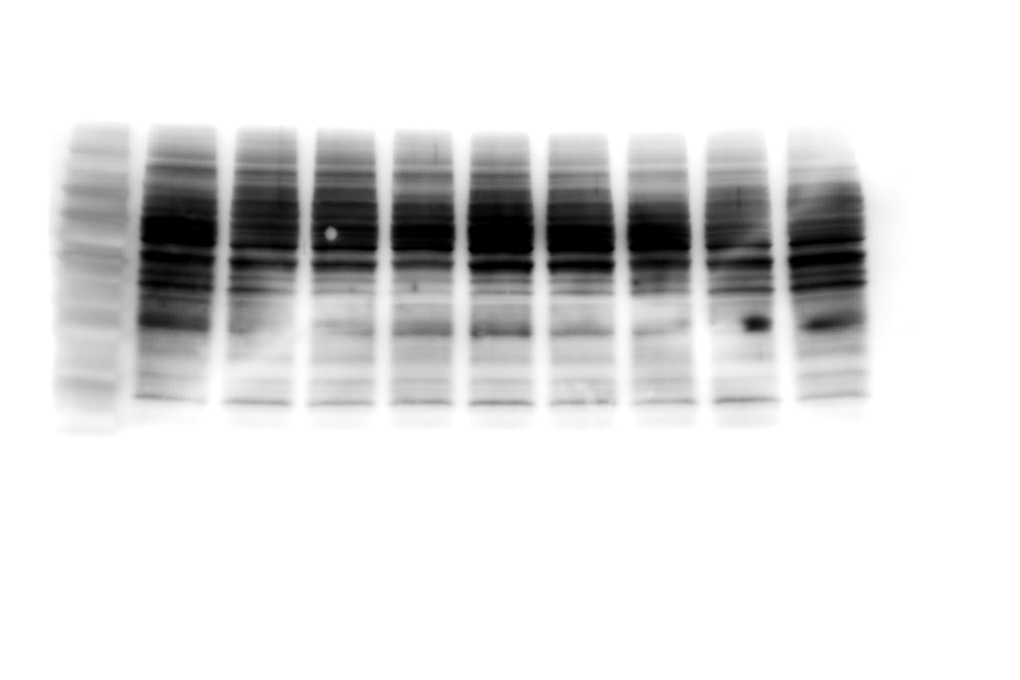

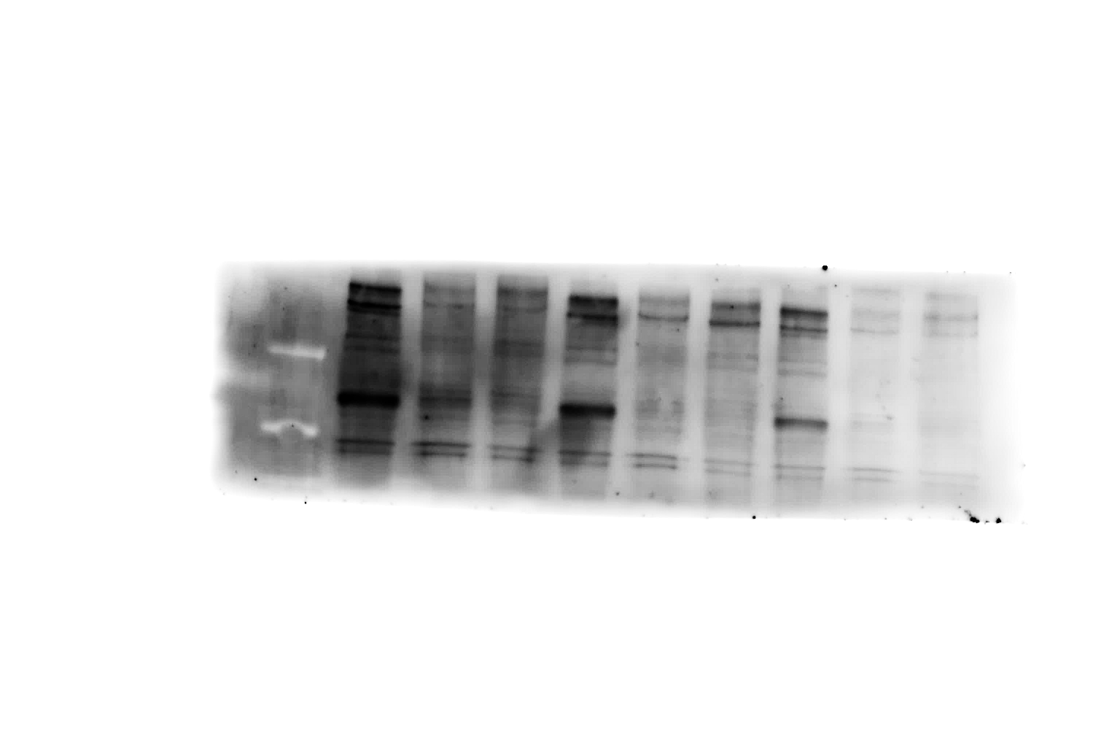
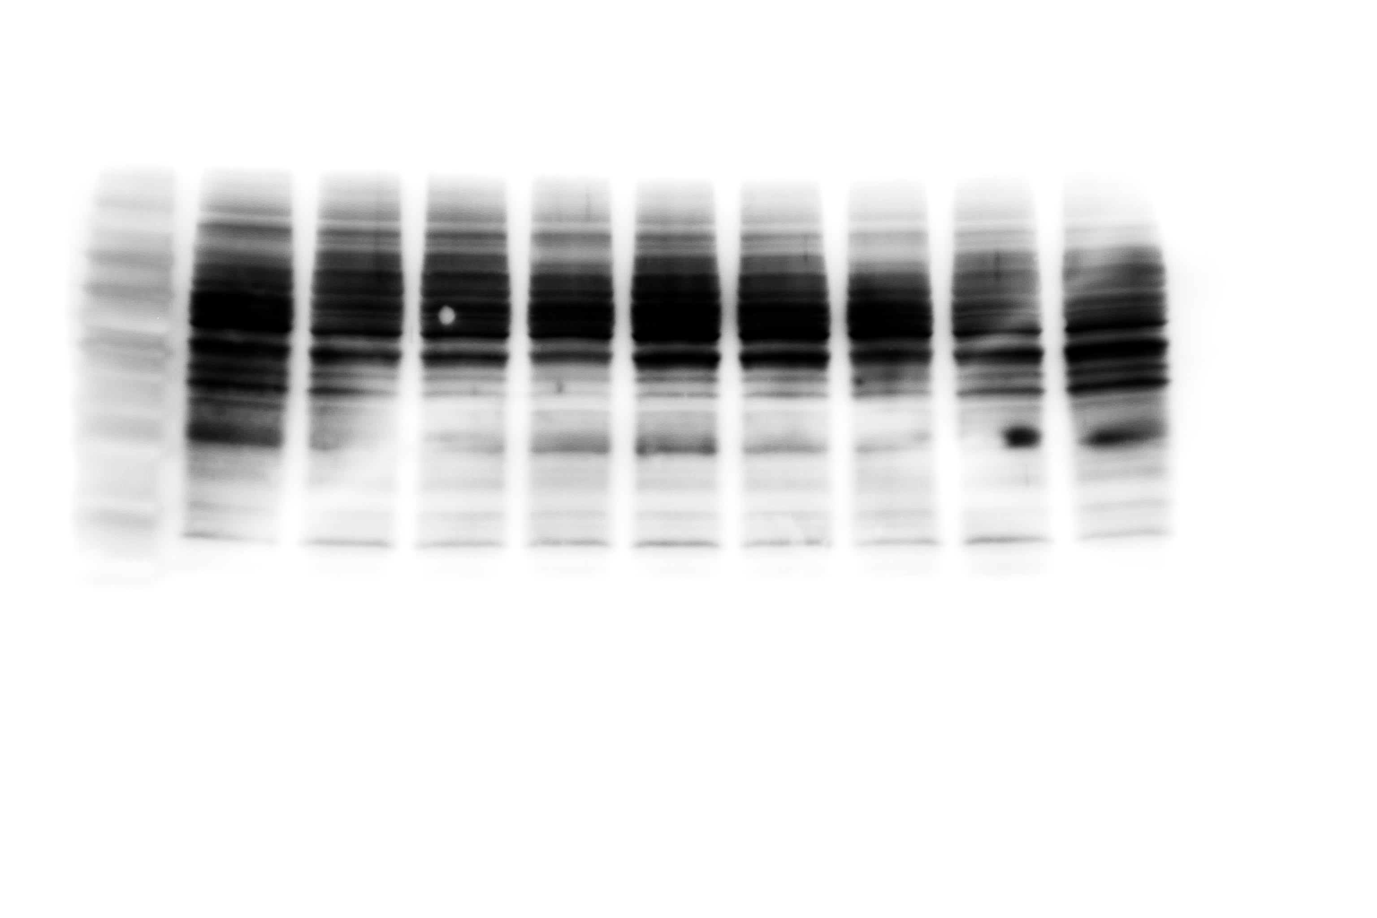

Supplementary Fig. 2
a
Supernatant of human PDAC cell culture
BxPc-3
MIA PaCa-2
PANC-1
Capan-2
AsPC-1
Hs766T
CFPAC-1
Capan-1
Positive control
(diluted serum samples)
C4BPA
b
PANC-1
Capan-2
Control
siRNA
CD40
siRNA1
CD40
siRNA2
Control
siRNA
CD40
siRNA1
CD40
siRNA2
Day 4
β-actin
Day 5
β-actin
Day 6
β-actin
c
d
1.4
CFPAC-1
2.0
MIA PaCa-2
CFPAC-1
CFPAC-1 + rhC4BPA
MIA PaCa-2
MIA PaCa-2 + rhC4BPA
1.2
ns
1.0
1.5
rhC4BPA
**
rhC4BPA
0.8
Absorbance at 450 nm
Absorbance at 450 nm
1.0
0.6
0.4
** P<0.01
0.5
0.2
0
Day 0
Day 1
Day 2
Day 3
0
Day 0
Day 1
Day 2
Day 3

Slide 3
Supplementary Fig. 3
PANC-1
Capan-2
ns
*
ns
1.4
*
**
1.2
**
ns
*
*
*
1.2
ns
** P<0.01
1.0
*
** P<0.01
1.0
* P<0.05
0.8
* P<0.05
0.8
Absorbance at 450 nm
at 72 h after drug exposure
Absorbance at 450 nm
at 72 h after drug exposure
0.6
0.6
0.4
0.4
0.2
0.2
0
0
rhC4BPA
−
−
−
+
+
+
rhC4BPA
−
−
−
+
+
+
Gem (ng/ml)
0
20
50
0
20
50
Gem (ng/ml)
0
20
50
0
20
50

Slide 4

Supplementary Fig. 4
a
mouse C4BPA peptide composed of 54 amino acids (mC4BPA peptide [54])
N-terminus--------
EASEDLKPALTGNKTMQYVPNSHDVKMALEIYKLTLEVELLQLQIQKEKHTEAH -C-terminus
b
primary PDAC
Liver
metastasis
PanIN
KC
KPC1
KPC2
PKCY1
PKCY2
KPC1Liv
KPC2Liv
mC4BPA
mCD40
β-actin
c
d
(cells)
Control
mC4BPA peptide [54]
3000
*
* P<0.05
2500
*
mCD4⁺
mCD8⁺
2000
Number of lymphocytes per 5 x 10³ cells
PE-mCD4
PE-mCD4
1500
1000
500
FITC-mCD8
FITC-mCD8
0
Control
mC4BPA peptide [54]
e
PKCY cells
2.5
* P<0.05
Control
Control + mC4BPA peptide [54]
2.0
*
1.5
mC4BPA
peptide [54]
Absorbance at 450 nm
1.0
0.5
0
Day 0
Day 1
Day 2
Day 3
Day 4

Slide 5
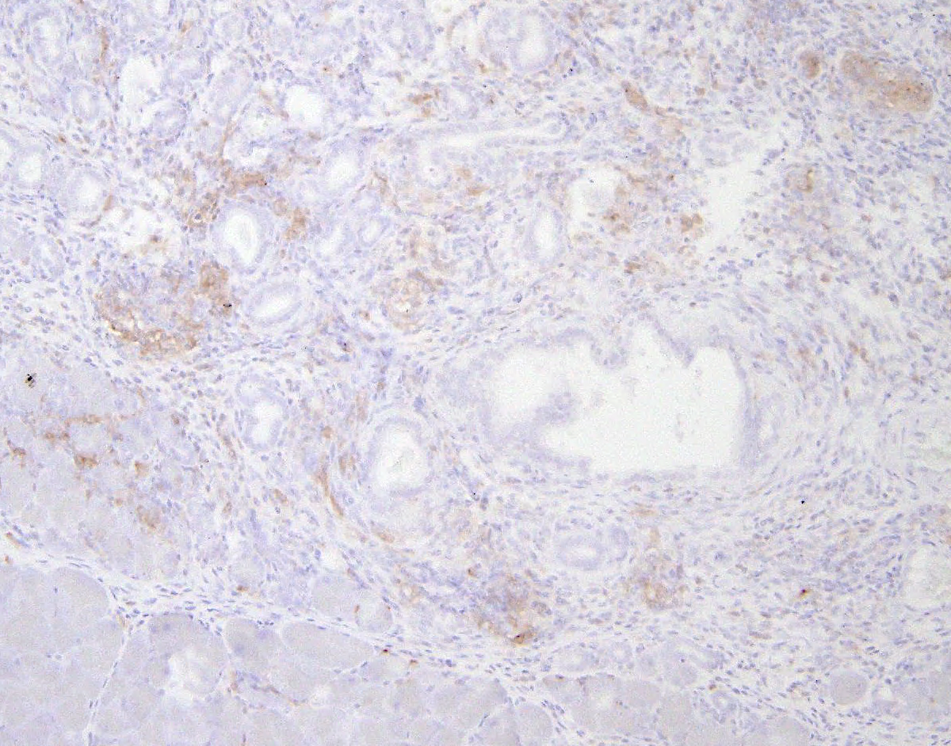
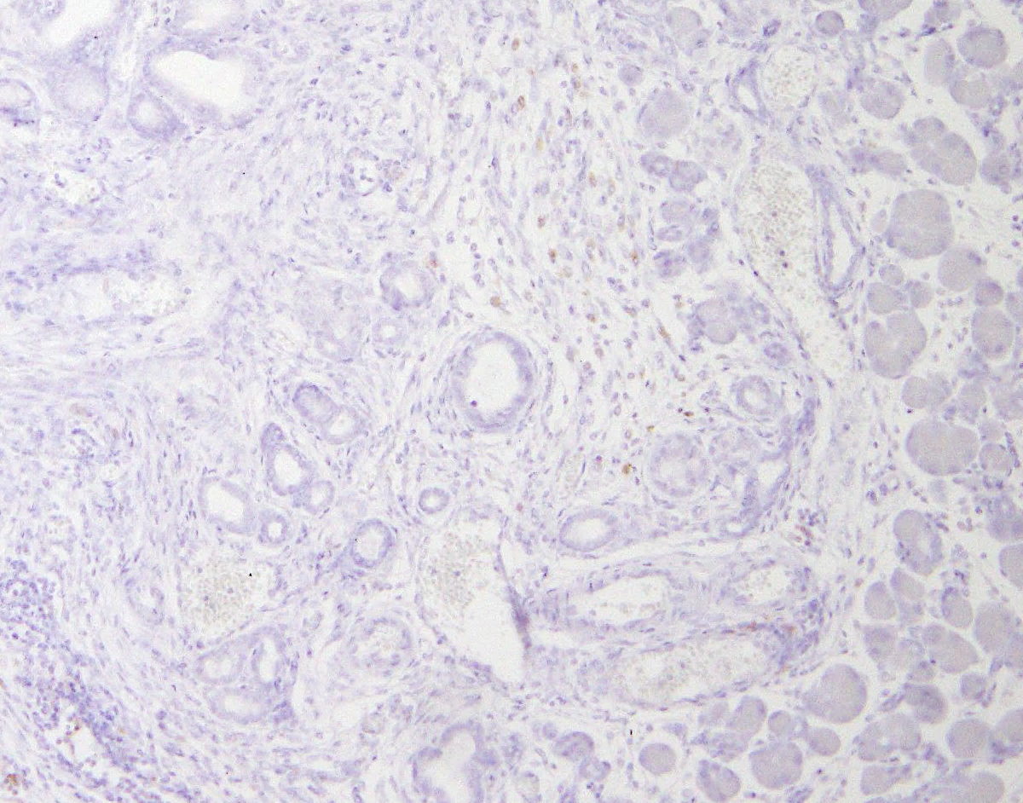
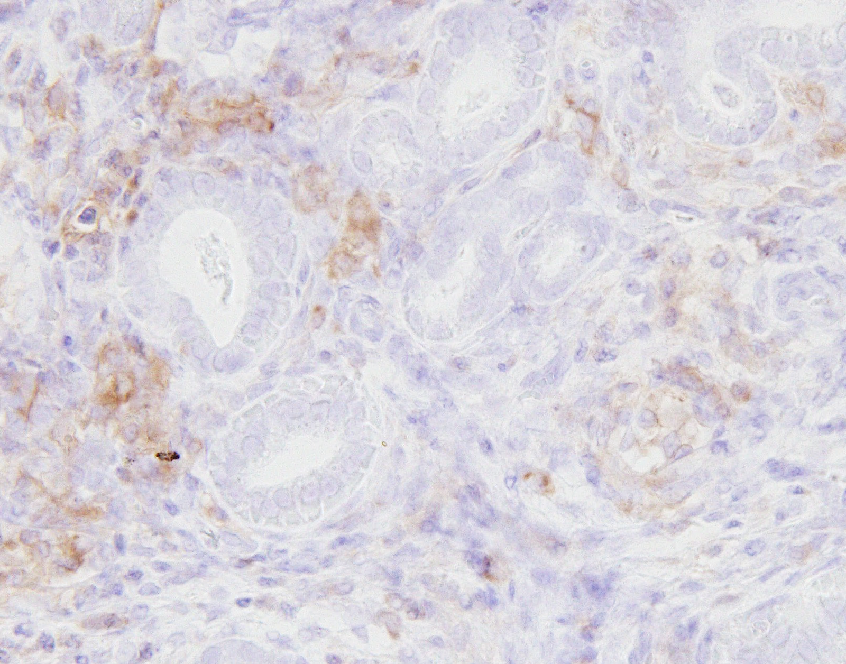
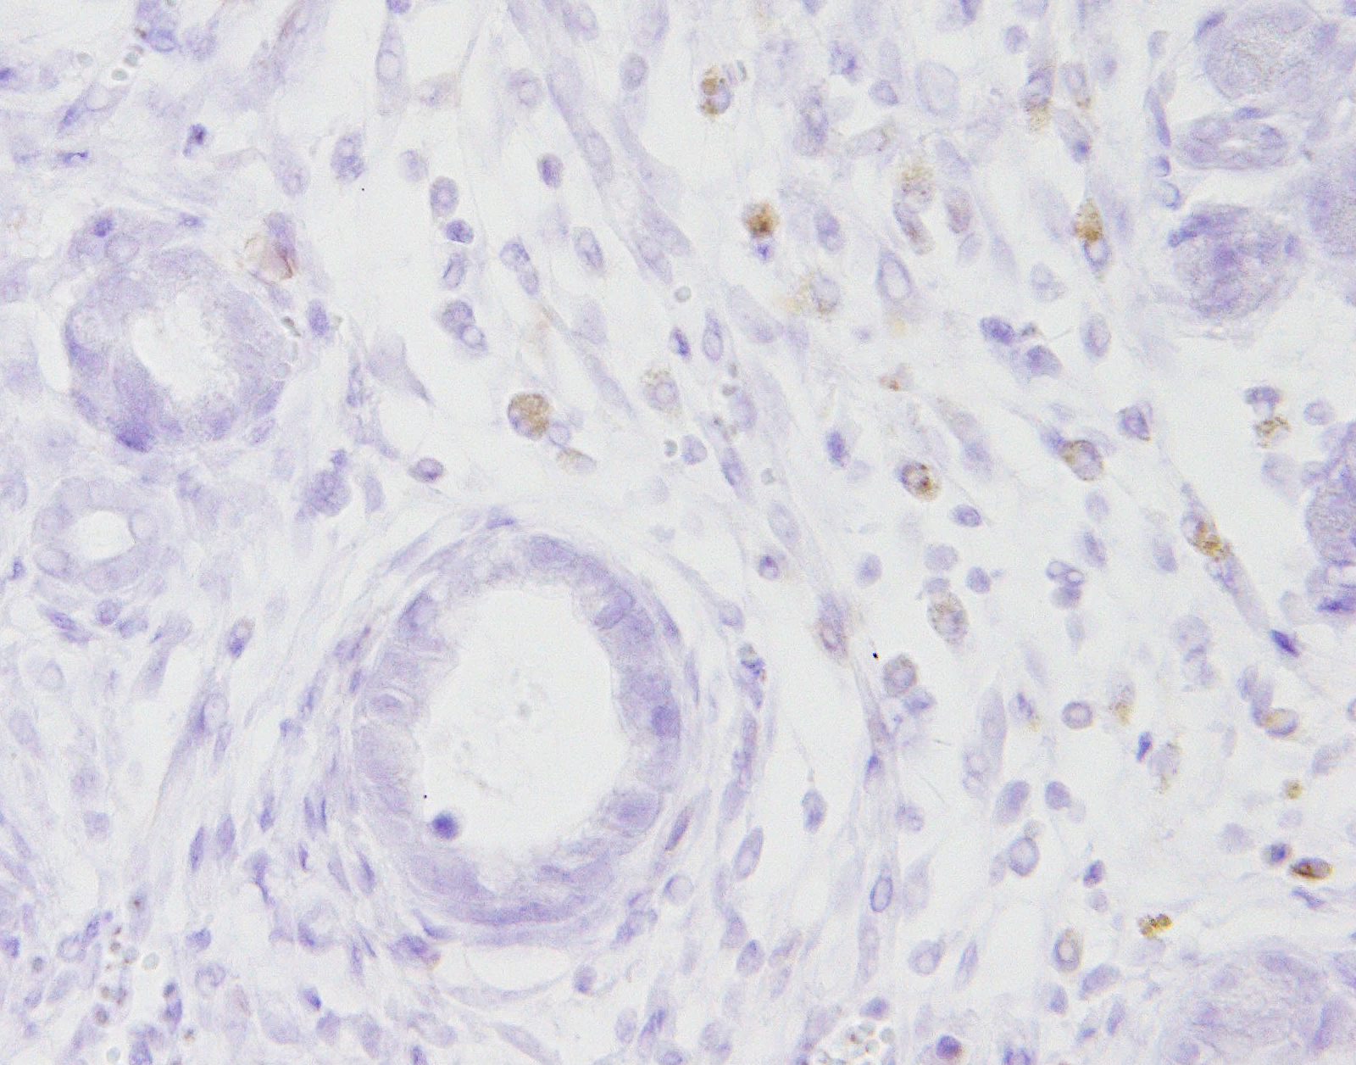
Supplementary Fig. 5
a
b
High stromal CD11c
Low stromal CD11c
(g)
Mouse body weight
25
20
15
Body weight
Control
mC4BPA peptide
10
5
0
Day0
Day3
Day7
Time after randomization
c
 | Control | mC4BPA peptide
High stromal CD11c | 4 (40%) | 7 (70%)
Low stromal CD11c | 6 | 3

Slide 6
Supplementary Fig. 6
a
b
(g)
Mouse body weight
(/HPF)
* P=0.048
25
20
P=0.38
P=0.29
20
15
15
Number of CD4⁺ cells
(in 2 different HPFs per mouse)
Body weight
Control
10
GnP
10
GnP/ICBs/mC4BPA peptide
5
5
0
Control
(n=12)
GnP
(n=12)
GnP/ICBs/
mC4BPA peptide
(n=12)
0
Day0
Day5
Day10
Day15
Day20
Time after randomization
c
d
Pancreatic tumor
 | Control | GnP | GnP/ICB/ mC4BPA peptide
High stromal CD11c | 2 (33%) | 2 (33%) | 4 (67%)
Low stromal CD11c | 4 | 4 | 2
Control
(n=6)
GnP
(n=6)
GnP/ICBs
mC4BPA
peptide
(n=6)

