Slide 1
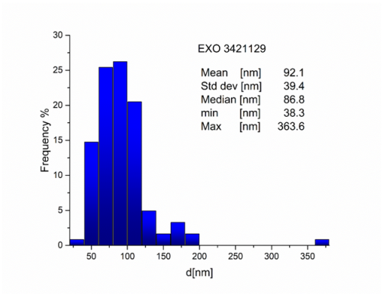
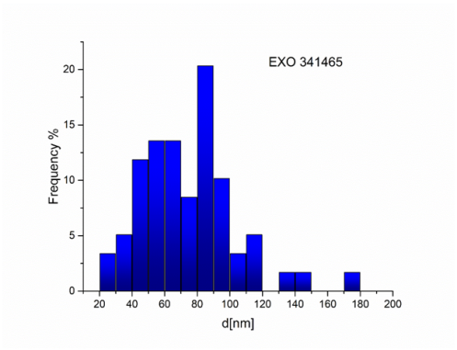
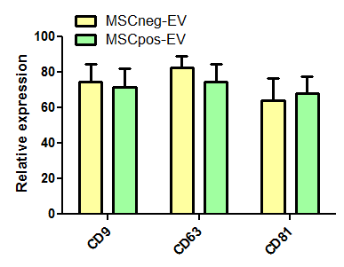
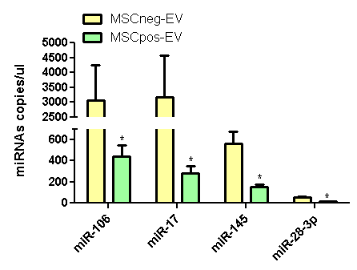
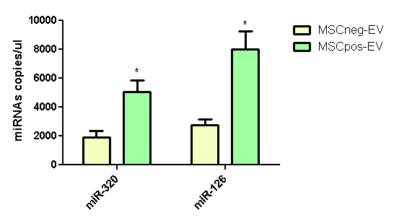
A
MSCneg-EV
MSCpos-EV
B
C
D
Suppl. Figure 1

Slide 2
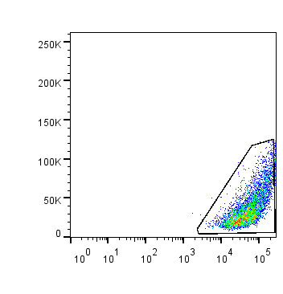
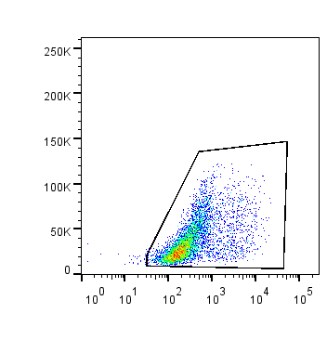
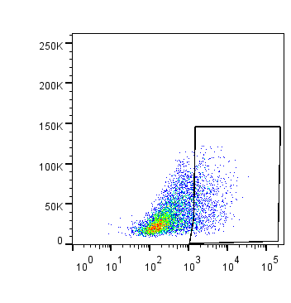
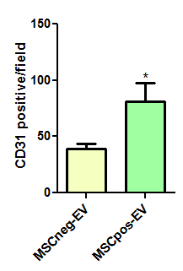
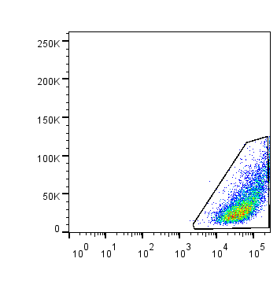
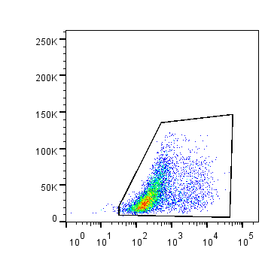
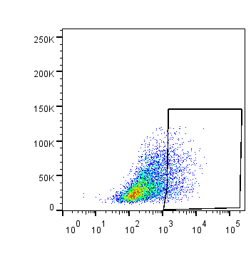


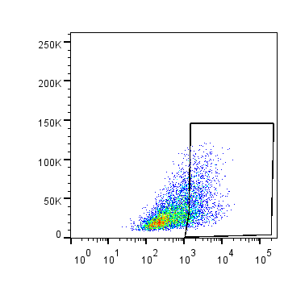
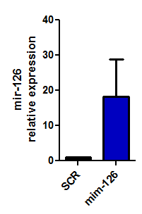
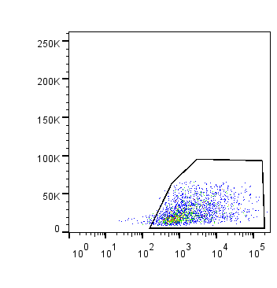
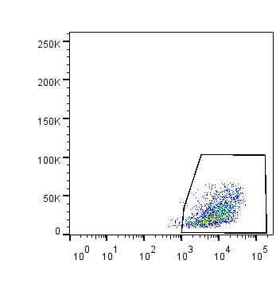
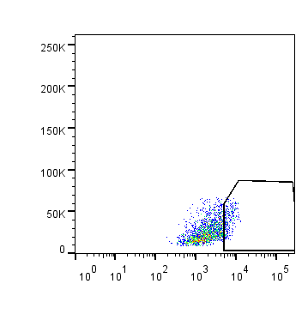
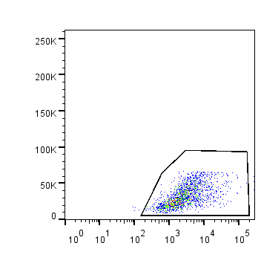
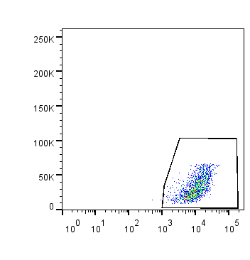
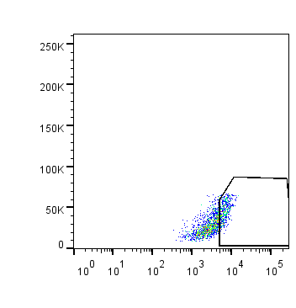
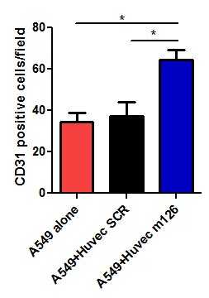
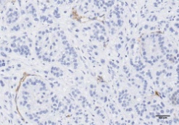
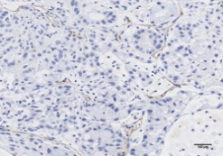
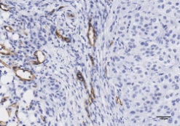
A
CD31
CD34
CXCR4
B
NT
MSCneg-EV
MSCpos-EV
C
D
CD31
CD34
CXCR4
SCR
mim-126
E
A549 alone
A549+ Huvec SCR
A549+Huvec+m126
CD31
Suppl. Figure 2

Slide 3
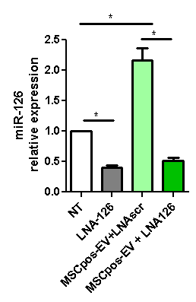
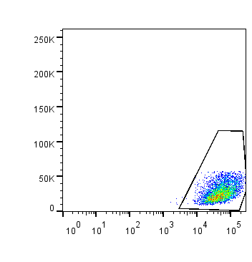
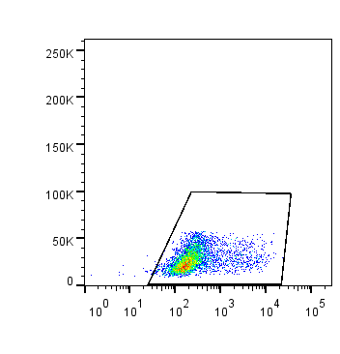

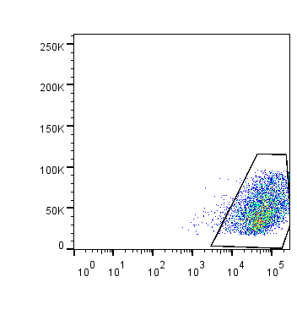
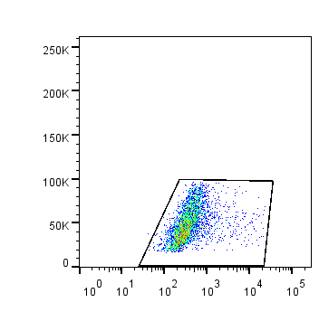
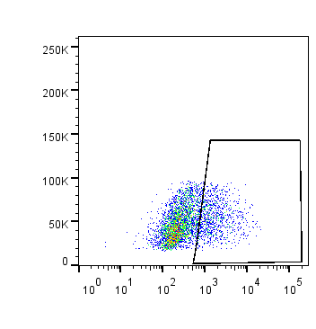
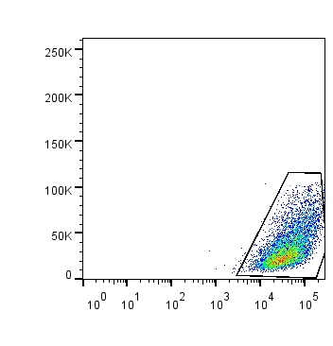


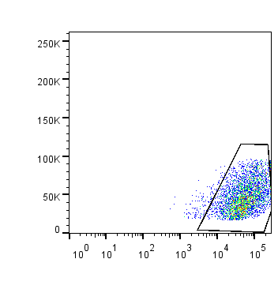


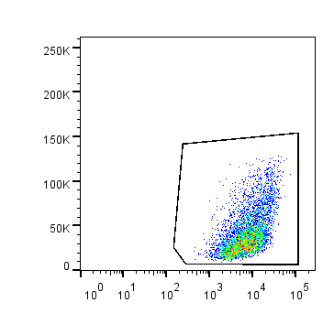

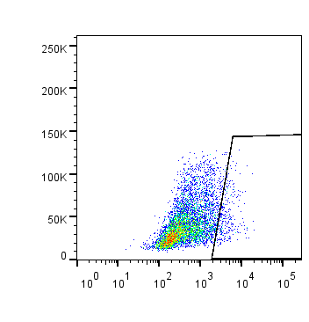
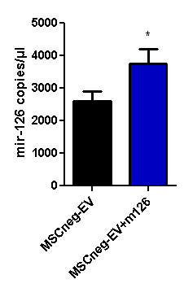
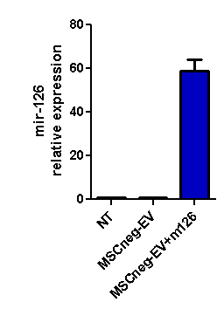
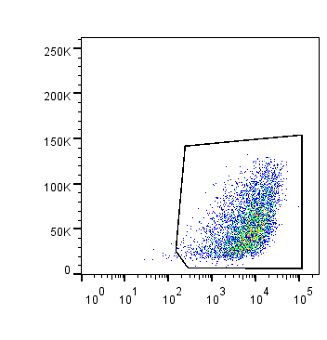
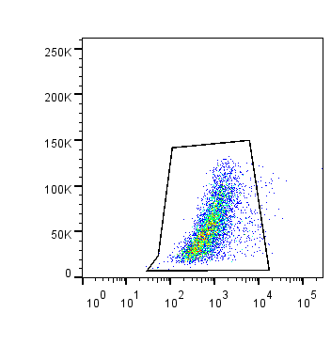
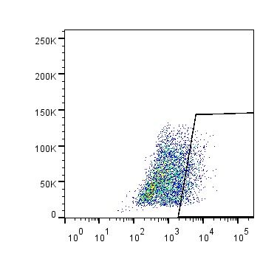
A
B
CD31
CD34
CXCR4
SCR
LNA-126
MSCpos-EV +
LNA SCR
MSCpos-EV +
LNA-126
C
D
CD31
CD34
CXCR4
EV
Cell
MSCneg-EV
MSCneg-EV+
Mim-126
Suppl. Figure 3

Slide 4
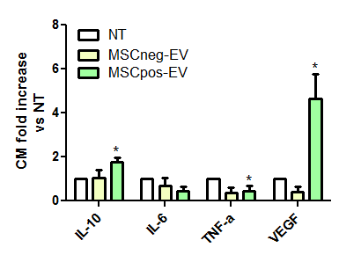
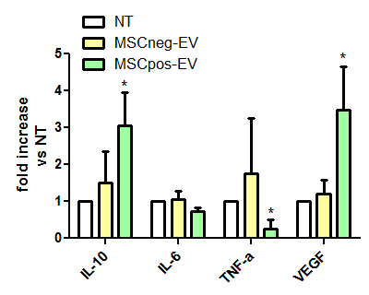
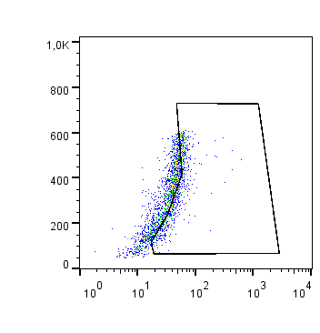
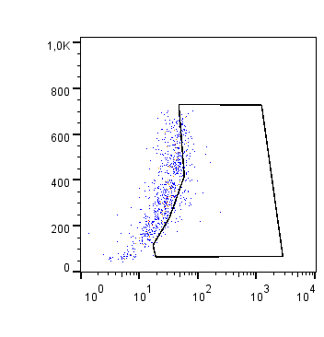
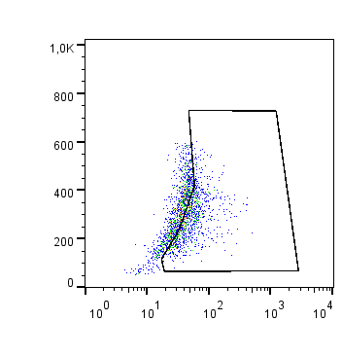
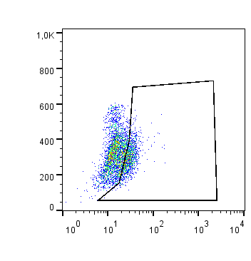
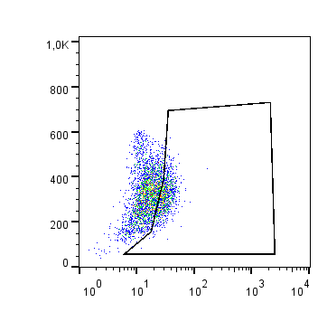
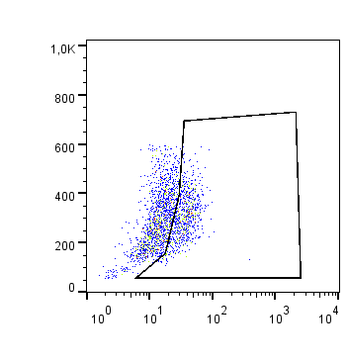
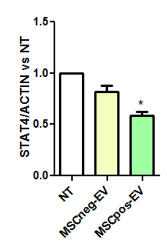


A
CM
Cell Lysate
B
NT
MSCneg-EVs
MSCpos-EVs
SSC
CD163
NT
MSCneg-EVs
MSCpos-EVs
SSC
CD206
C
MSCneg-EVs
MSCpos-EVs
NT
STAT4
Actin
Suppl. Figure 4

Slide 5
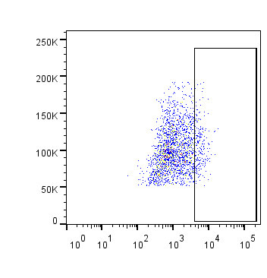
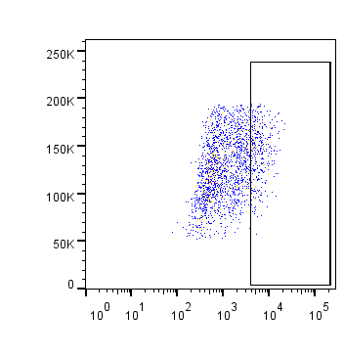











A
NT
MSCneg-PMN-EVs
MSCpos-PMN-EVs
SSC
CD163
NT
MSCneg-PMN-EVs
MSCpos-PMN-EVs
SSC
CD206
B
PMN-EVs
C
NT
MSCneg-PMN-EVs
MSCneg-PMN-EVs+m320
SSC
CD163
NT
MSCneg-PMN-EVs
MSCneg-PMN-EVs+m320
SSC
CD206
Suppl. Figure 5

Slide 6


A
B
Suppl. Figure 6

Slide 7

Suppl. Figure 7

Slide 8








A
B
NT
Normoxia-PMN-EVs
Hypoxia-PMN-Evs
SSC
CD206
NT
Normoxia-PMN-EVs
Hypoxia-PMN-Evs
SSC
CD163
Suppl. Figure 8

Slide 9




A
B
p=0.335
C
D
p=0.8325
Suppl. Figure 9

