Slide 1
Conditions on each blot (left to right)
A375 | 451 lu | 451lu R | M233 | D10 BMR
Control | Control | Control | Control | Control
Control | Control | Control | Control | Control
Control | Control | Control | Control | Control
Dabrafenib | Dabrafenib | Dabrafenib | Dabrafenib | Dabrafenib + Trametinib
Dabrafenib | Dabrafenib | Dabrafenib | Dabrafenib | Dabrafenib + Trametinib
Dabrafenib | Dabrafenib | Dabrafenib | Dabrafenib | Dabrafenib + Trametinib
Vemurafenib | Vemurafenib | Vemurafenib | Vemurafenib
Vemurafenib | Vemurafenib | Vemurafenib | Vemurafenib
Vemurafenib | Vemurafenib | Vemurafenib | Vemurafenib

Slide 2


A375
451lu R
M233
GAPDH
GAPDH
GAPDH
451lu
D10 BMR
GAPDH
GAPDH

Slide 3
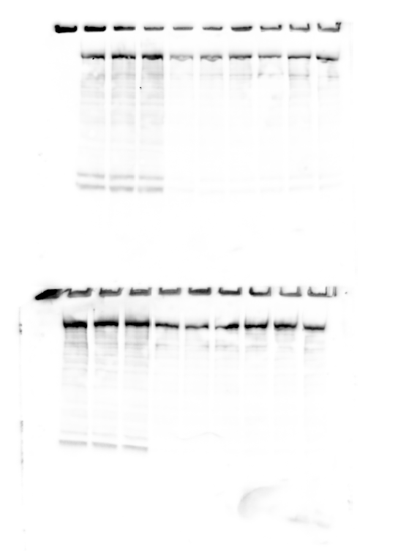
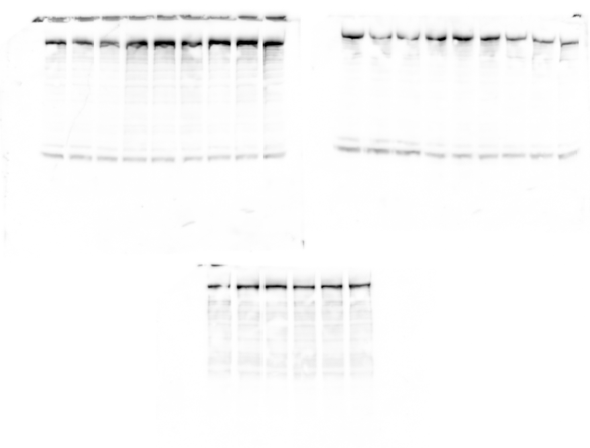
A375
451lu R
M233
FASN
FASN
FASN
451lu
D10 BMR
FASN
FASN

Slide 4
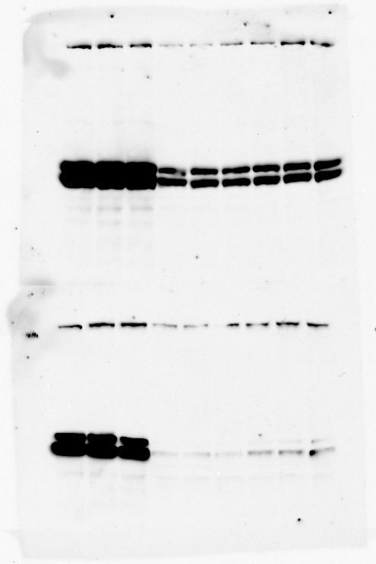
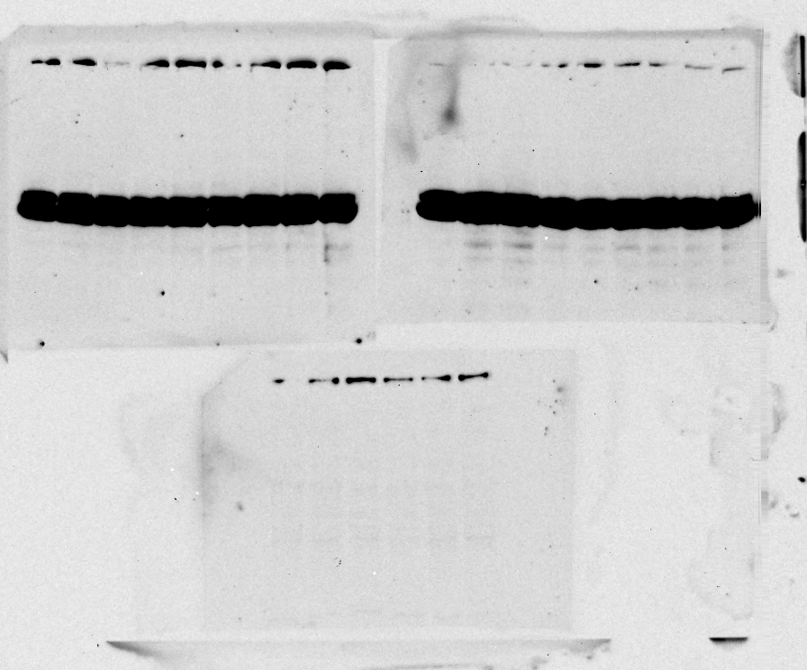
A375
451lu R
M233
ACACA
ACACA
ACACA
451lu
D10 BMR
ACACA
ACACA

Slide 5
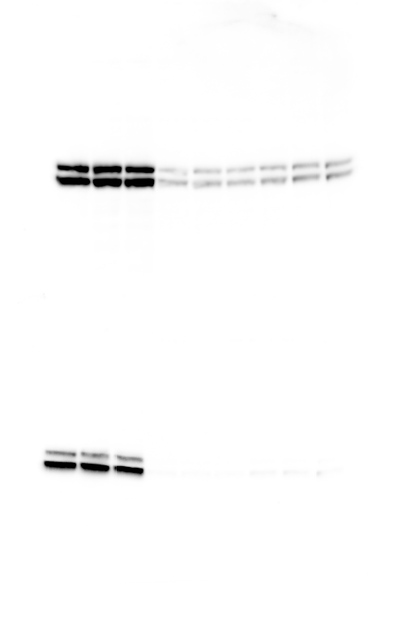
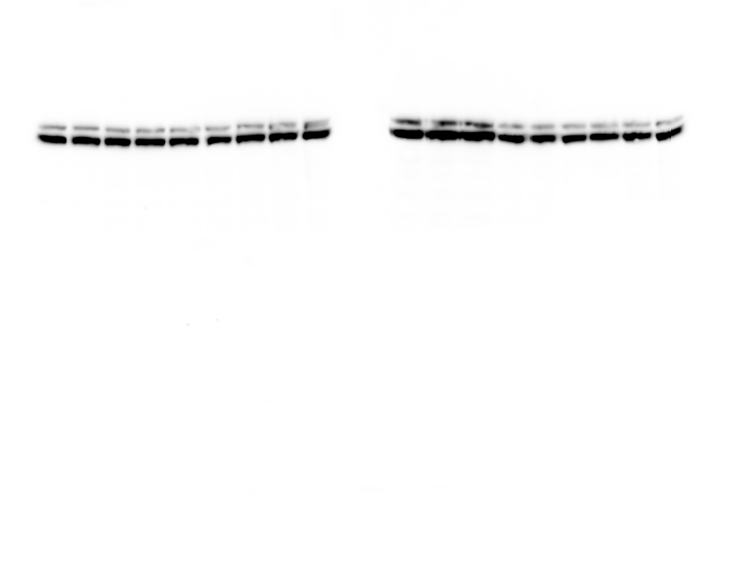
A375
451lu R
M233
pERK1/2
pERK1/2
pERK1/2
451lu
D10 BMR
pERK1/2

Slide 6
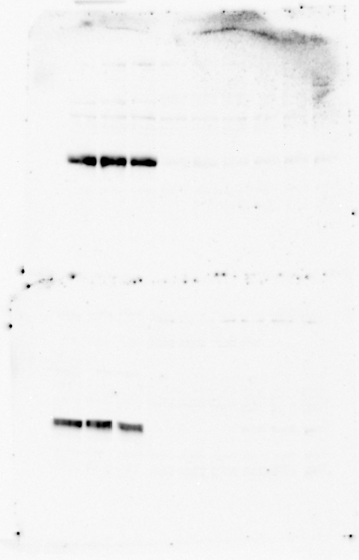
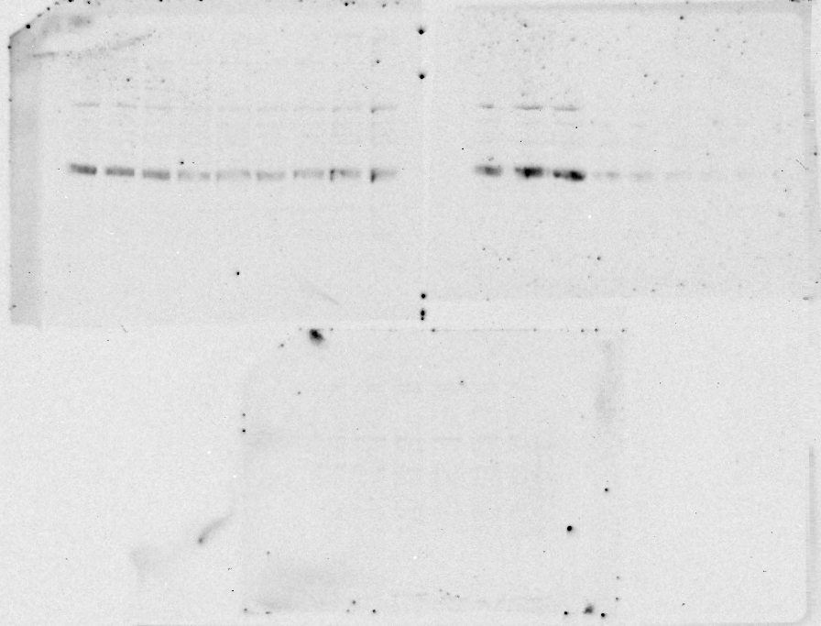
A375
451lu R
M233
pMEK
pMEK
pMEK
451lu
D10 BMR
pMEK

