Slide 1
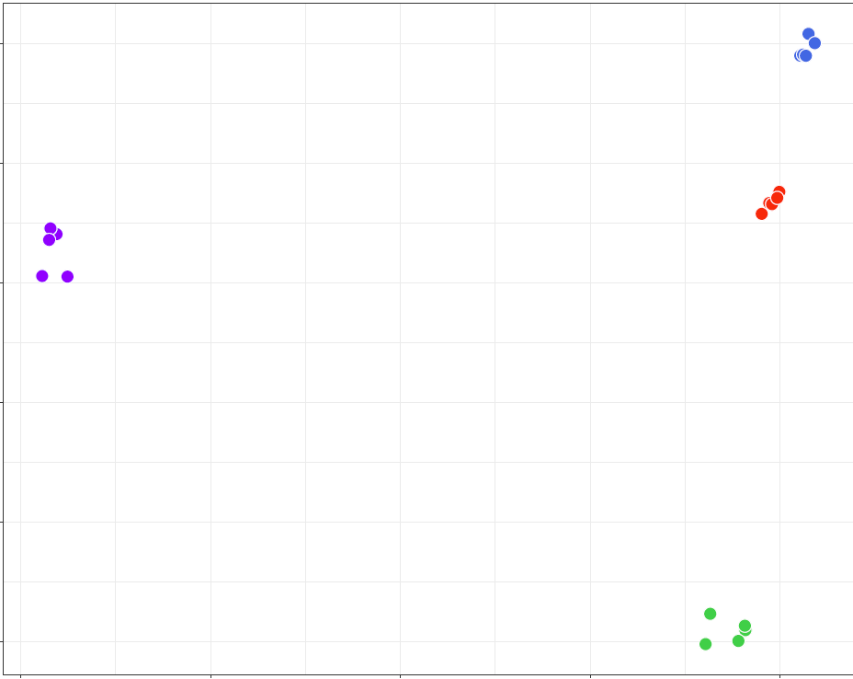
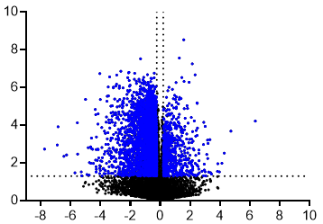
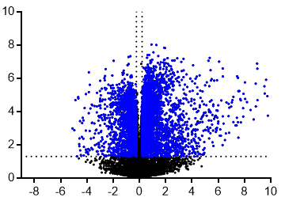
Supplemental FIGURE 1
A
20
Control
10
OE-CYR61
0
sh-Control
PC2 (13% variance)
sh-CYR61
-10
-20
-30
-75
-50
-25
0
25
B
PC1 (67% variance)
n=6559
n=717
-Log₁₀(q value)
Log₂(FC)
C
n=2520
n=4922
-Log₁₀(q value)
Log₂(FC)

Slide 2
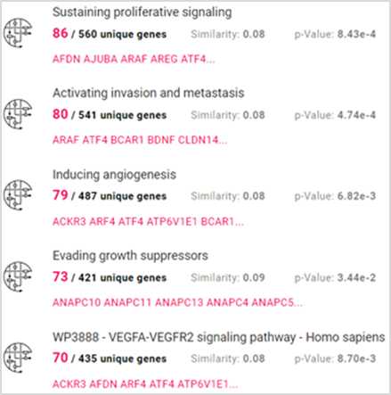
Supplemental FIGURE 2
A
B
REACTOME PATHWAYS
Signal Transduction
Count
13.2% p = 0.079
Gene expression (Transcription)
6.9% p = 0.029
Signaling by Rho GTPases
4.0% p = 0.049
Metabolism of RNA
4.0% p = 0.040
Signaling by Rho GTPases
3.8% p = 0.082
BIOLOGICAL PROCESS
Count
Transcription
12.1% p = 0.0013
Transcription regulation
11.6% p = 0.00086
Transport
11.5% p = 0.02
Ubl conjugation pathway
5.6% p = 7.3 e-8
C
Protein transport
4.3% p = 0.0004
Binding 36%
(GO:0005488)
Transporter activity 6%
(GO:0005215)
Molecular function regulator activity 6%
(GO:0098772)
Transcription regulator activity 9%
(GO:0140110)
Catalytic activity 31% (GO:0003824)

Slide 3
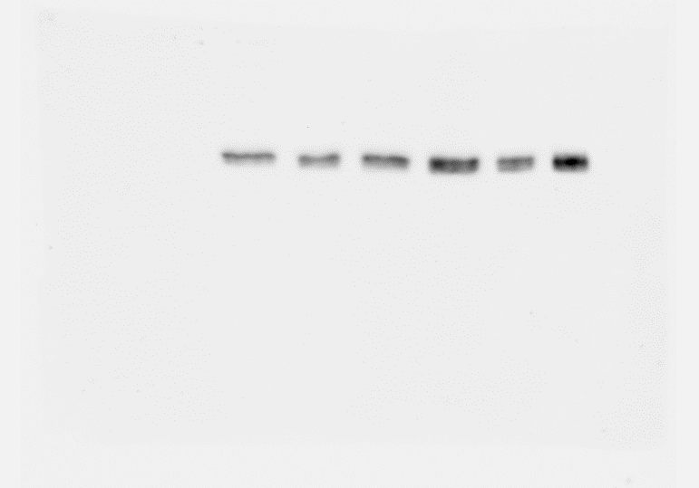
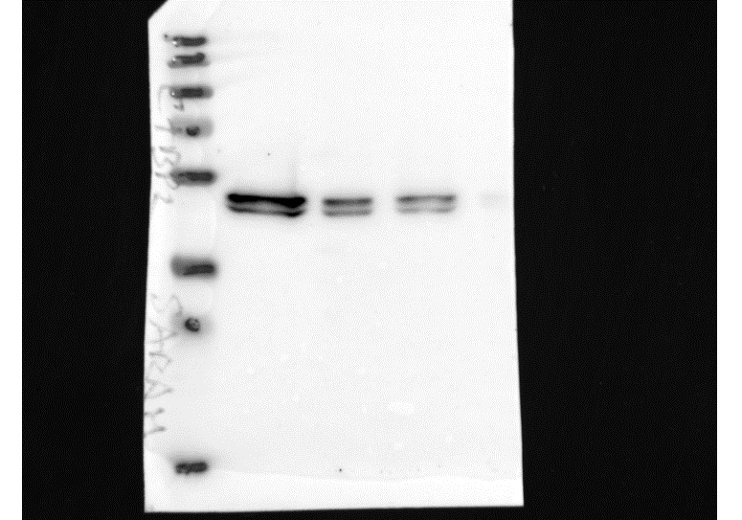
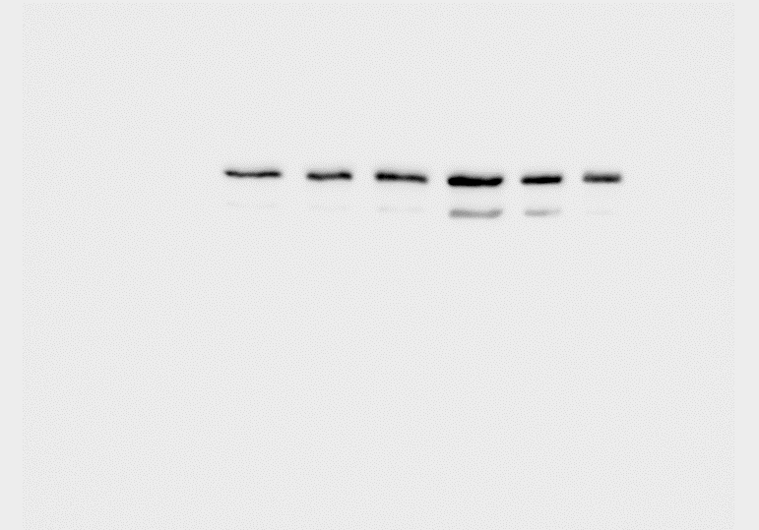
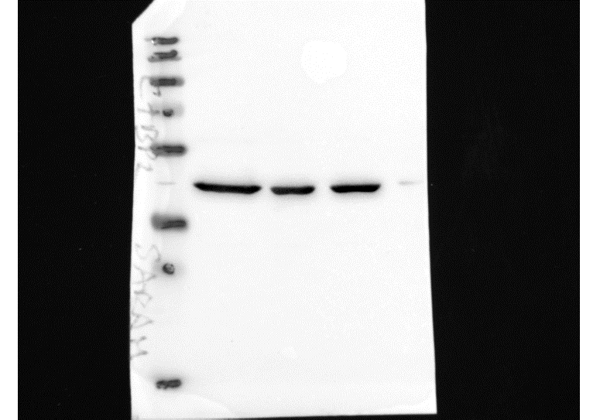
Supplemental FIGURE 3
A
K7M2
U2OS
B
K7M2
U2OS
4
*
5
**
*
4
ns
CtBP2
3
3
CtBP2 mRNA level
(Fold change)
2
2
Actin
1
1
0
0
Control
shCtBP2
Control
shCtBP2
Control
Control
OE-CtBP2
OE-CtBP2
shCtBP2
shCtBP2
OE-CtBP2
OE-CtBP2
C
POU5F1
NANOG
SOX2
ZEB1
CD44
CD133
4
ns
*
5
ns
*
4
ns
ns
4
*
**
4
**
***
5
ns
*
3
4
3
3
3
4
2
3
2
2
2
3
1
2
1
1
1
2
1
0
0
1
0
0
0
0
Relative mRNA levels (Fold change)
ALDH2
EpCAM
βCATENIN
RUNX2
OSTERIX
Control
shCtBP2
ns
***
ns
***
ns
ns
**
ns
ns
ns
OE-CtBP2
6
4
6
2
2
4
3
4
1
2
2
2
1
0
1
0
0
0
0
Control
Control
Control
Control
Control
shCtBP2
shCtBP2
shCtBP2
shCtBP2
shCtBP2
OE-CtBP2
OE-CtBP2
OE-CtBP2
OE-CtBP2
OE-CtBP2
D
U2OS
Control
shCtBP2
OE-CtBP2
E
U2OS
U2OS
400
ns
*
50
ns
*
300
40
200
30
Size of colony (AU)
Plating efficiency (%)
100
20
10
0
0
Control
shCtBP2
Control
shCtBP2
OE-CtBP2
OE-CtBP2

Slide 4
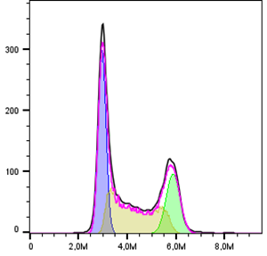
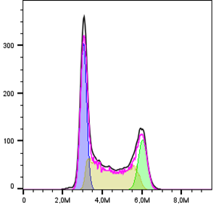
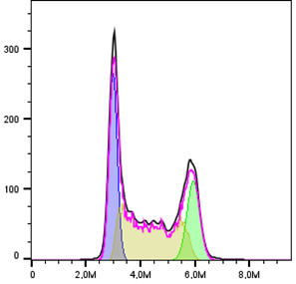
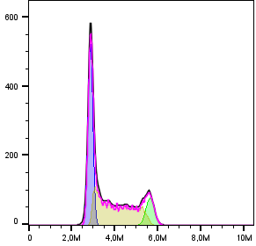
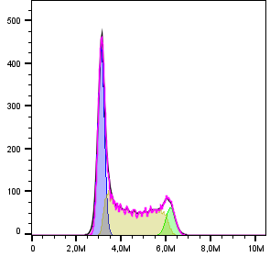
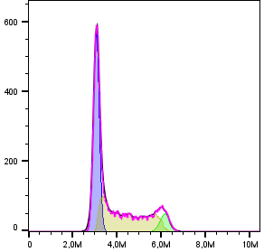
Supplemental FIGURE 4
A
K7M2
ns
U2OS
ns
1.5
ns
1.5
ns
1.0
1.0
Proliferation Rate
(Fold change)
0.5
0.5
0
0
Control
shCtBP2
OE-CtBP2
Control
shCtBP2
OE-CtBP2
B
K7M2
shCtBP2
OE-CtBP2
Count
Count
Count
FL6A-PB450-A
FL6A-PB450-A
FL6A-PB450-A
U2OS
shCtBP2
OE-CtBP2
Count
Count
Count
FL6A-PB450-A
FL6A-PB450-A
FL6A-PB450-A
C
K7M2
U2OS
G2
100
100
10.8
8.69
7.29
S
80
20.3
19.6
20.8
80
G1
60
60
45.5
48.6
42.0
Cell number (%)
41.7
40
40.6
45.5
40
20
36.9
37.3
31.6
20
41.9
40.6
49.3
0
0
Control
shCtBP2
OE-CtBP2
Control
shCtBP2
OE-CtBP2

Slide 5
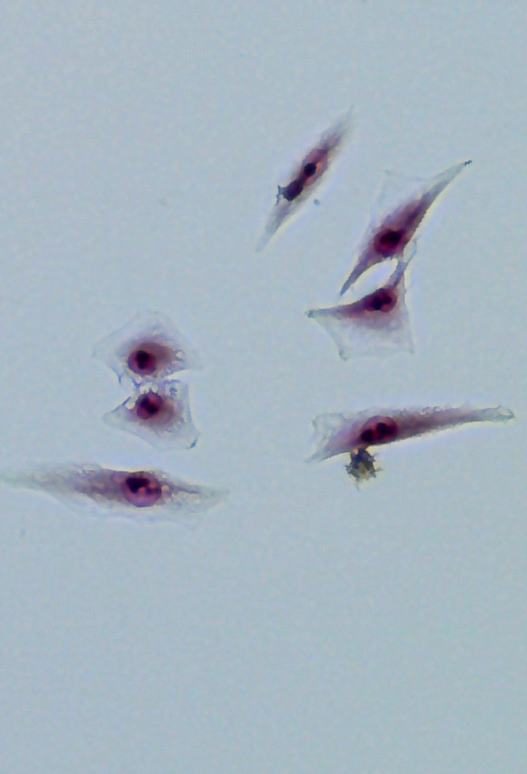
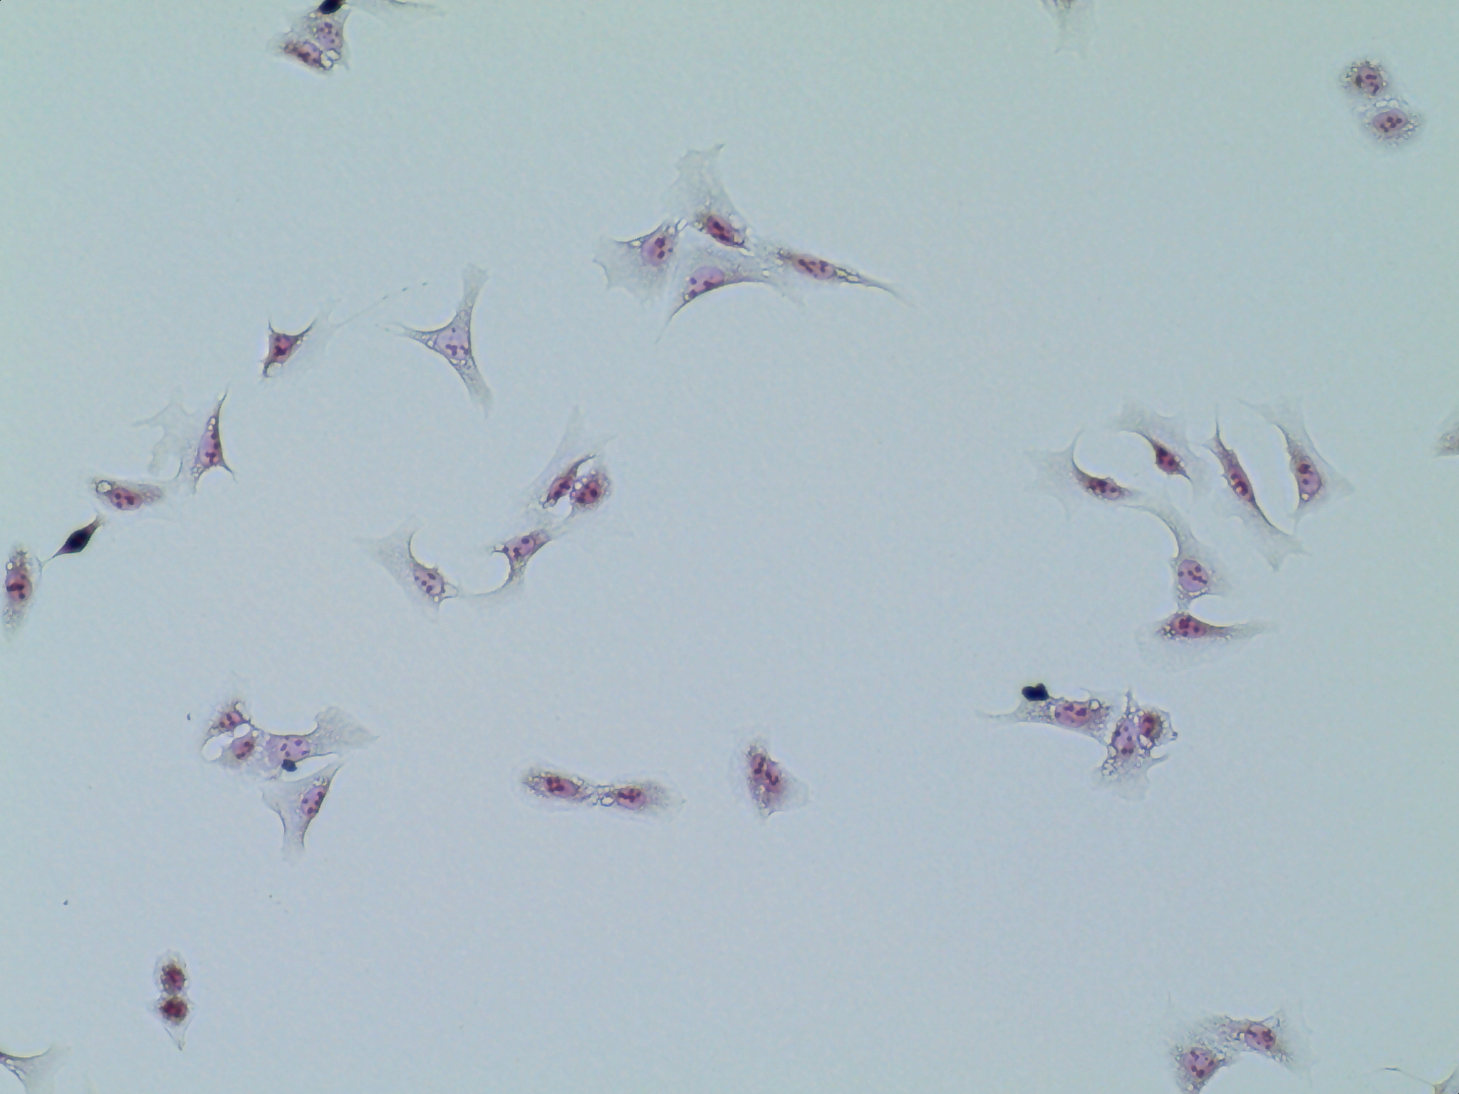
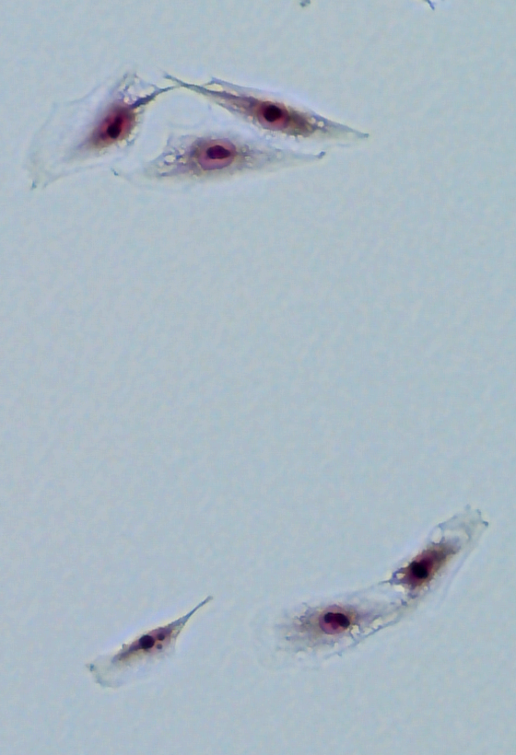
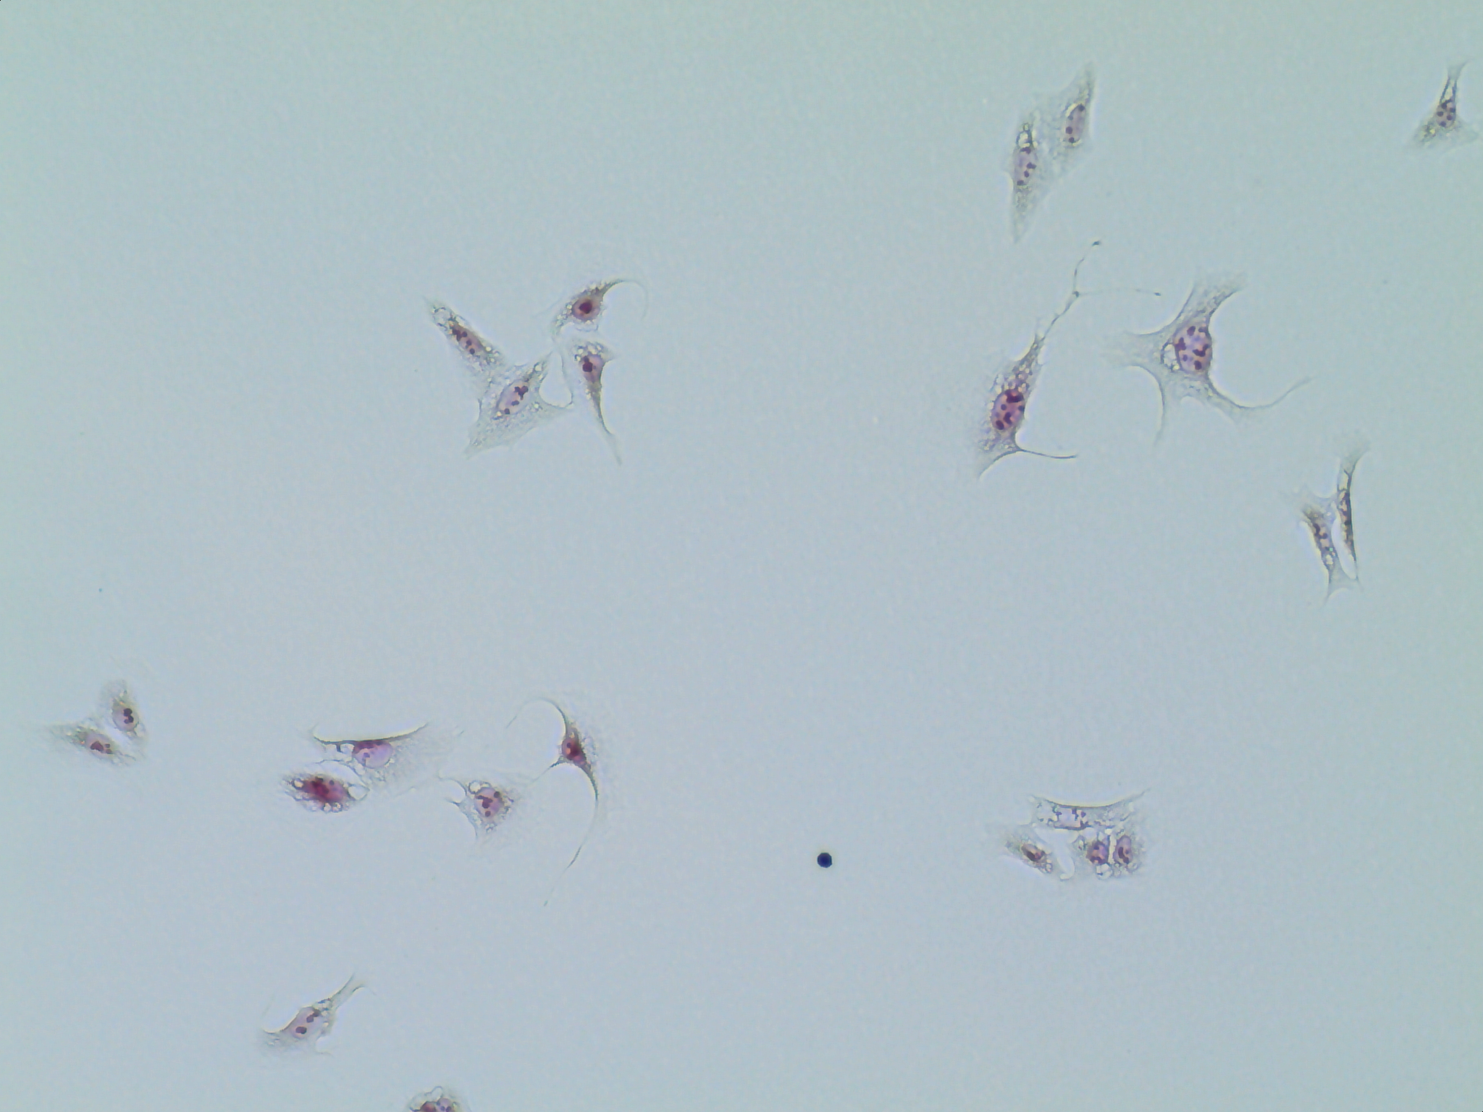
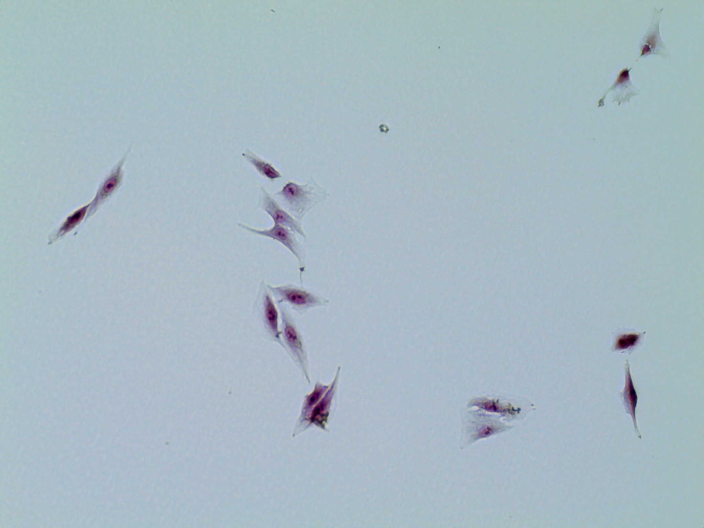
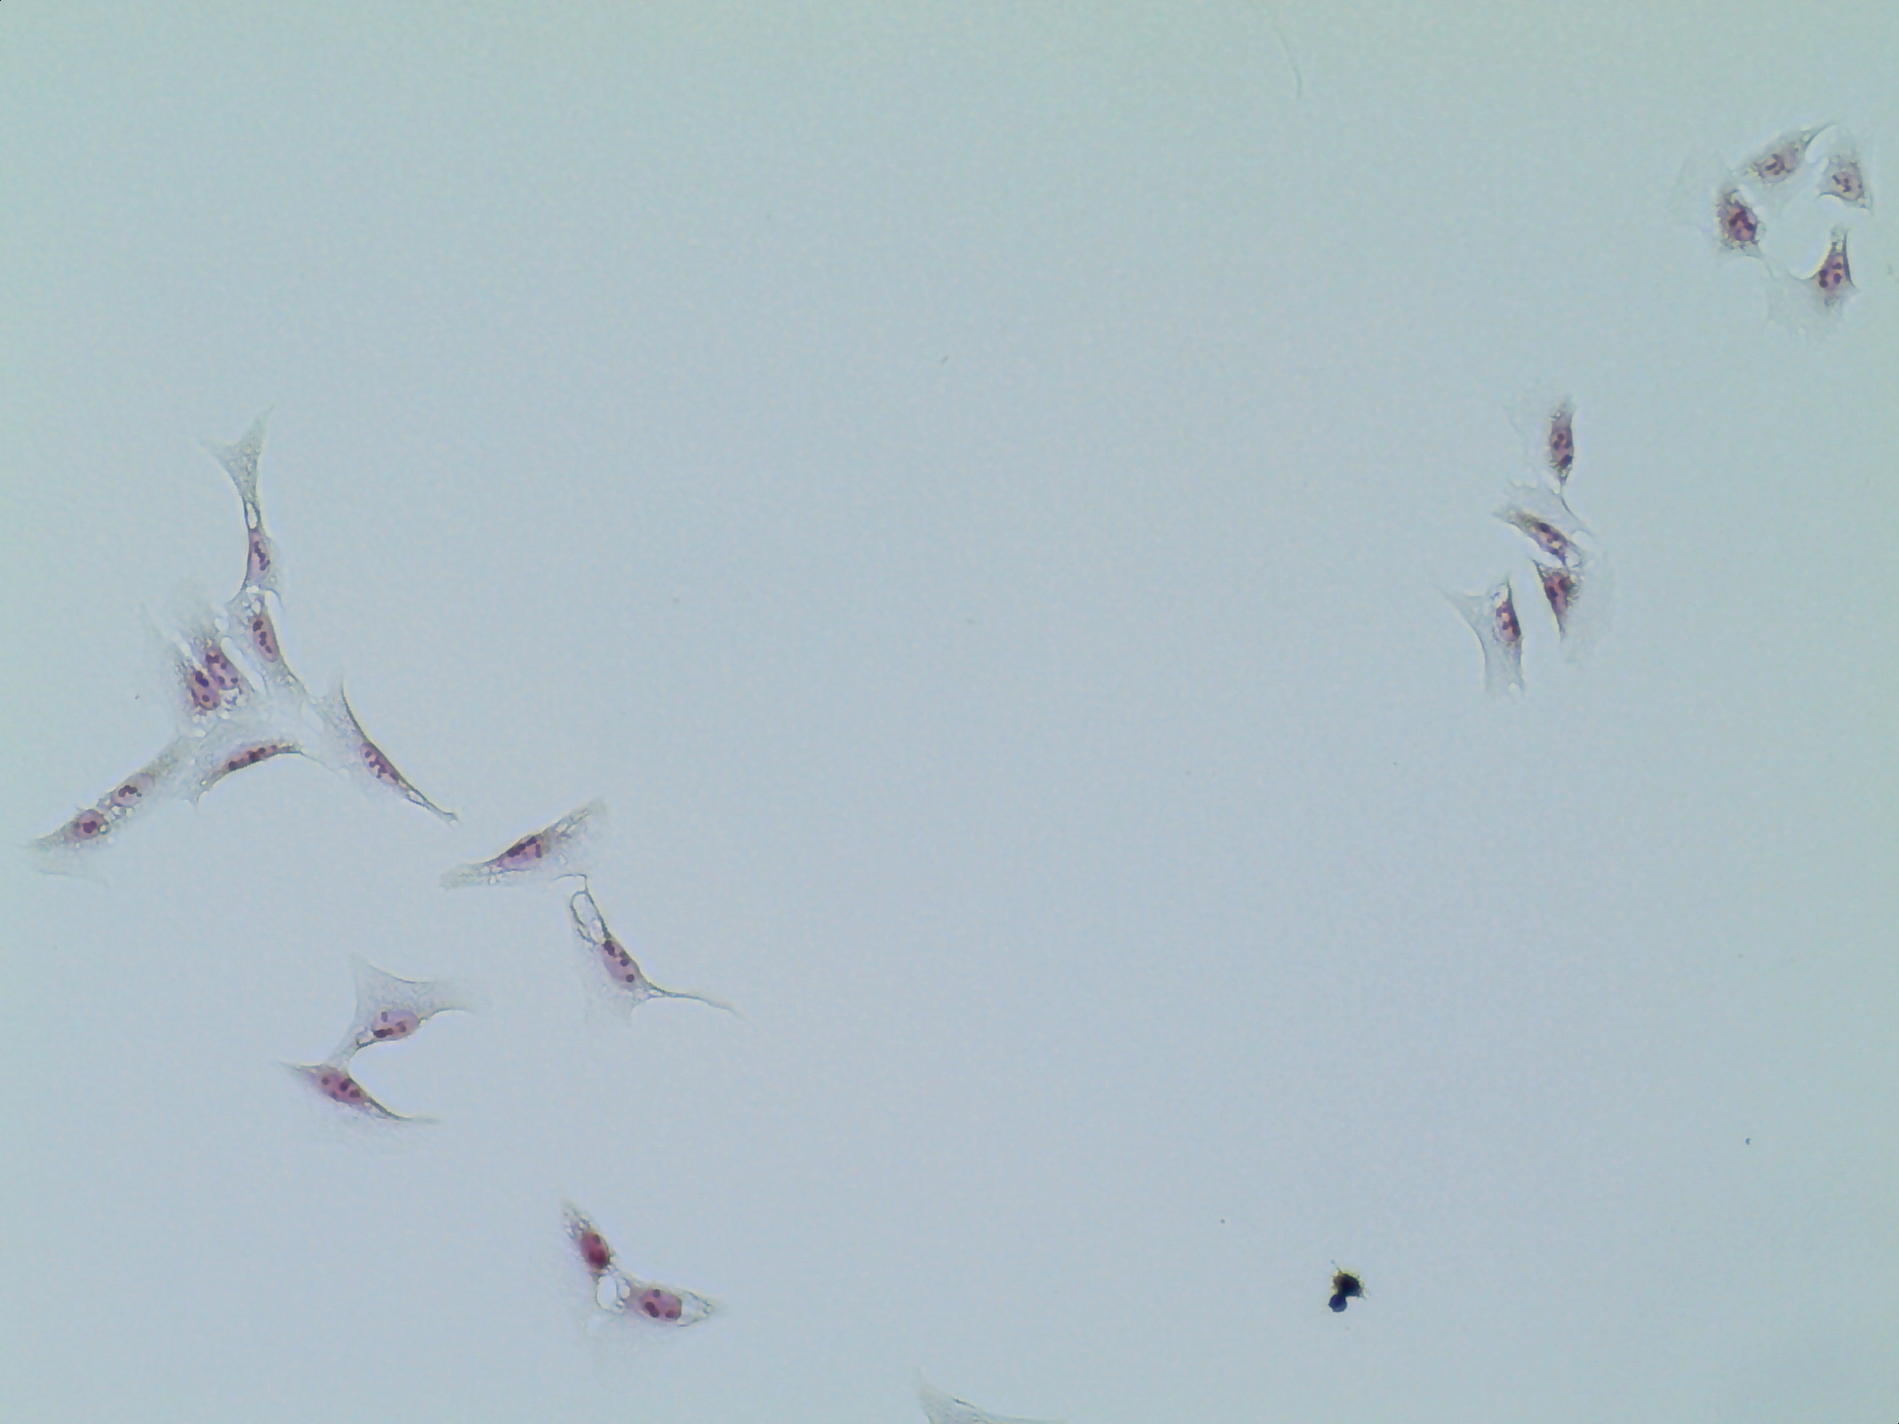
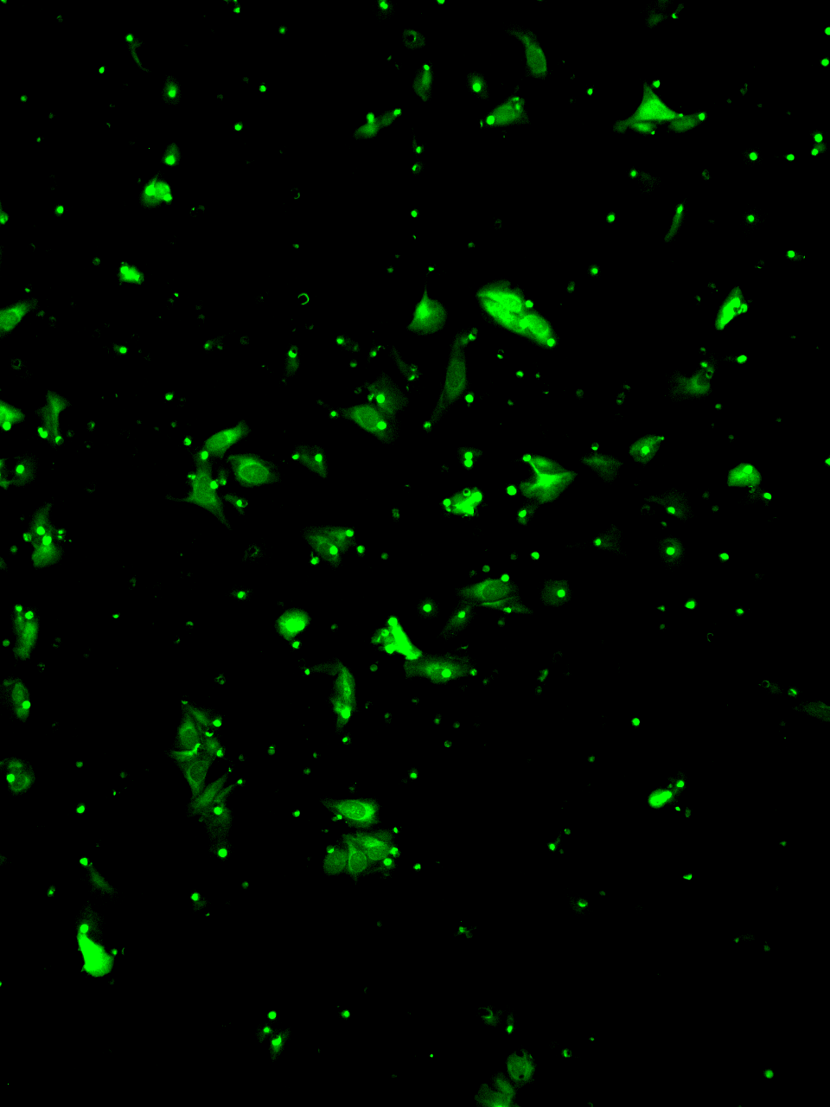
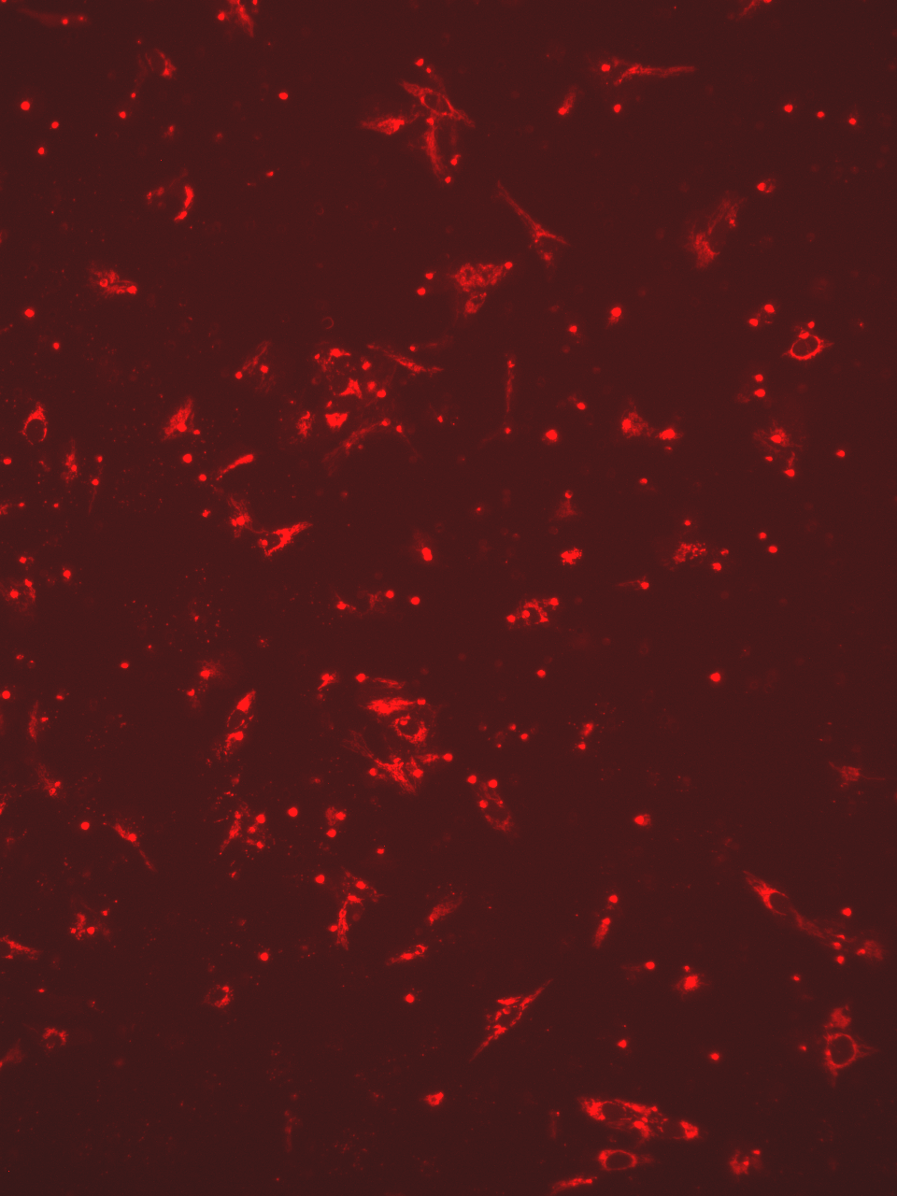
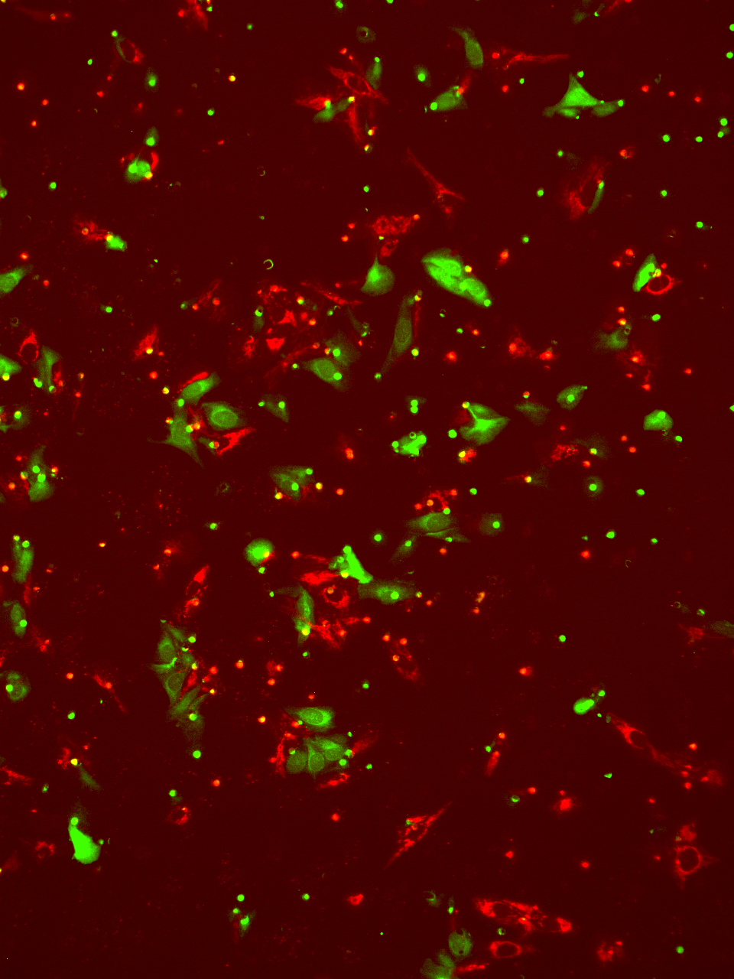
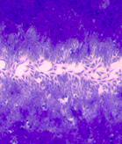
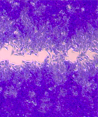
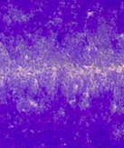
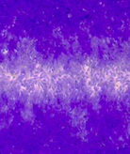
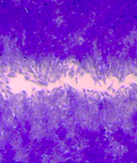
Supplemental FIGURE 5
A
K7M2
U2OS
B
K7M2
U2OS
800
ns
ns
600
ns
300
ns
Cell Surface
Area (µm²)
200
Control
400
100
200
0
0
50
ns
ns
40
ns
300
ns
30
Cell Perimeter
(µm)
200
F
20
100
shCtBP2
10
0
0
ns
ns
0.5
ns
0.4
ns
0.4
0.3
0.3
0.2
Circularity Index
0.2
0.1
OE-CtBP2
0.1
0
0
Control
Control
shCtBP2
shCtBP2
100 µm
100 µm
OE-CtBP2
OE-CtBP2
C
U2OS
shCtBP2 cells
OE-CtBP2 cells
Merge
D
5
4
3
3
2
Cell Number (AU)
Mean Difference
2
1
1
0
0
-1
shCtBP2
100 µm
OE-CtBP2
E
U2OS
shCtBP2
OE-CtBP2
F
Untreated
+ rCYR61
Untreated
*
*
1.5
*
ns
1.0
Relative Closure
0.5
+rCYR61
0
Control
sh
CtBP2
OE
CtBP2

Slide 6
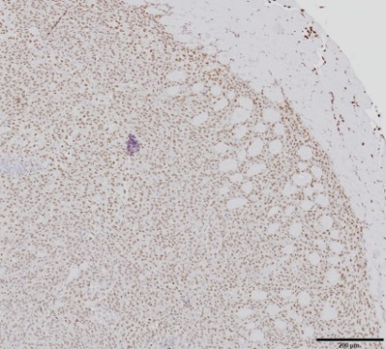
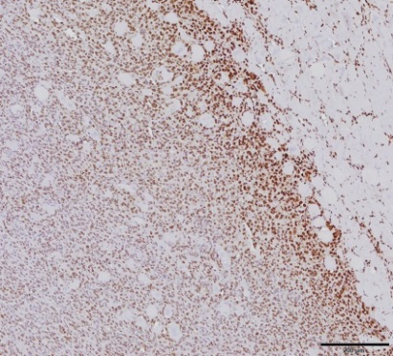
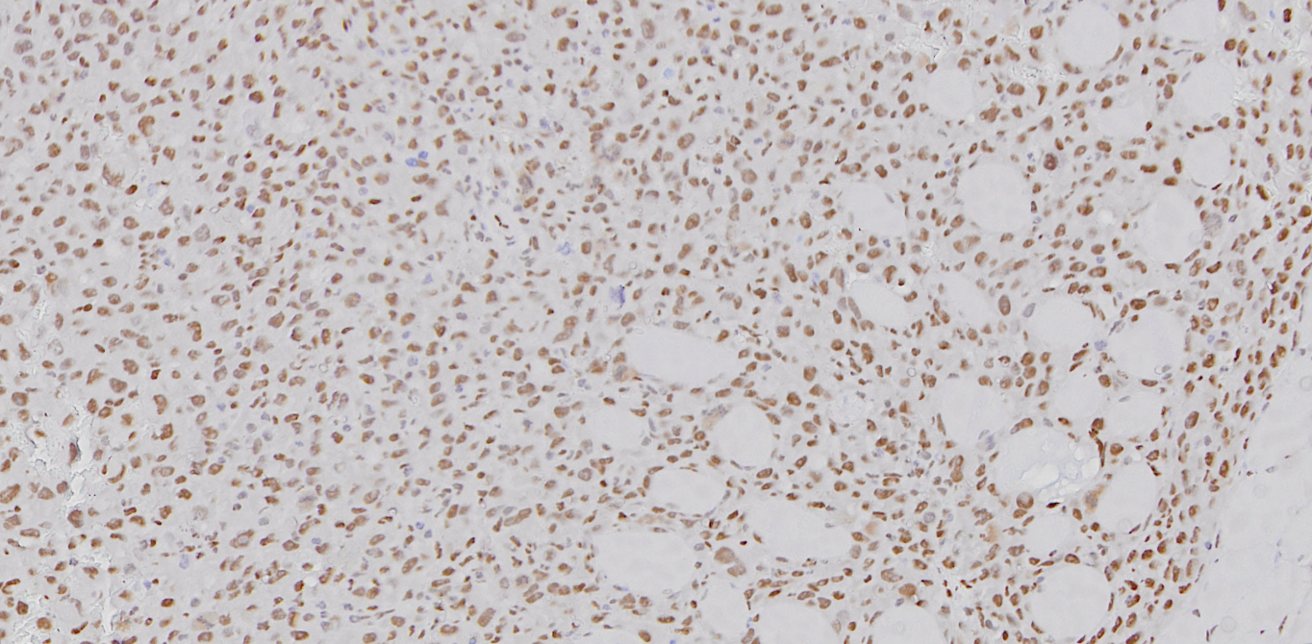
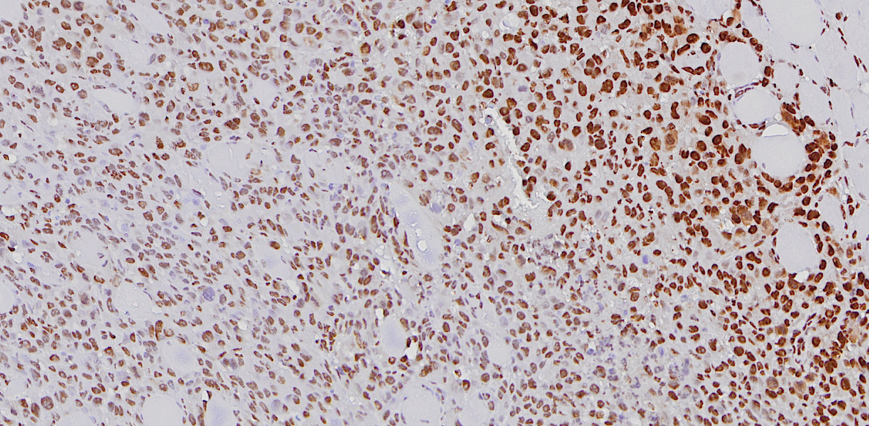
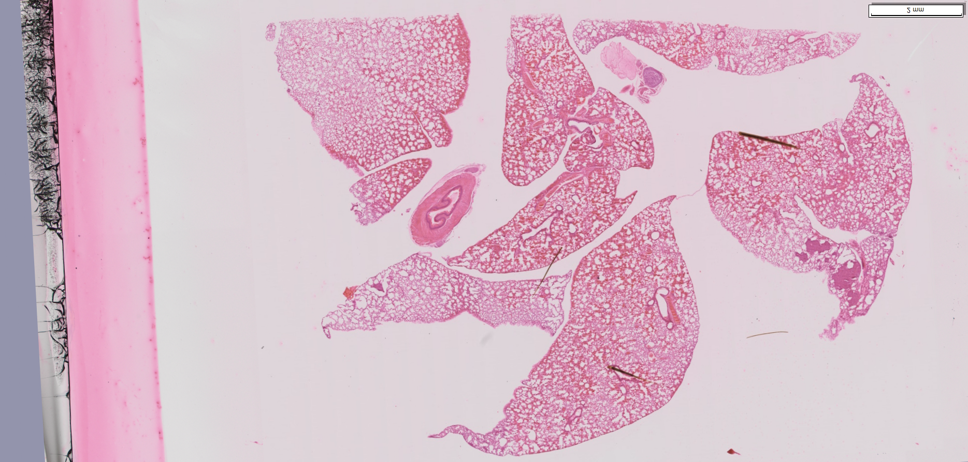
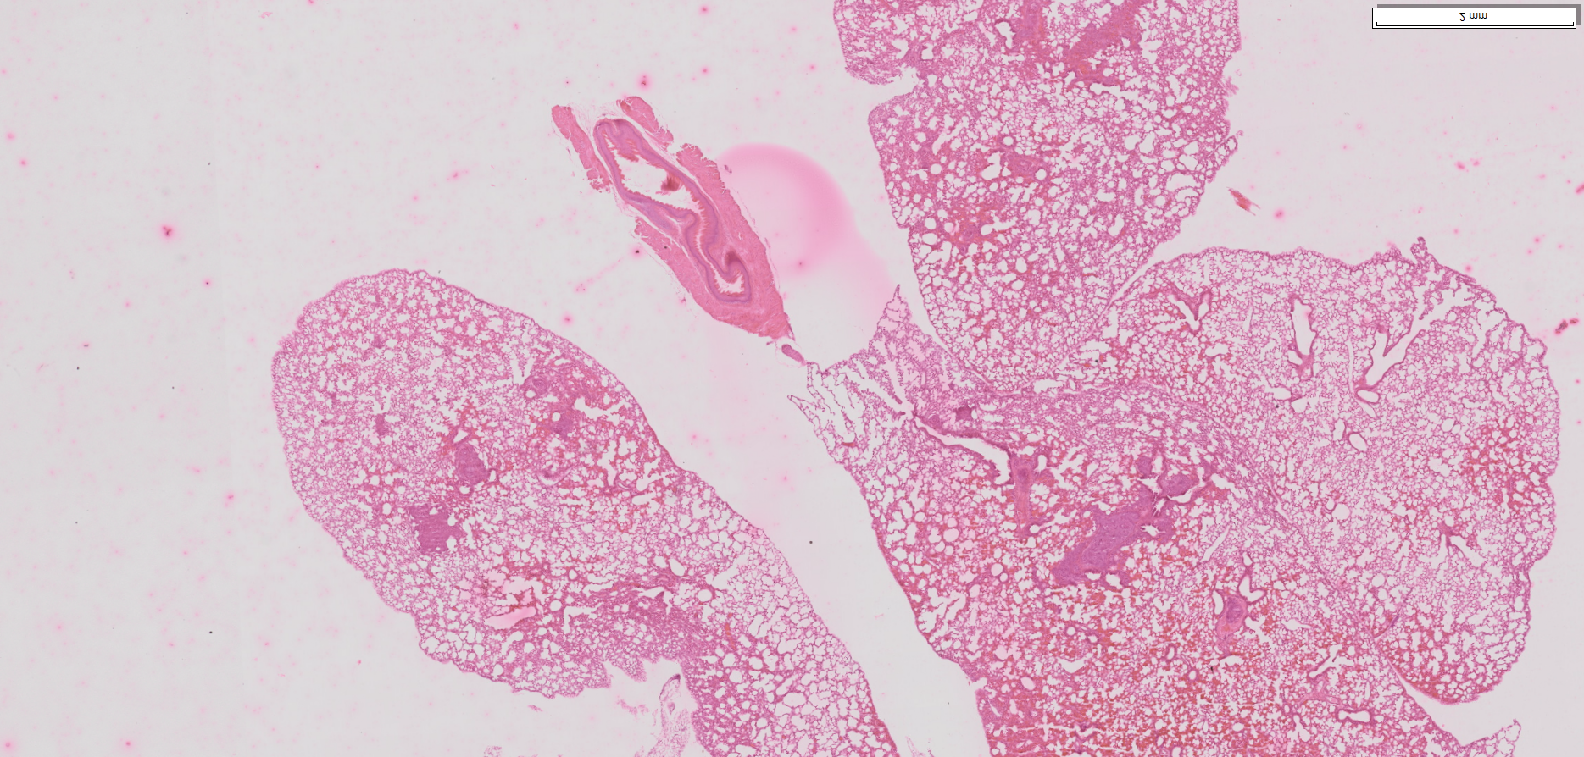
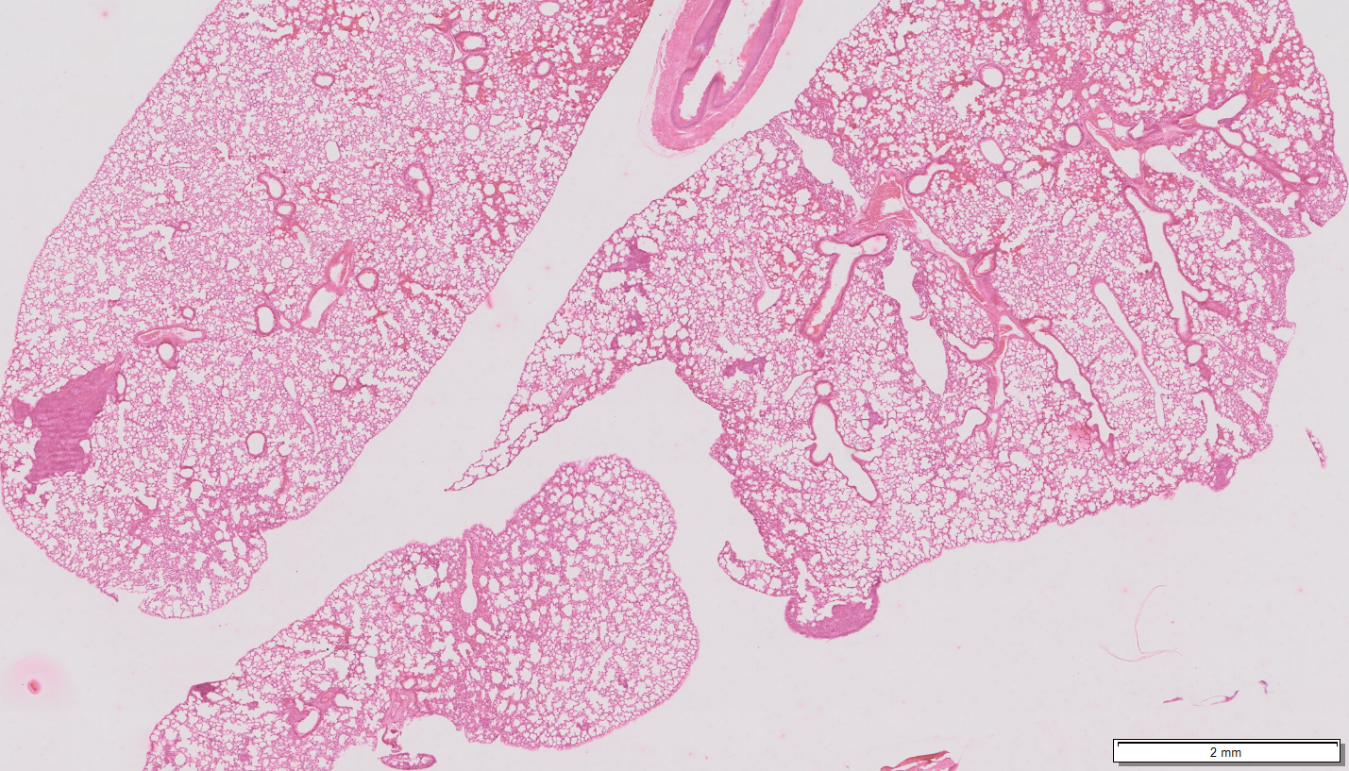
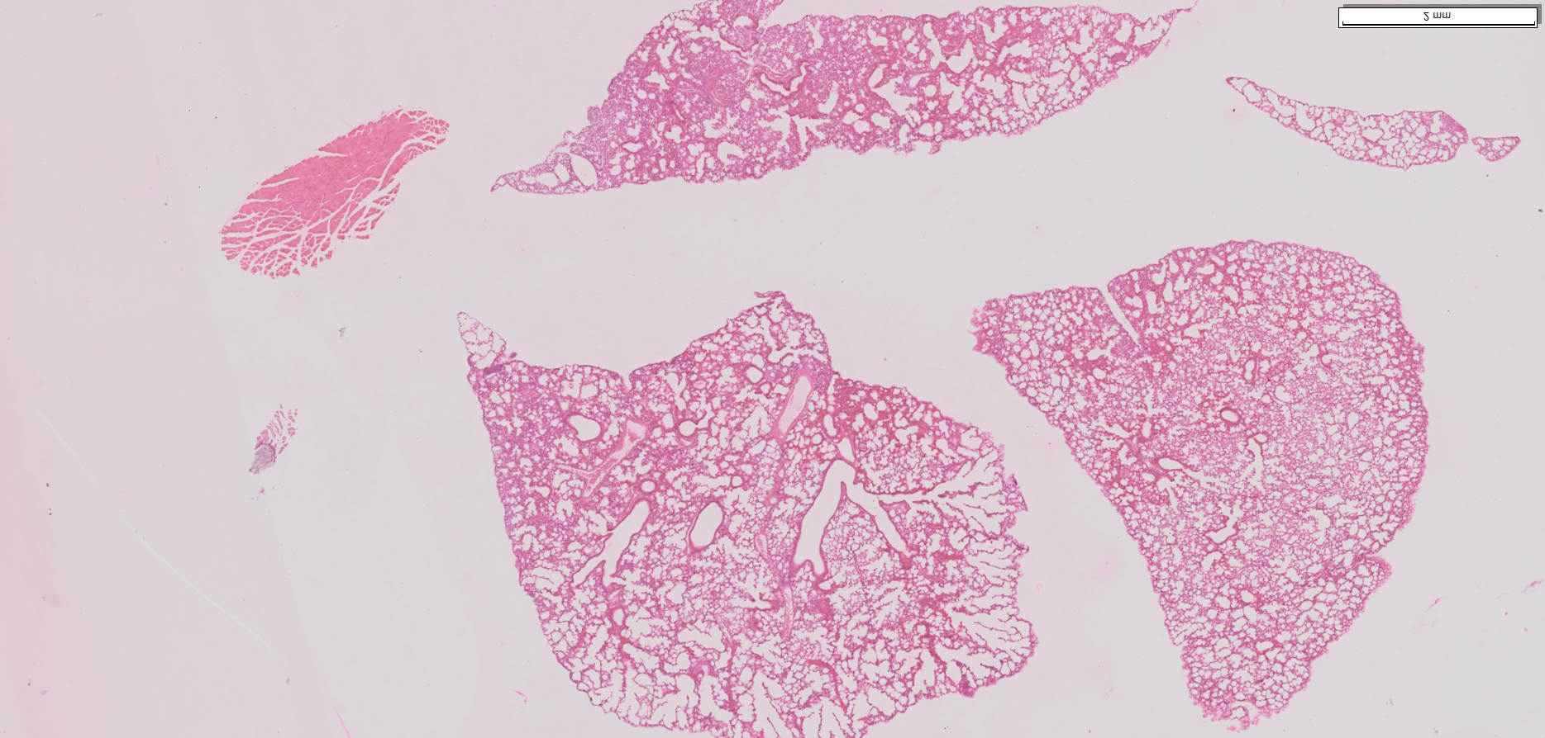
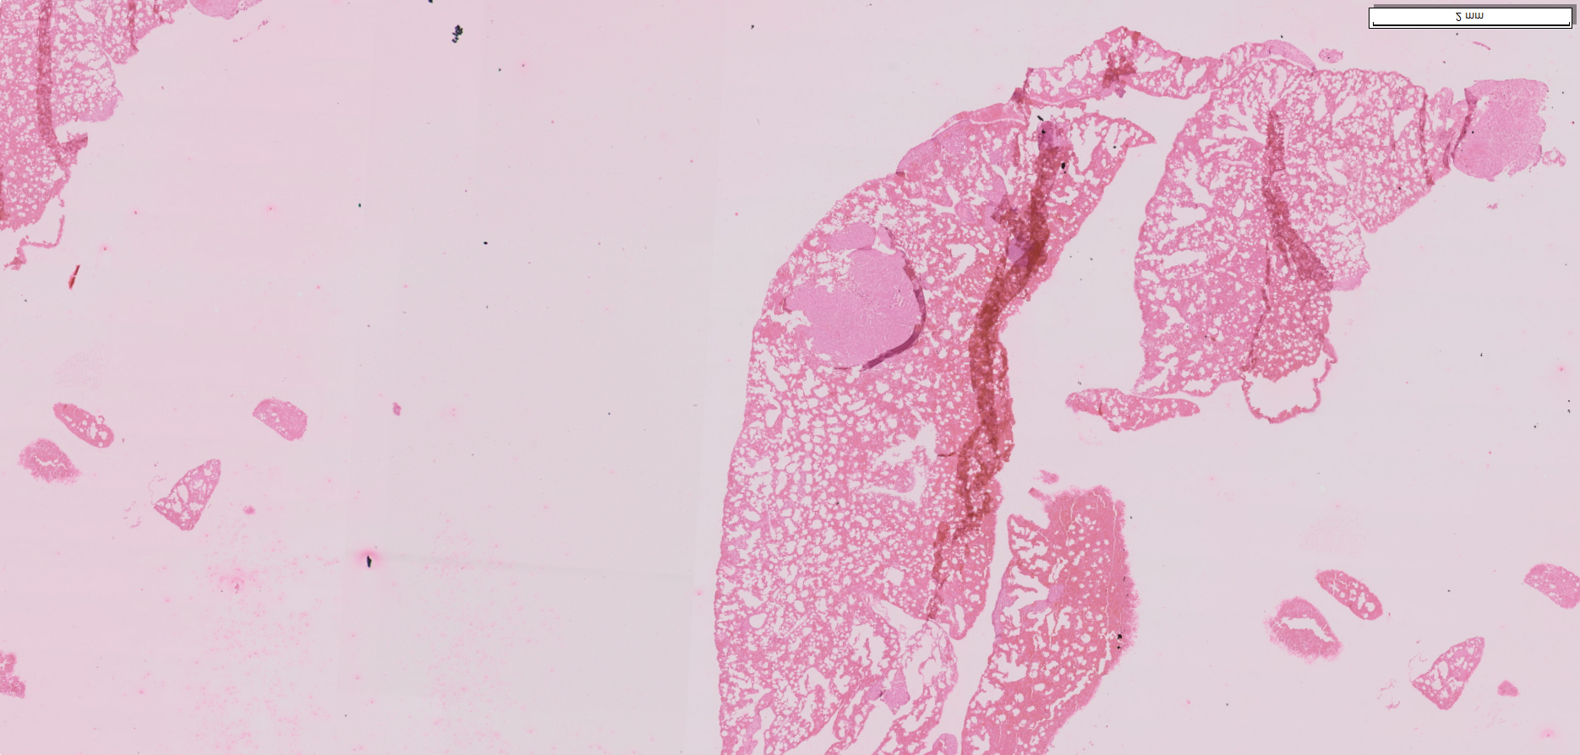
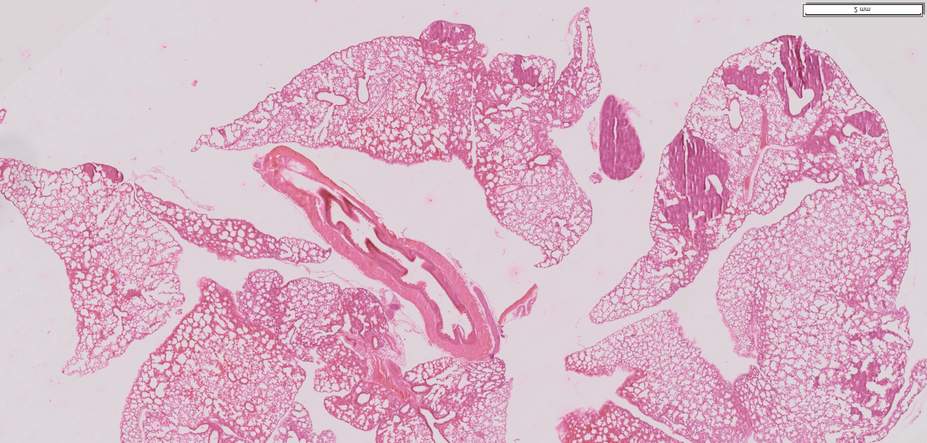
SUPPLEMENTAL FIGURE 6
A
shCYR61
OE-CYR61
M
M
F
F
C
C
T
T
200 µm
50µm
B
Control
2 mm
2 mm
sh-CYR61
2 mm
2 mm
OE-CYR61
2 mm
2 mm

