Slide 1
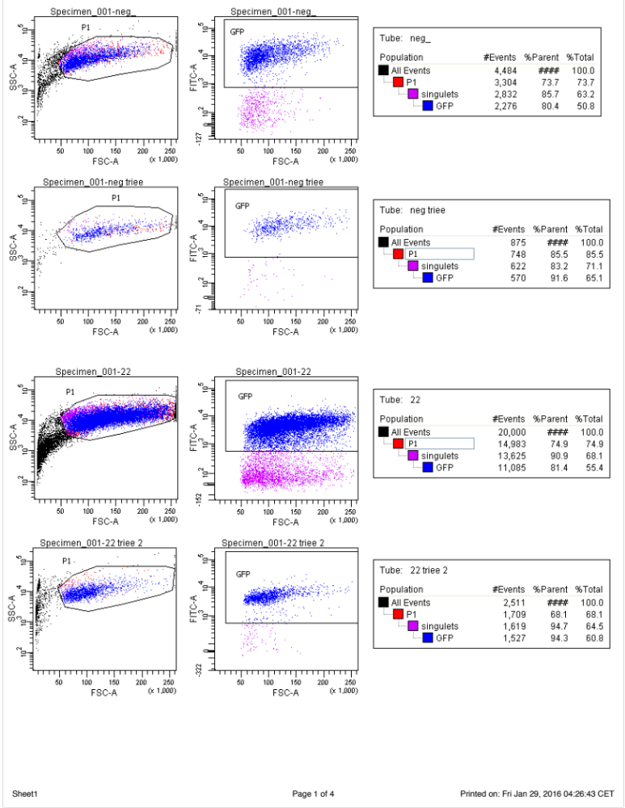
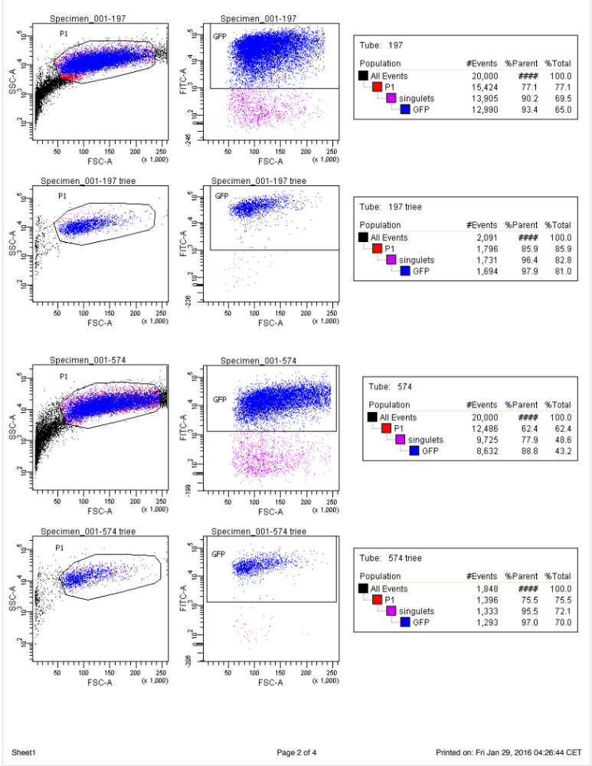
Figure S1. Flow cytometry-based cell sorting gating strategy on U87MG-miR cell lines.

