Slide 1
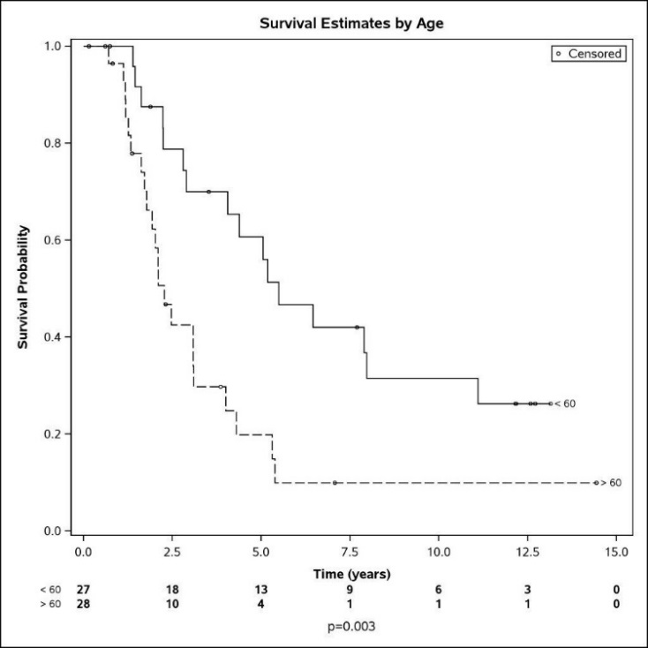
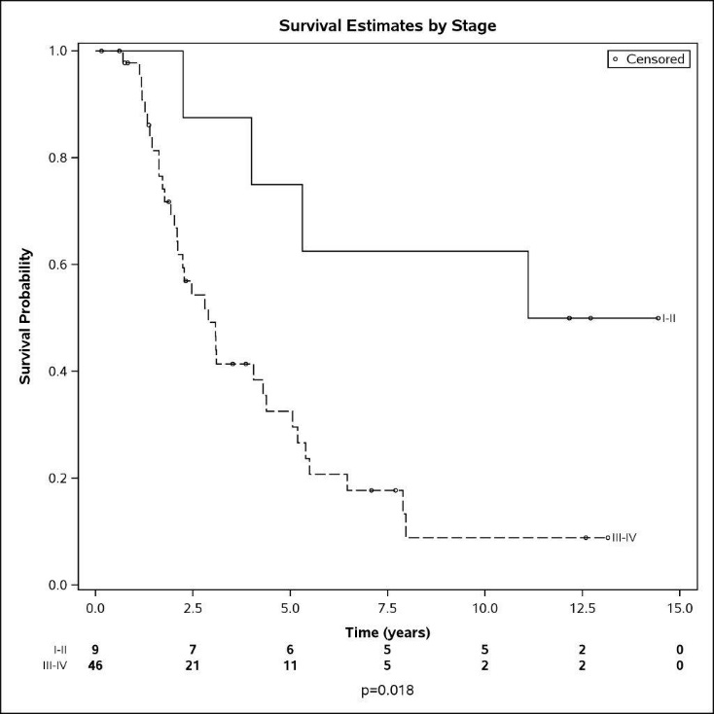
A
B
Additional file 1- Figure S1. Survival Estimates by Patient age and tumor grade. Kaplan Meier survival analysis to estimate overall survival in patients as a function of age (A) or tumor stage (B). Patient survival was displayed visually in Kaplan Meier plots and significance of differences determined with Log Rank tests.

