Slide 1
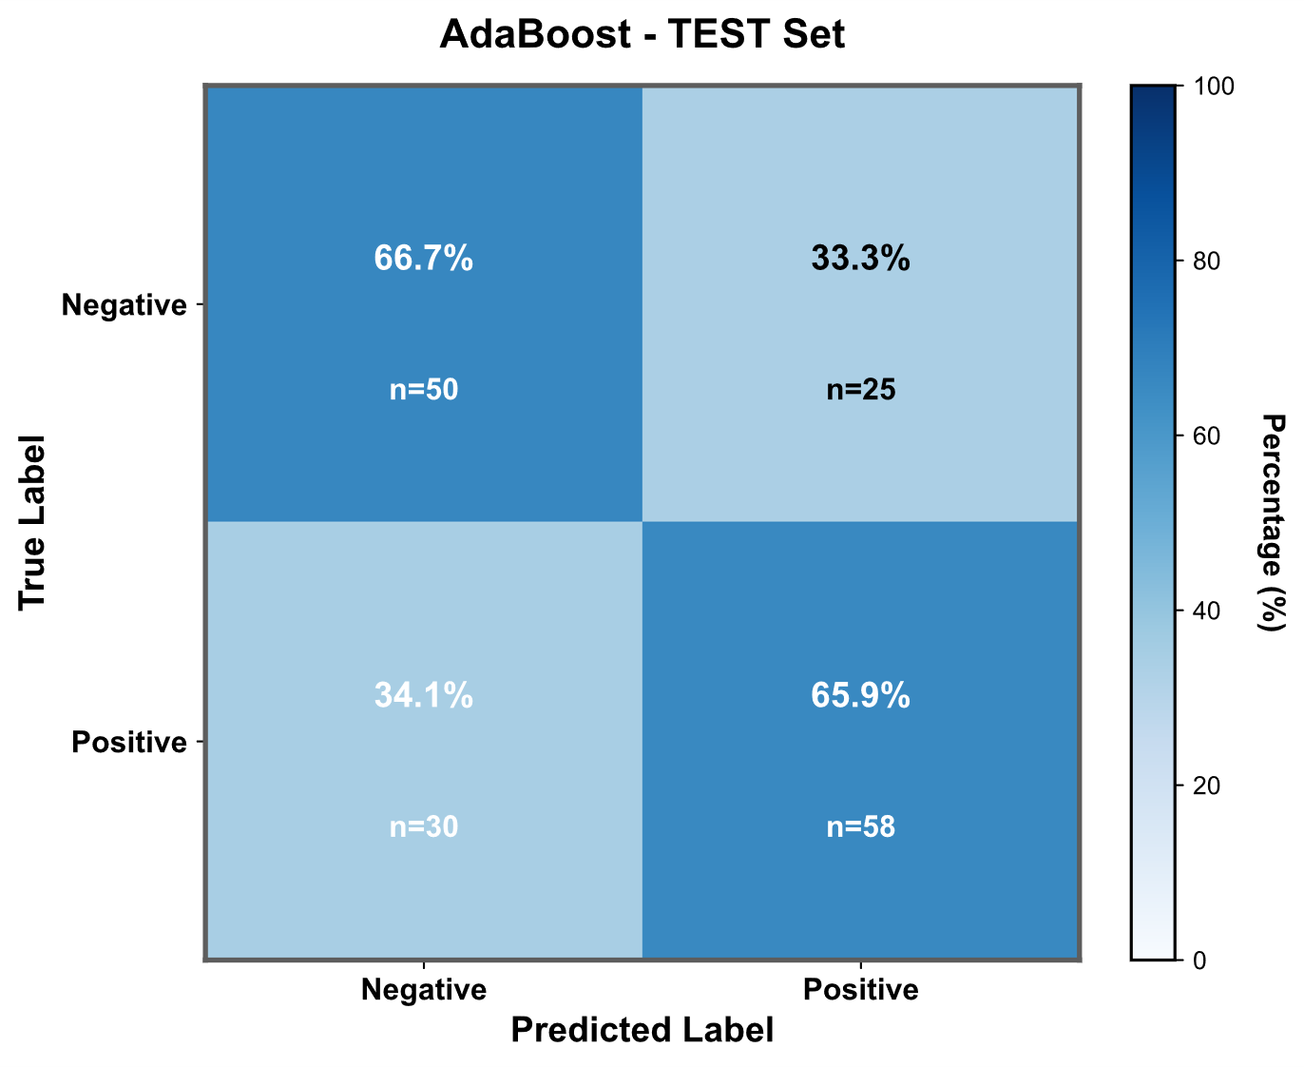
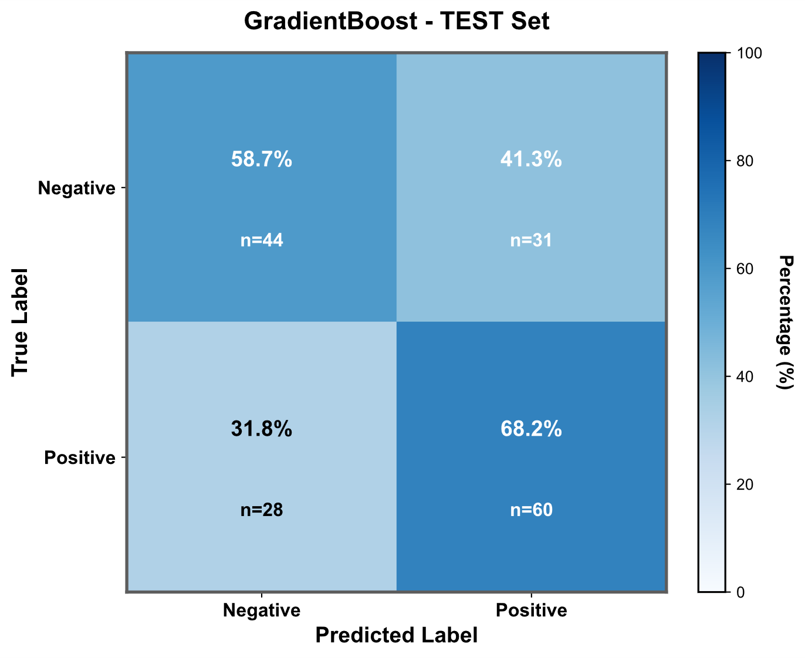
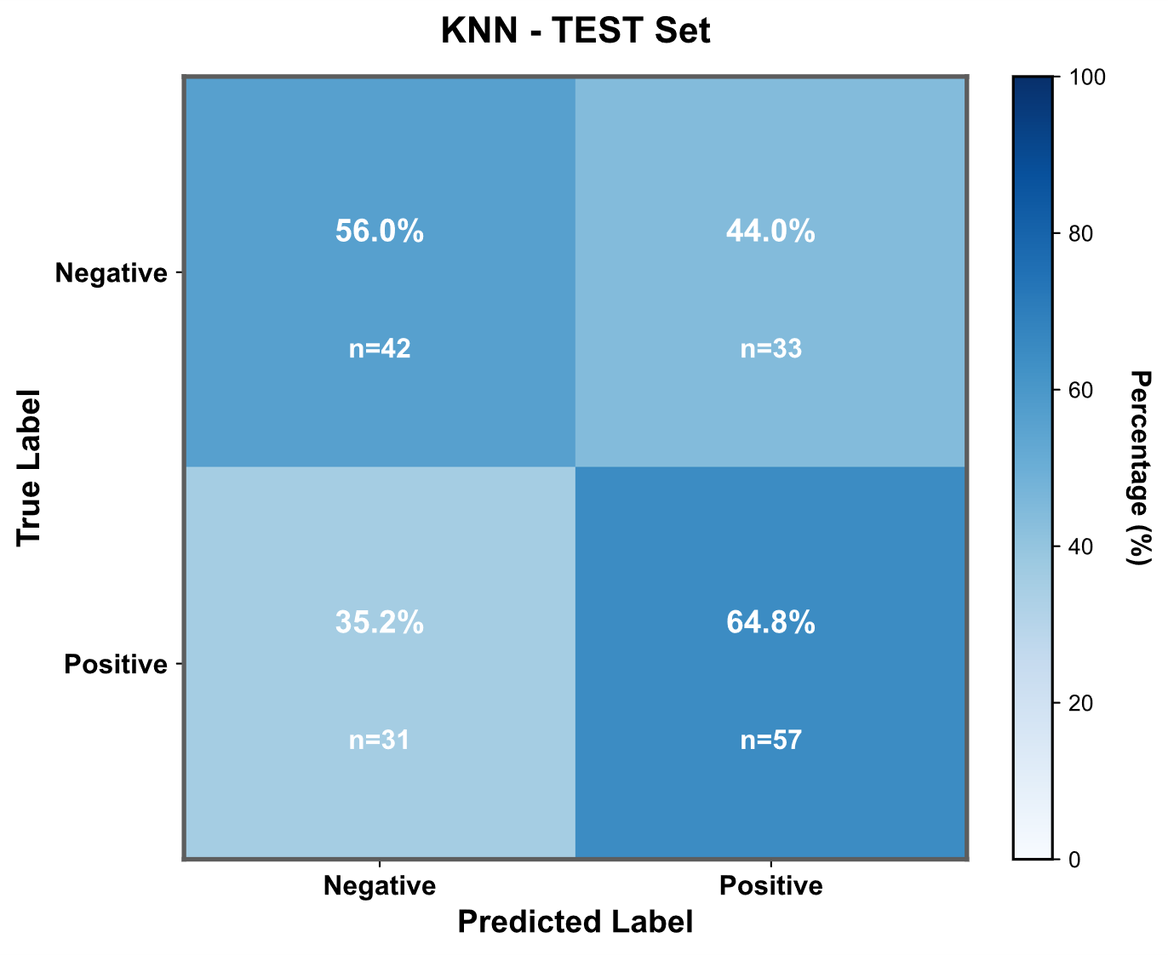
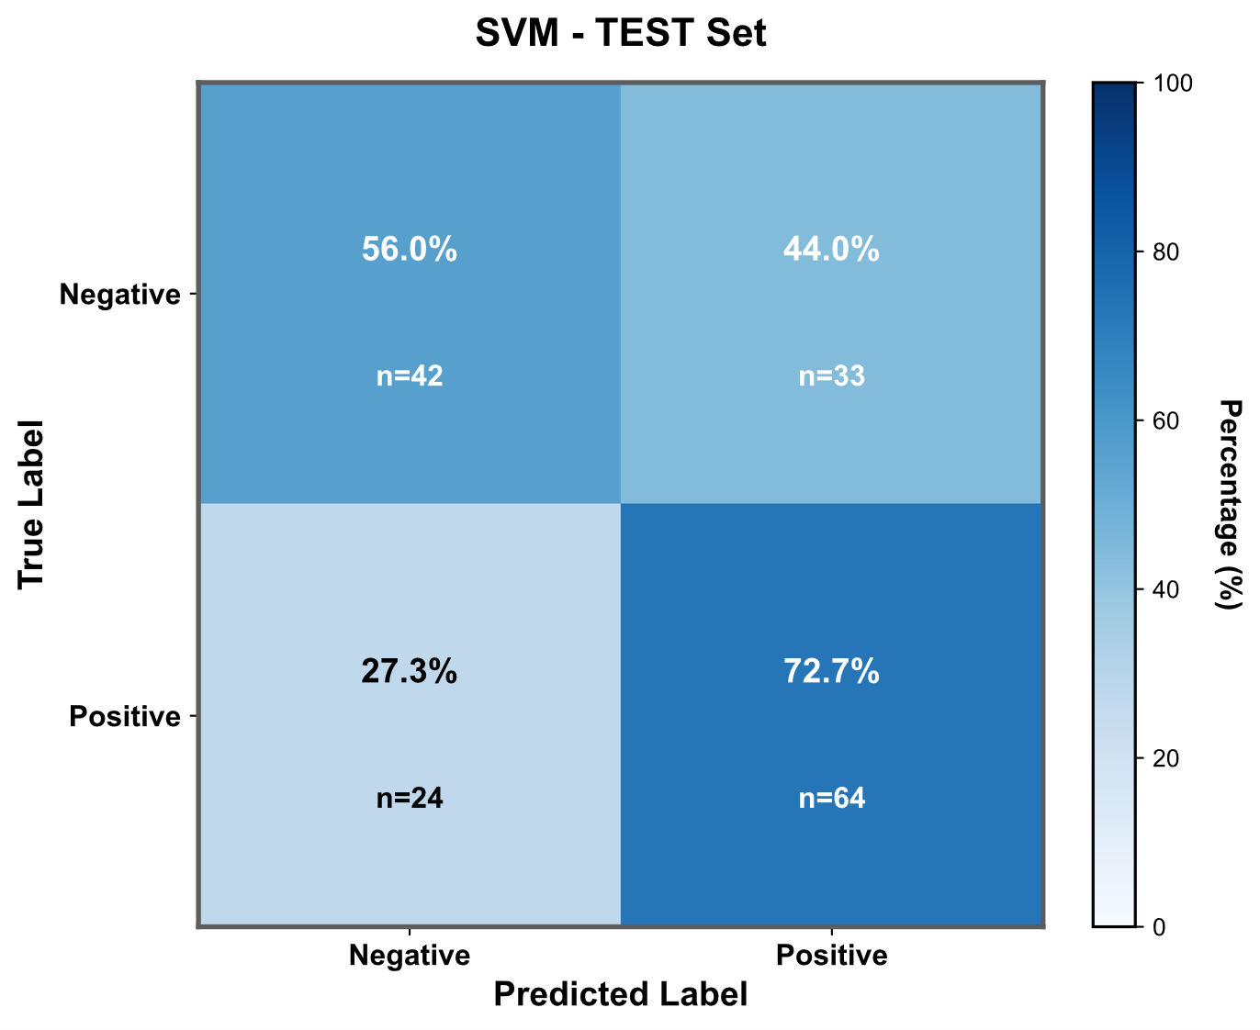

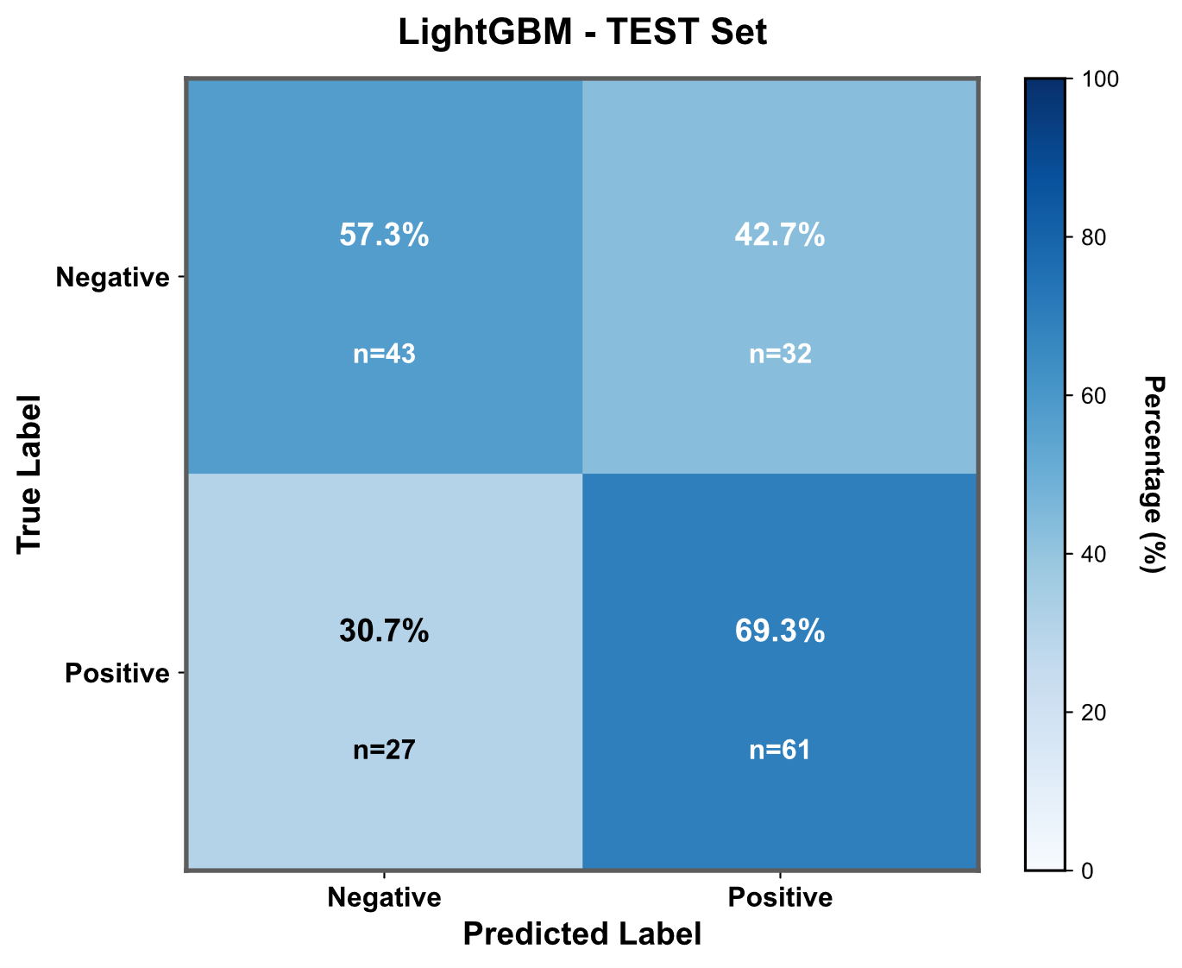
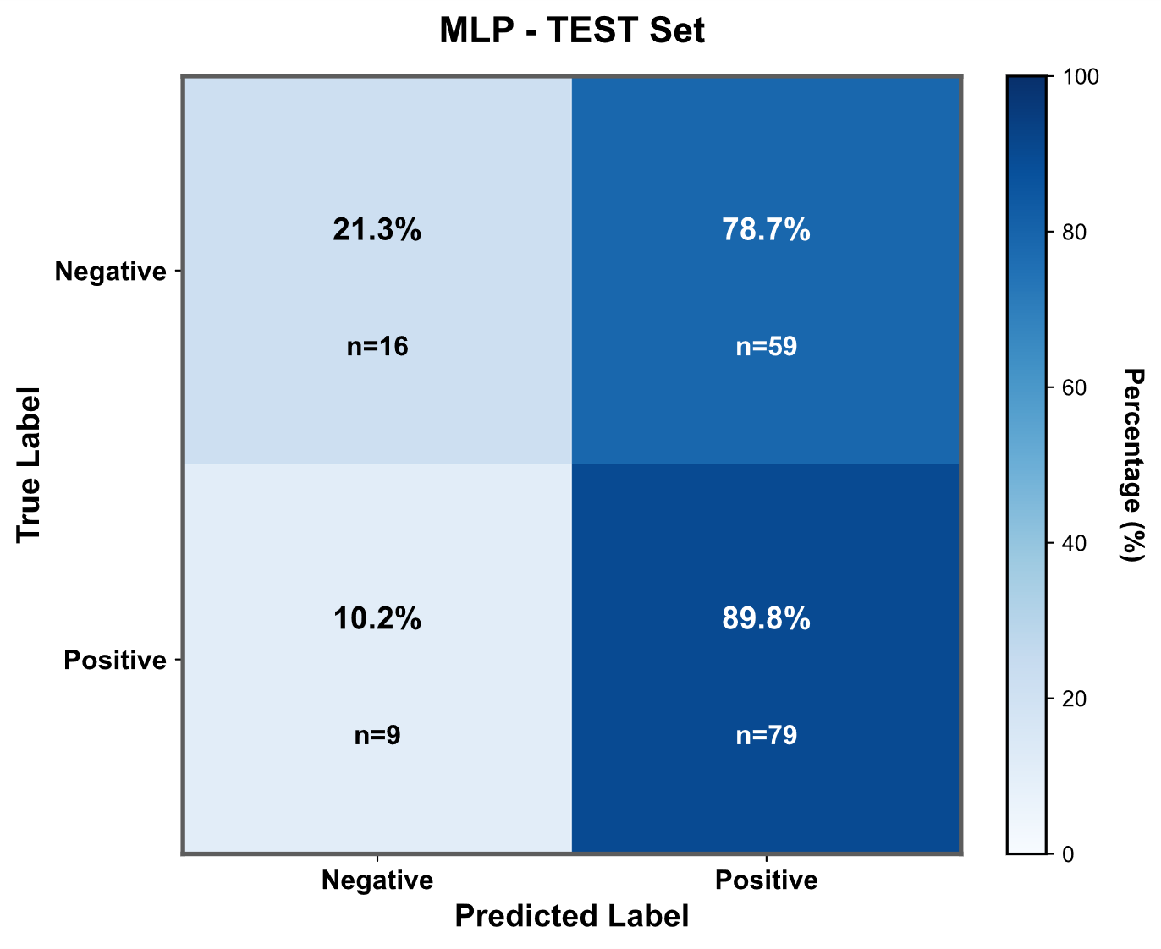
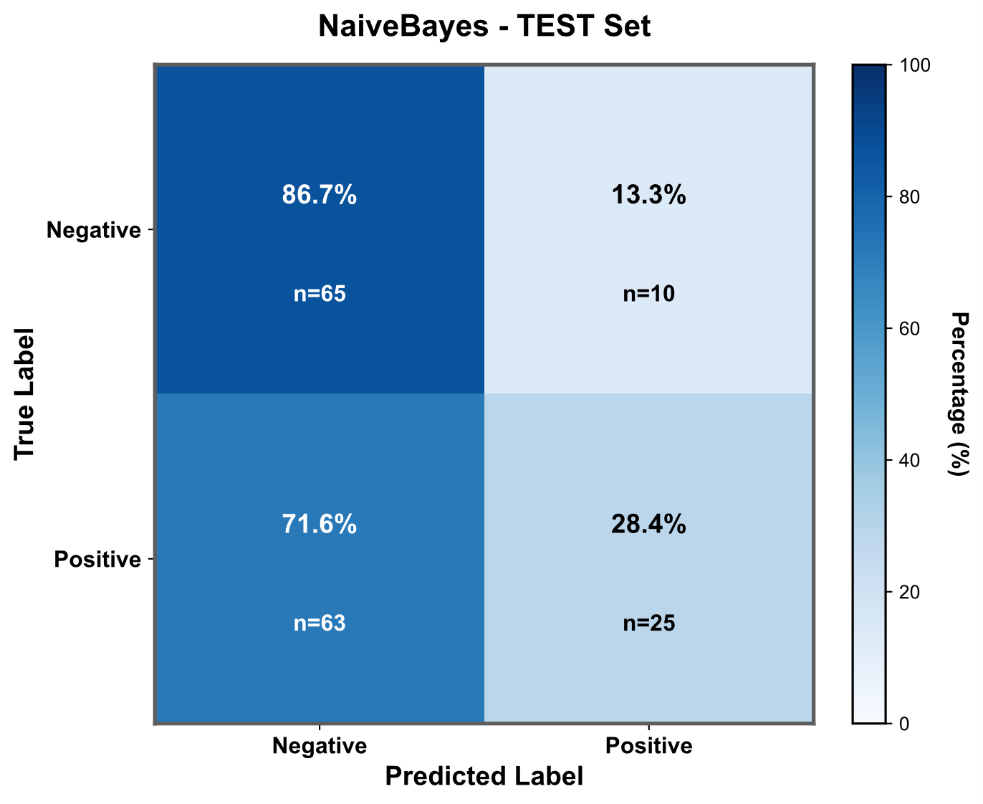
Figure C.2 Model confusion matrix diagram. This graph shows the confusion matrix of the remaining 8 models excluding the top 3 in the test set. The darker the color of the blue area, the higher the value, visualizing the discriminative ability of these 8 models for the outcome. KNN, K-Nearest Neighbors; MLP, Multilayer Perceptron; SVM, Support Vector Machine.

