Slide 1
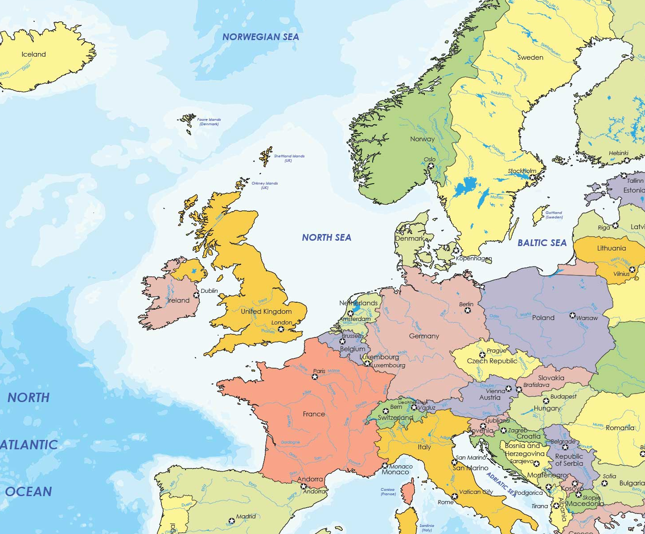




† HEMS invited and participating
‡ HEMS invited but not participating
Patient transfer between European countries to treat COVID-19
Patient transfer between European countries after COVID-19 has been treated
Transfer of COVID-19 patients from outside of Europe
Cross-boder “COVID-19 flights” of participating air ambulance providers and the armed forces of different European countries. The illustration does not claim to be complete.

