Slide 1
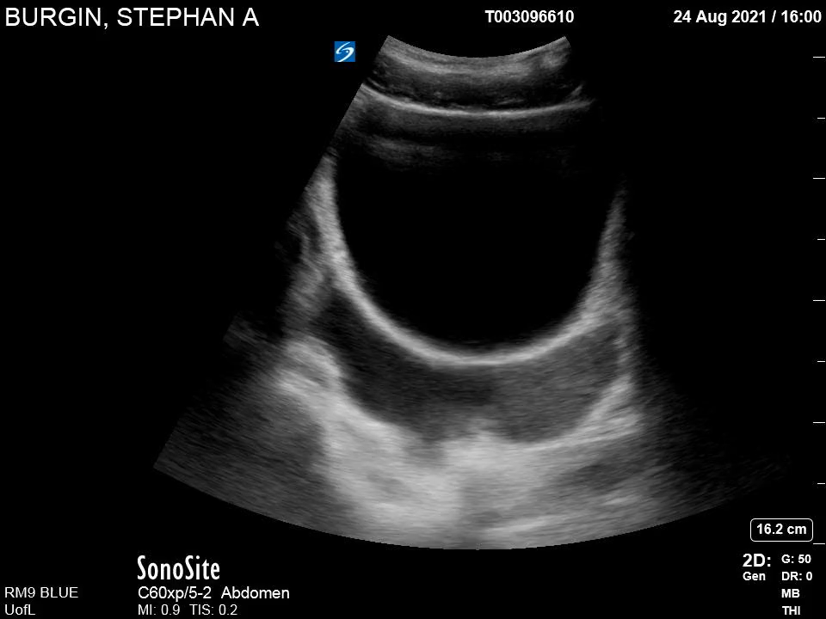
Pelvis Transverse
HP
B

