Slide 1
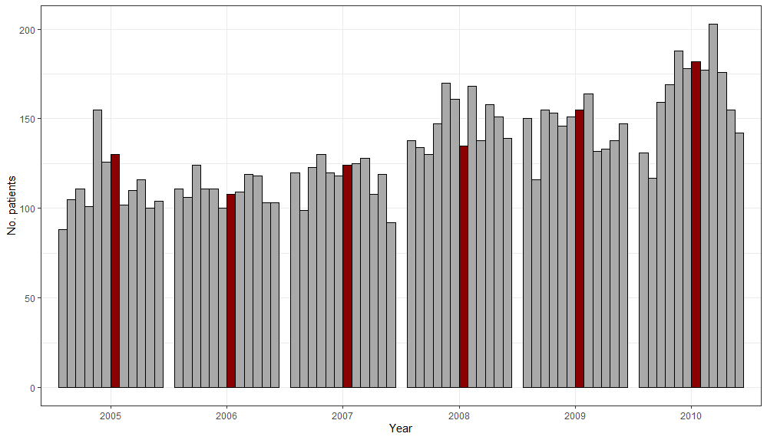
(Figure a) - Number of patients by month, 2005-2010 – July highlighted in red.

Slide 2
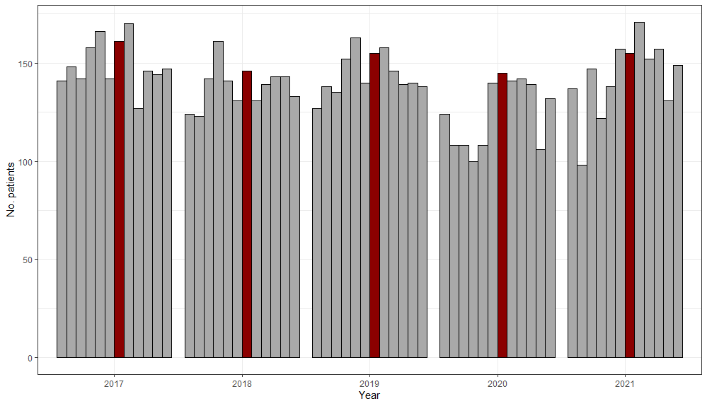
(Figure b) - Number of patients by month, 2017-2021 – July highlighted in red.

Slide 3
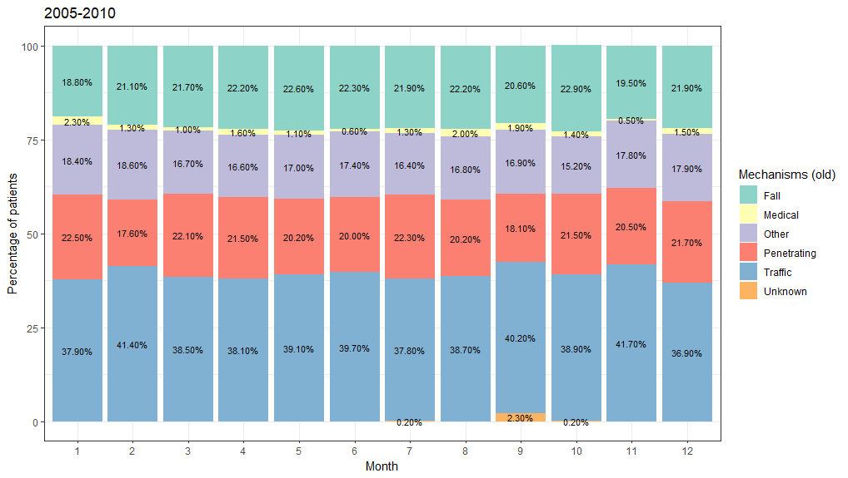
(Figure c) - Mechanism of injury: percentage of patients by month, 2005-2010.
N.B. October, November and December only include 2005-2009, due to incomplete data for 2010.

Slide 4
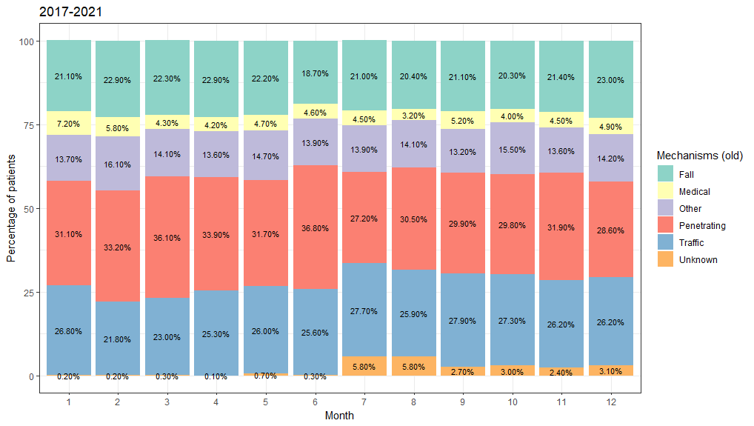
(Figure d) - Mechanism of injury: percentage of patients by month, 2017-2021.
N.B. January and February only include 2018-2021, due to incomplete data for 2017.

