Slide 1
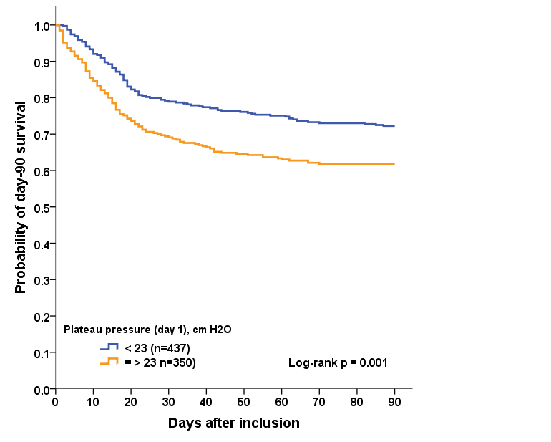
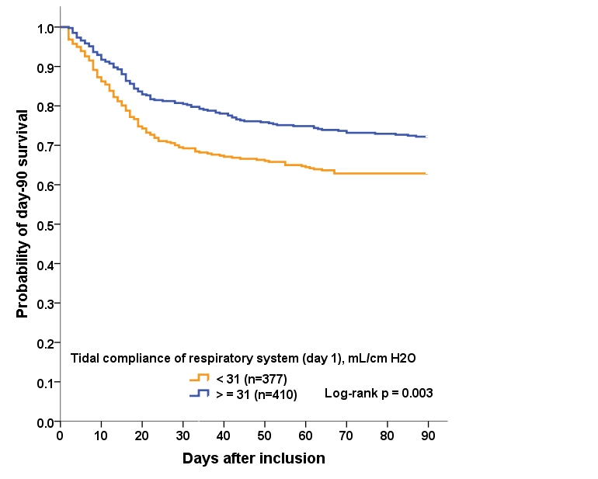
A
Figure S2. Kaplan-Meier graphs of the probability
of survival over 90 days
B

