Slide 1
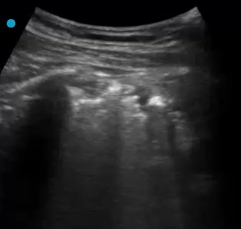
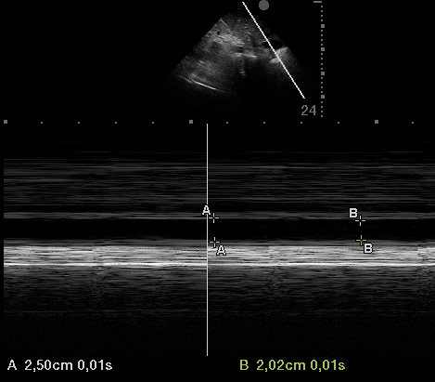
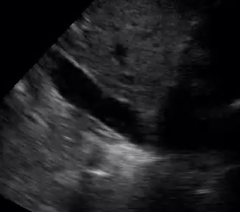
Profile A videos
Lung Ultrasound B-lines
Inferior veina cava collapsibillity negative
Liver
Pleural line
IVC
Right atrium
Rib
Subcostal view
Expiration
Rib
B-lines
Inspiration
IVCCI = 19%
Anterior view

