Slide 1
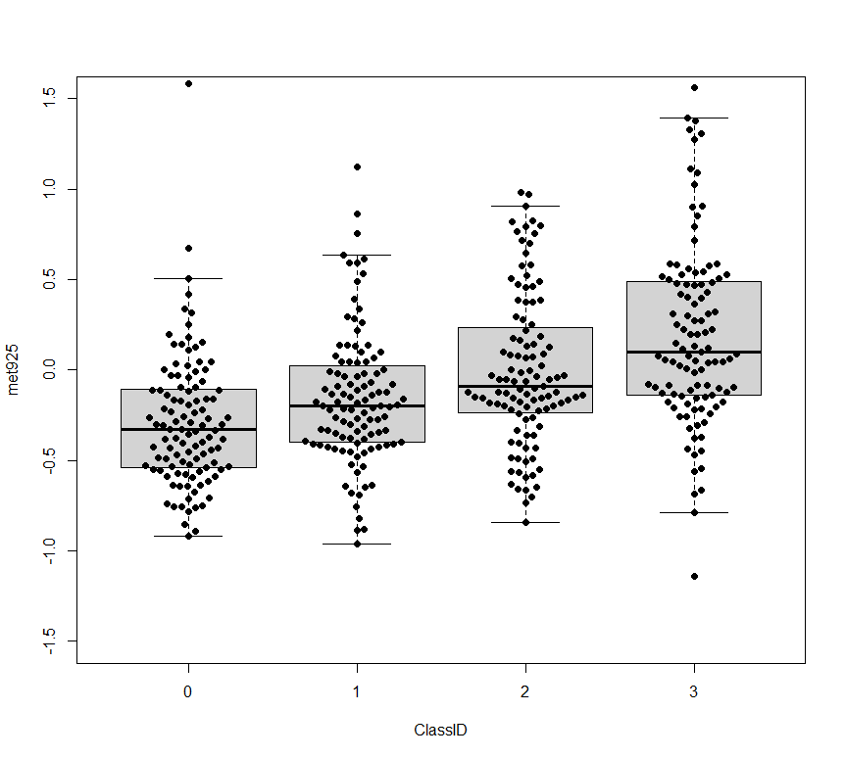
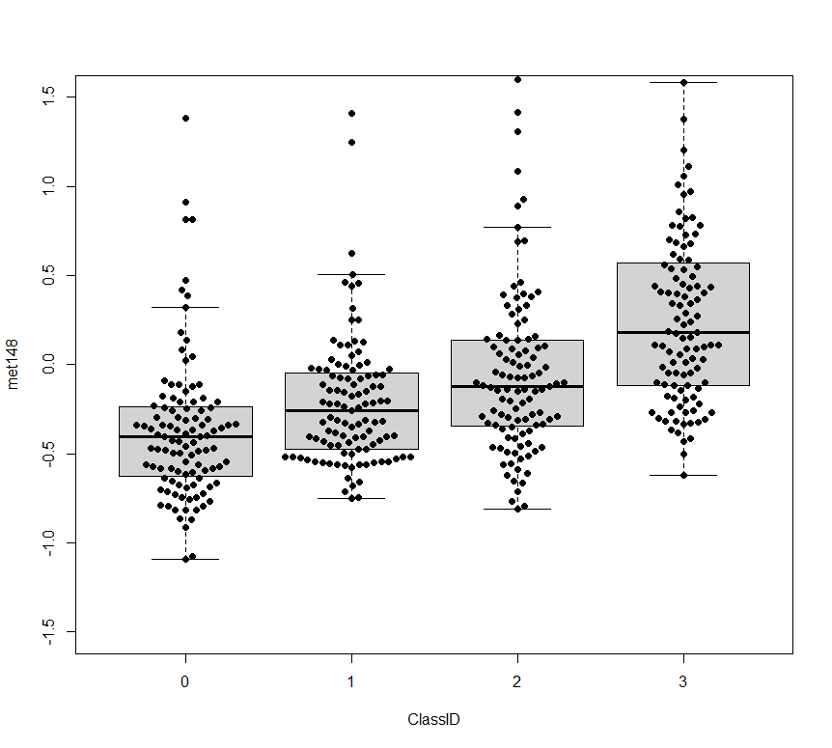
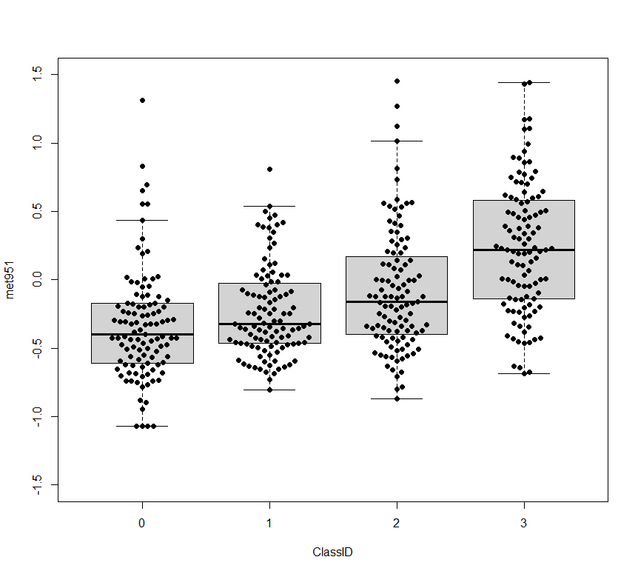
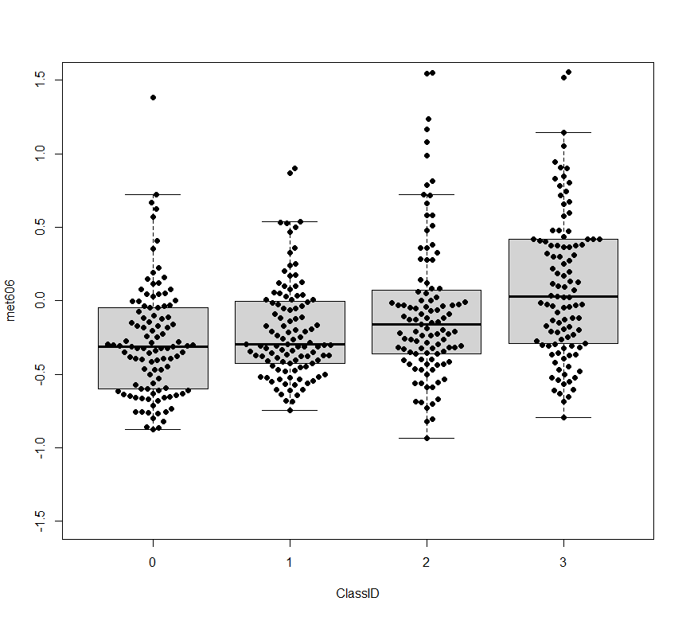
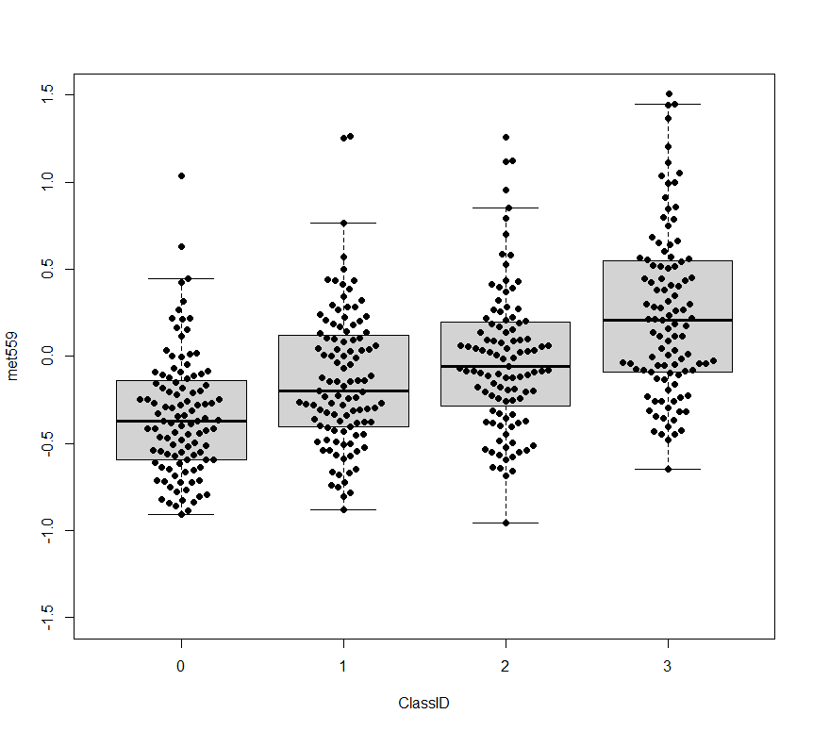
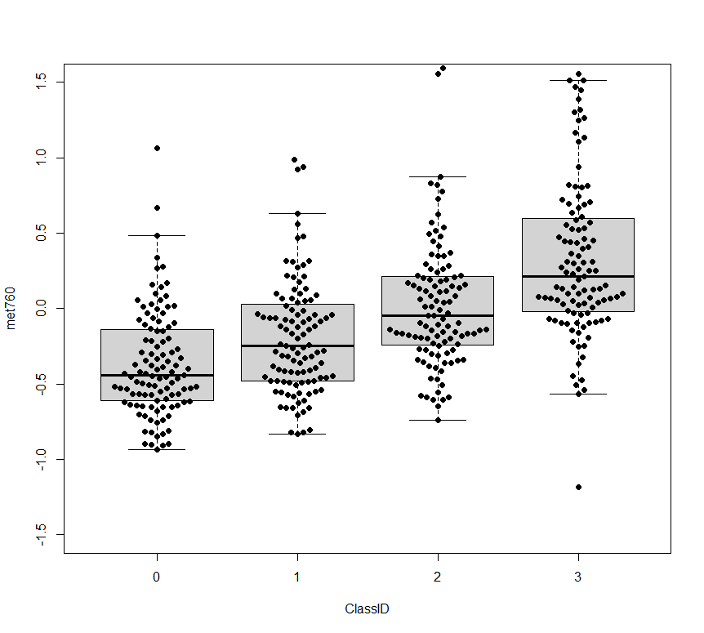
Additional file 5. VITdAL-ICU cohort Day 0 Short Chain Acylcarnitines by N-formylmethionine quartiles
succinylcarnitine (C4)
2-methylbutyroylcarnitine (C5)
Relative Abundance
Relative Abundance
Q1 Q2 Q3 Q4 Q1 Q2 Q3 Q4
N-formylmethioninie Quartile N-formylmethioninie Quartile
tiglyl carnitine (C5)
isovalerylcarnitine (C5)
Relative Abundance
Relative Abundance
Q1 Q2 Q3 Q4 Q1 Q2 Q3 Q4
N-formylmethioninie Quartile N-formylmethioninie Quartile
hexanoylcarnitine (C6)
octanoylcarnitine (C8)
Relative Abundance
Relative Abundance
Q1 Q2 Q3 Q4 Q1 Q2 Q3 Q4
N-formylmethioninie Quartile N-formylmethioninie Quartile

Slide 2
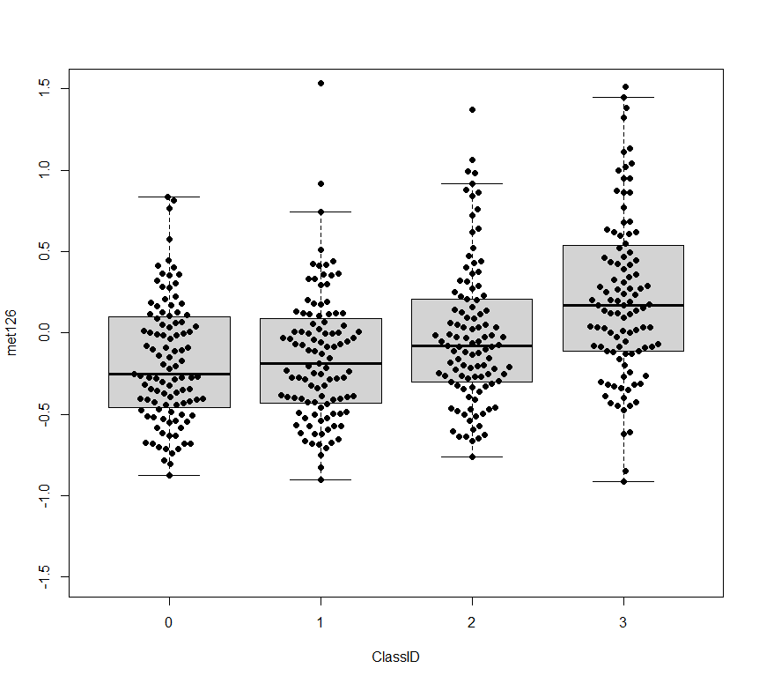
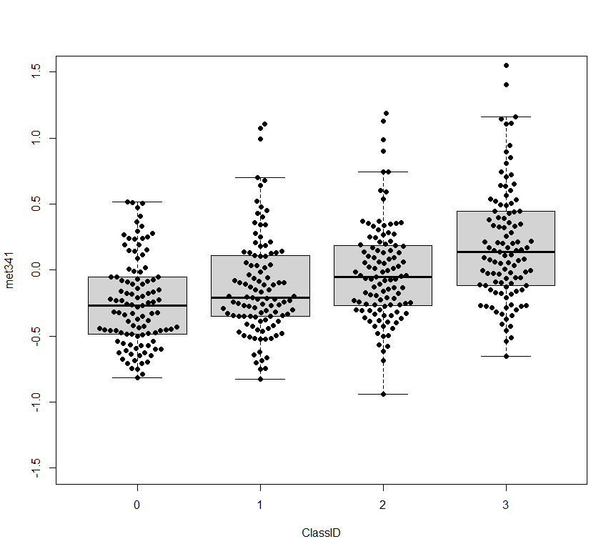
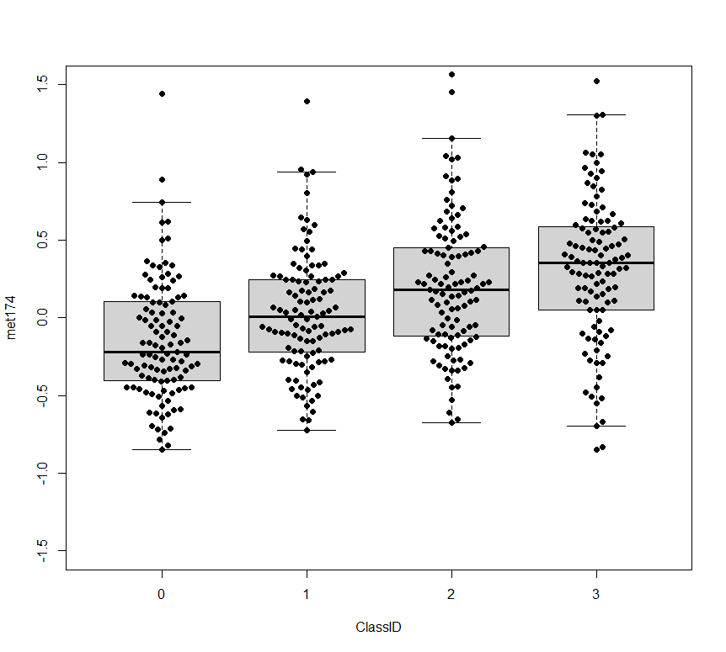
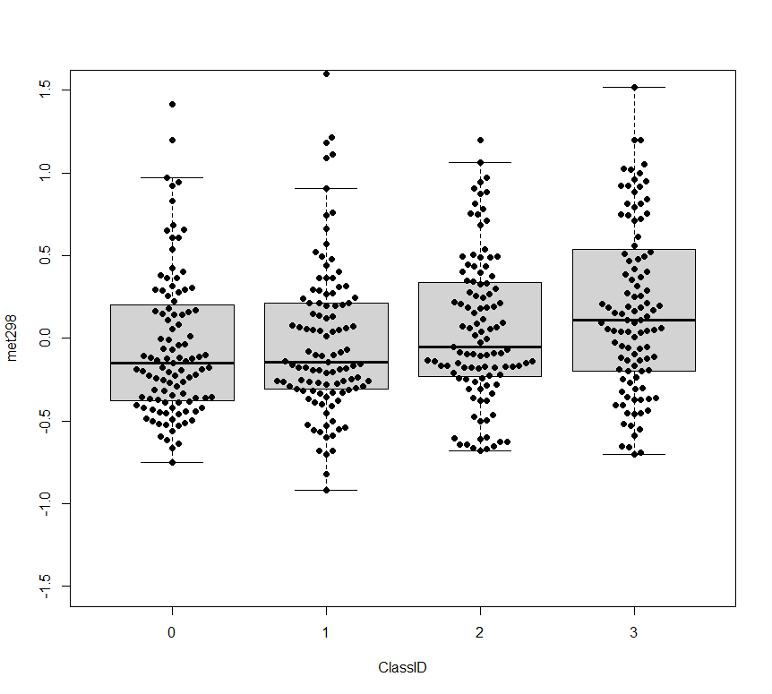
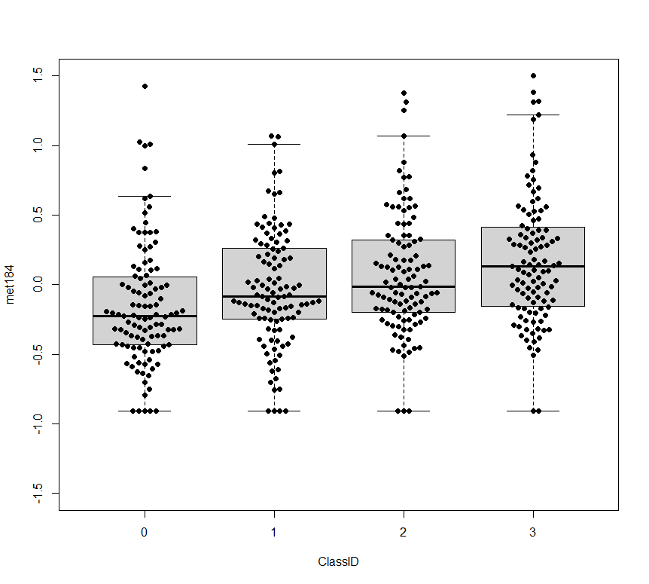
Additional file 5. (Continued) VITdAL-ICU cohort Day 0 BCAA Metabolism by N-formylmethionine quartiles
2-hydroxy-3-methylvalerate
beta-hydroxyisovalerate
Relative Abundance
Relative Abundance
Relative Abundance
Q1 Q2 Q3 Q4 Q1 Q2 Q3 Q4
N-formylmethioninie Quartile N-formylmethioninie Quartile
3-hydroxy-2-ethylpropionate
alpha-hydroxyisovalerate
Relative Abundance
Relative Abundance
Q1 Q2 Q3 Q4 Q1 Q2 Q3 Q4
N-formylmethioninie Quartile N-formylmethioninie Quartile
2-hydroxy-3-methylvalerate
Relative Abundance
2
Q1 Q2 Q3 Q4 Q1 Q2 Q3 Q4
N-formylmethioninie Quartile N-formylmethioninie Quartile

Slide 3
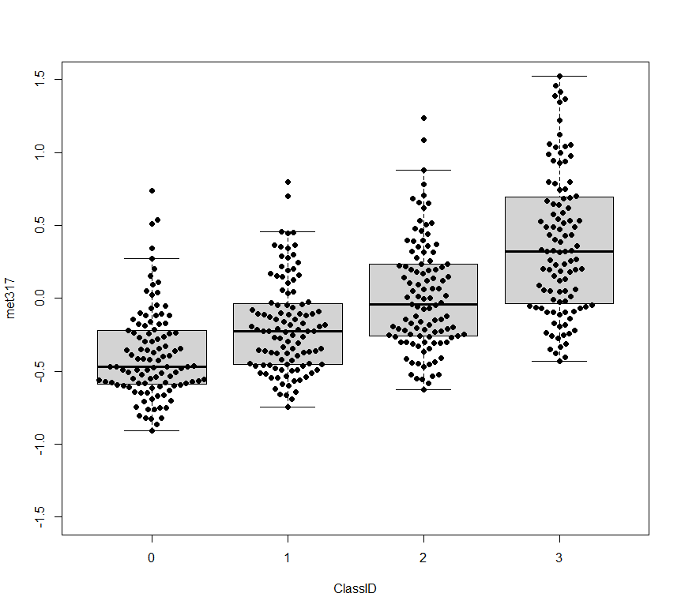
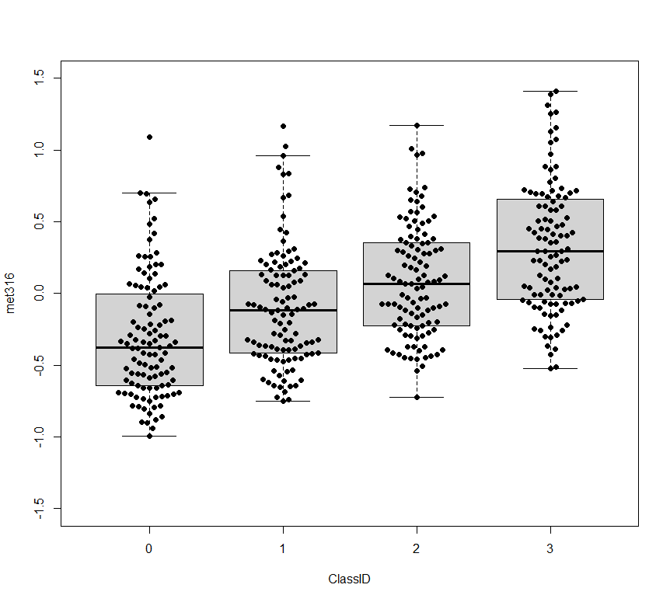
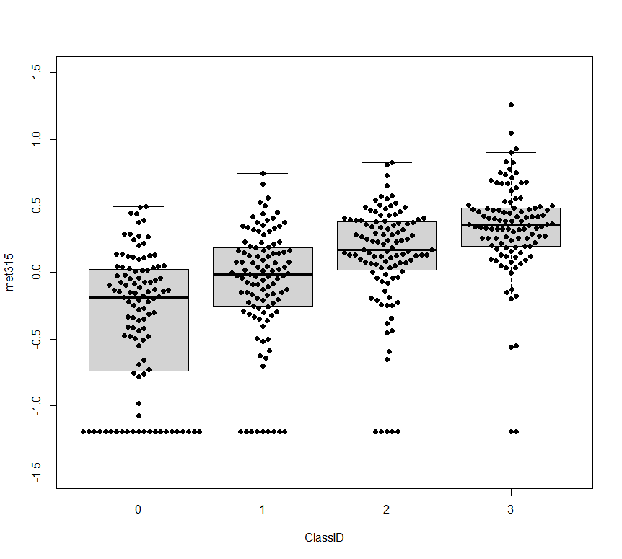
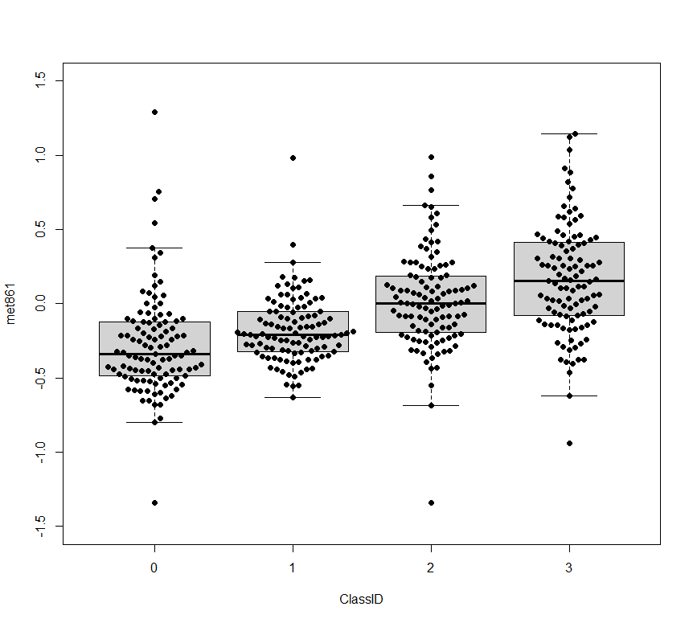
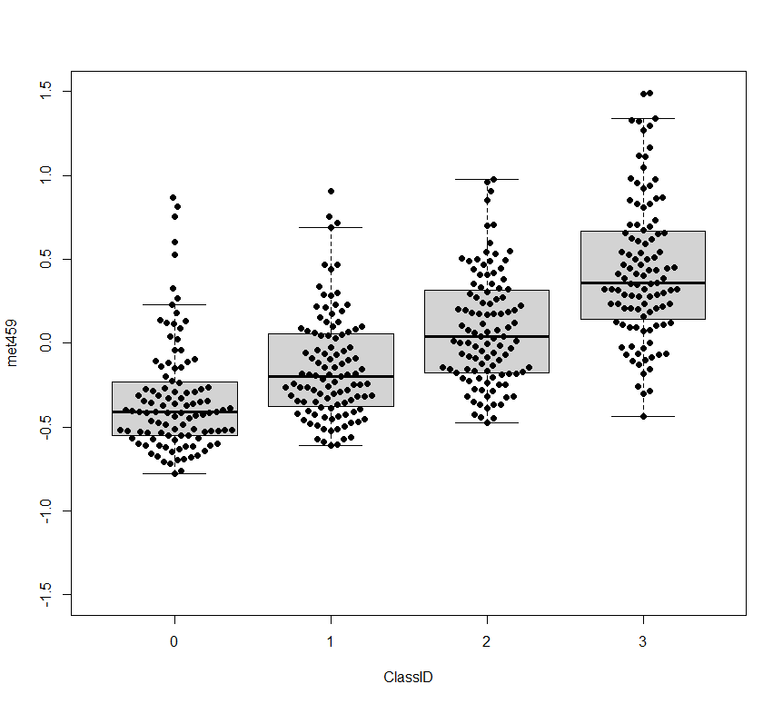
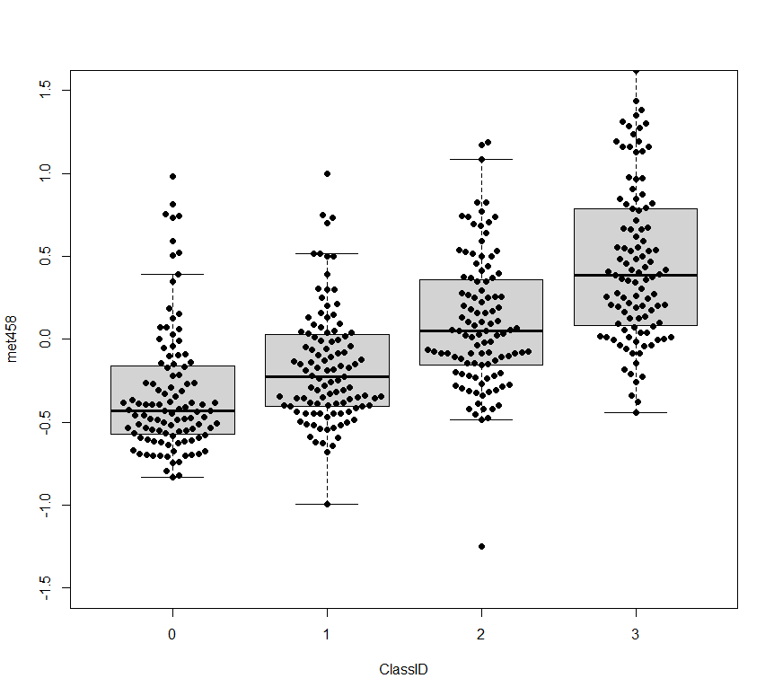
Additional file 5. (Continued) VITdAL-ICU cohort Day 0 Pentose Phosphate Pathway Metabolism by N-formylmethionine quartiles
arabonate/xylonate
arabitol
Relative Abundance
Relative Abundance
Relative Abundance
Q1 Q2 Q3 Q4 Q1 Q2 Q3 Q4
N-formylmethioninie Quartile N-formylmethioninie Quartile
arabinose
ribitol
Relative Abundance
Relative Abundance
Q1 Q2 Q3 Q4 Q1 Q2 Q3 Q4
N-formylmethioninie Quartile N-formylmethioninie Quartile
erythronate
erythritol
Relative Abundance
Relative Abundance
Q1 Q2 Q3 Q4 Q1 Q2 Q3 Q4
N-formylmethioninie Quartile N-formylmethioninie Quartile

Slide 4
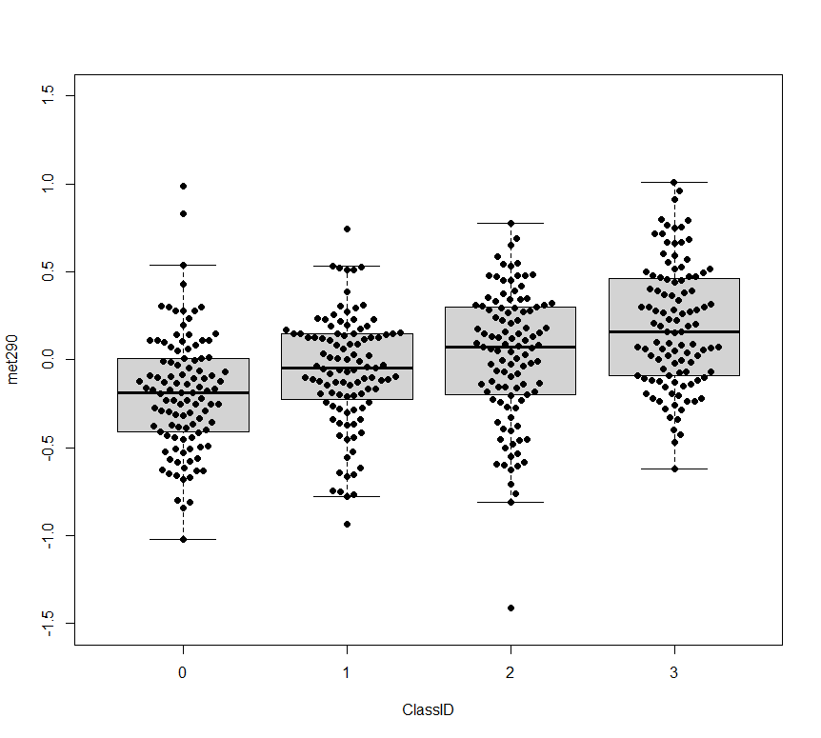
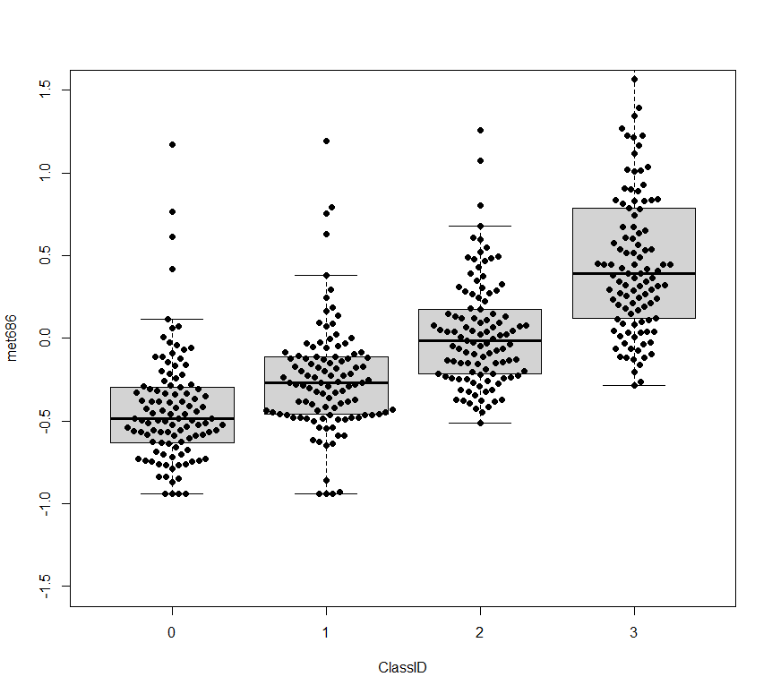
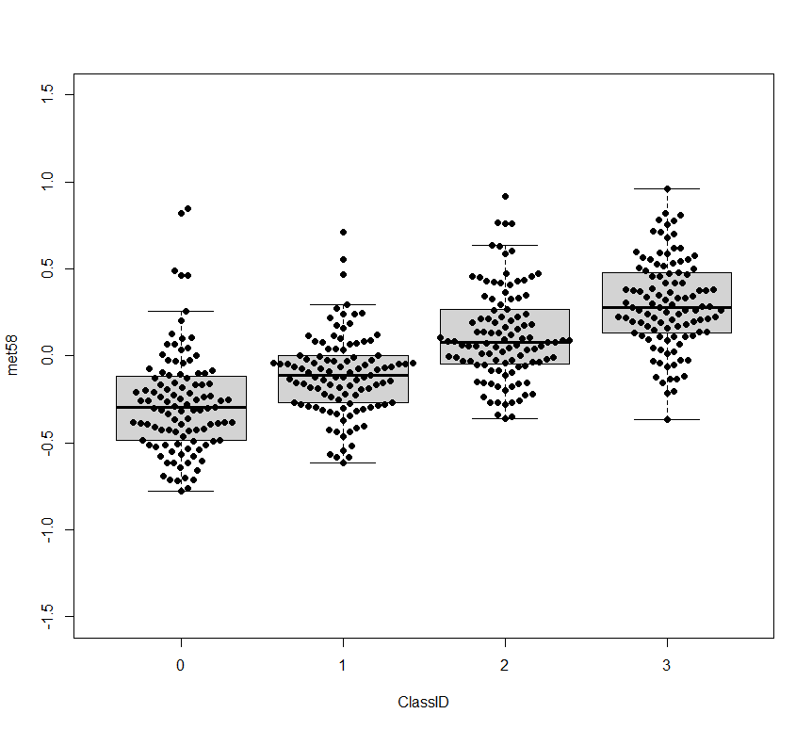
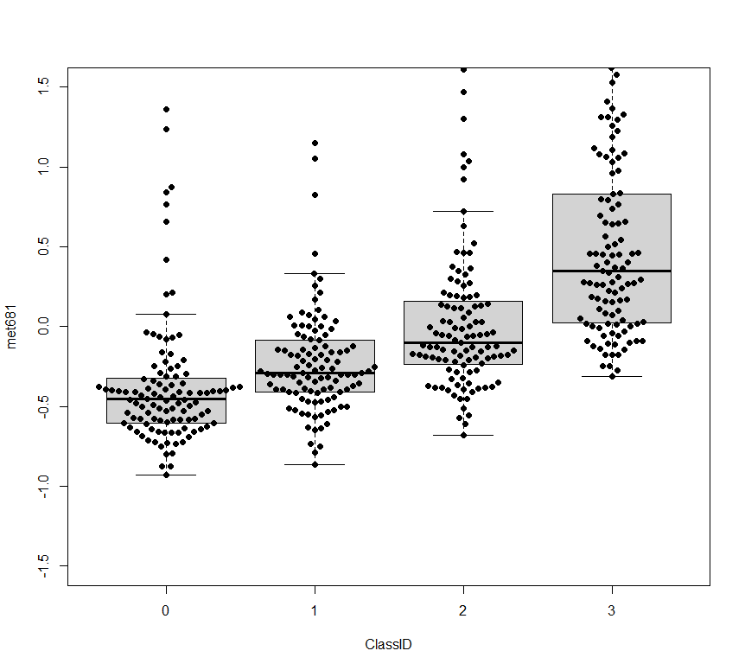
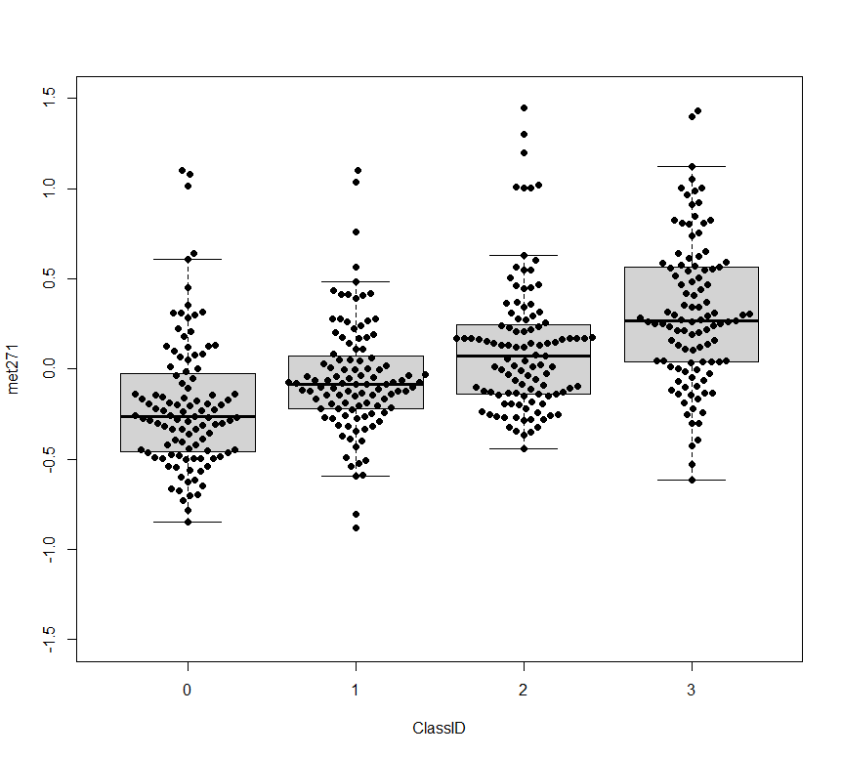
Additional file 5. (Continued) VITdAL-ICU cohort Day 0 Purine Metabolism by N-formylmethionine quartiles
allantoin
N6-carbamoylthreonyladenosine
Relative Abundance
Relative Abundance
Q1 Q2 Q3 Q4 Q1 Q2 Q3 Q4
N-formylmethioninie Quartile N-formylmethioninie Quartile
1-methyladenosine
N2,N2-dimethylguanosine
Relative Abundance
Relative Abundance
Q1 Q2 Q3 Q4 Q1 Q2 Q3 Q4
N-formylmethioninie Quartile N-formylmethioninie Quartile
7-methylguanine
Relative Abundance
Q1 Q2 Q3 Q4 Q1 Q2 Q3 Q4
N-formylmethioninie Quartile N-formylmethioninie Quartile

