Slide 1
Supplementary figures E1-E9

Slide 2
Figure e1
12,906 patients
4,499 patients with AHRF
2,813 patients with ARDS within 48 hours
2,377 patients undergoing IMV
CKD n=244
Transfer from other ICU n=149
Missing creatinine data n=59
1,957 patients with outcome
No AKI n=1084
Stage 1 AKI n=319
Stage 2 AKI n=194
Stage 3 AKI n=360
Notes:
Figure e1. Flow chart for outcome analysis for LUNG-SAFE study. AKI=acute kidney injury; CKD=chronic kidney disease; MV=mechanical ventilation.

Slide 3
Figure e2
18,964 patients
8,852 not on MV
10,112 patients on MV
2,239 transferred in on MV
7,873 patients first MV day available
2,714 missing outcome
5,159 patients with outcome
2,512 missing dates
2,647 patients with outcome and date
635 unconfirmed ARDS
2,012 patients with confirmed ARDS
27 missing AKI data
1,985 patients with AKI data
58 with miscoded dates
1,927 patients for analysis
Notes:
Figure e2. Flow chart for outcome analysis including chronic kidney disease (CKD). AKI=acute kidney injury; CKD=chronic kidney disease; MV=mechanical ventilation.

Slide 4
Figure e3
Notes:
Figure e3: Kaplan Meier plot of 28-day hospital survival and AKI stage (including CKD)

Slide 5
Figure e4
Notes:
Figure e4: Kaplan Meier plot of 90-day hospital survival and AKI stage (including CKD)

Slide 6
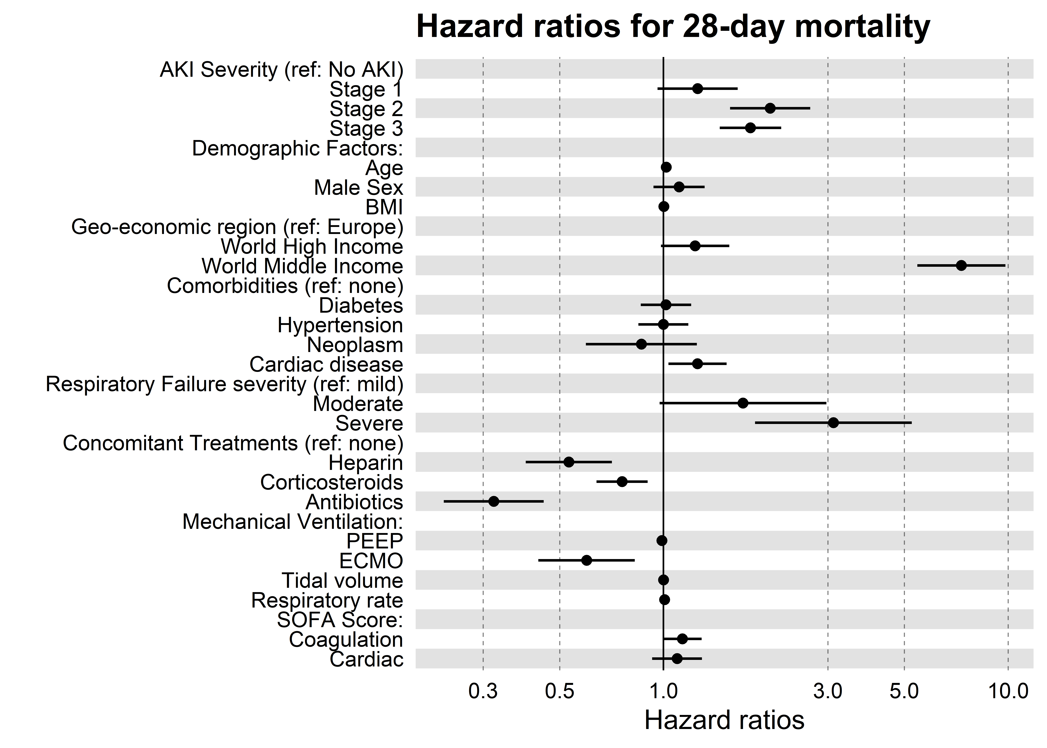
Figure e5
Notes:
Figure e5. Hazard ratio plots for 28-day ICU mortality against AKI stage (including CKD patients)

Slide 7
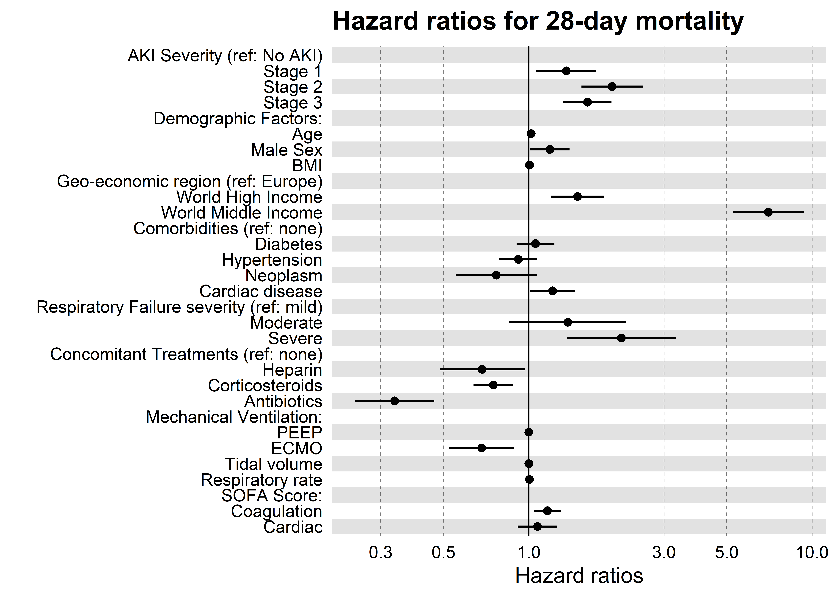
Figure e6
Notes:
Figure e6. Hazard ratio plots for 90-day hospital mortality against AKI stage (including CKD patients)

Slide 8
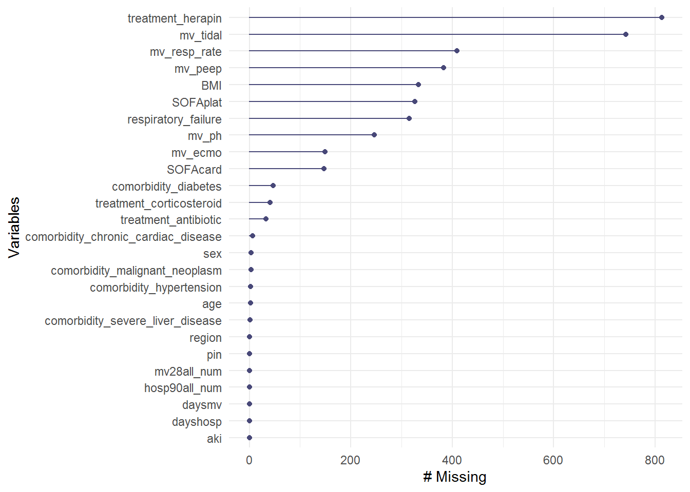
Figure e7
Notes:
Figure e7: Number of missing observations per variable included in analysis

Slide 9
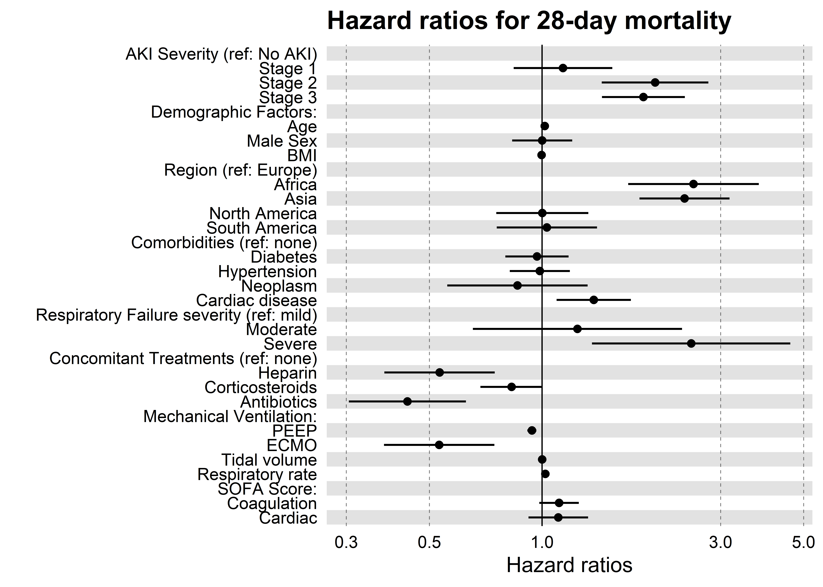
Figure e8
Notes:
Figure e8. Hazard ratio plots for 28-day ICU mortality against AKI stage (using geographic region)

Slide 10
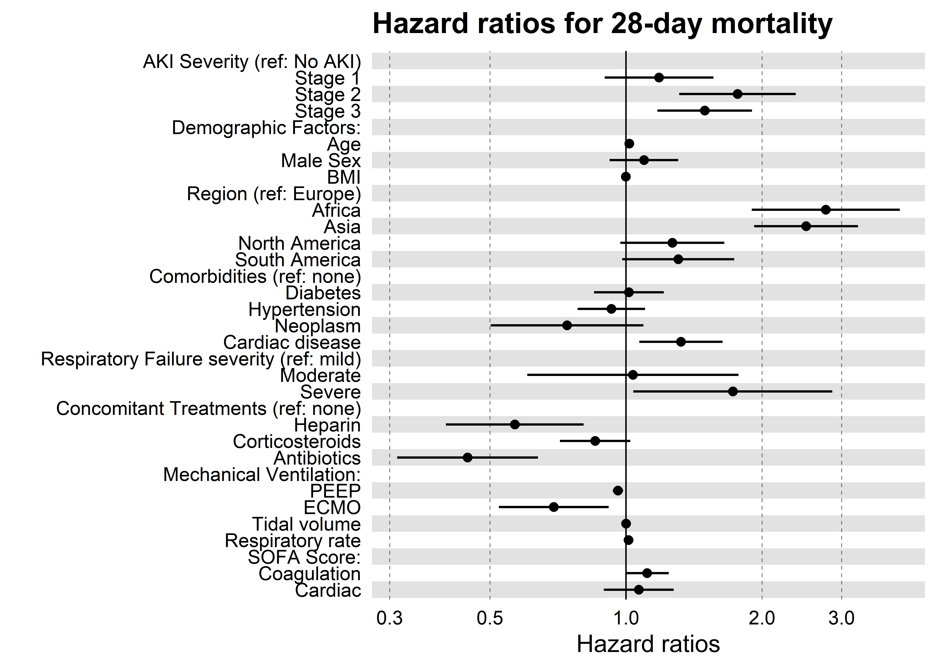
Figure e9
Notes:
Figure e9. Hazard ratio plots for 90-day hospital mortality against AKI stage (using geographic region)

