Slide 1
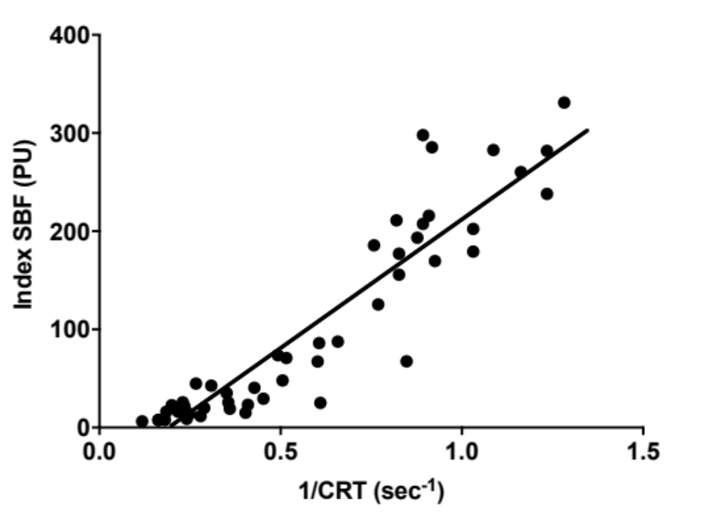
R²=0.86, p<0.0001
Supplementary Figure 1. SBF correlation with 1/CRT. Pearson test.

Slide 2
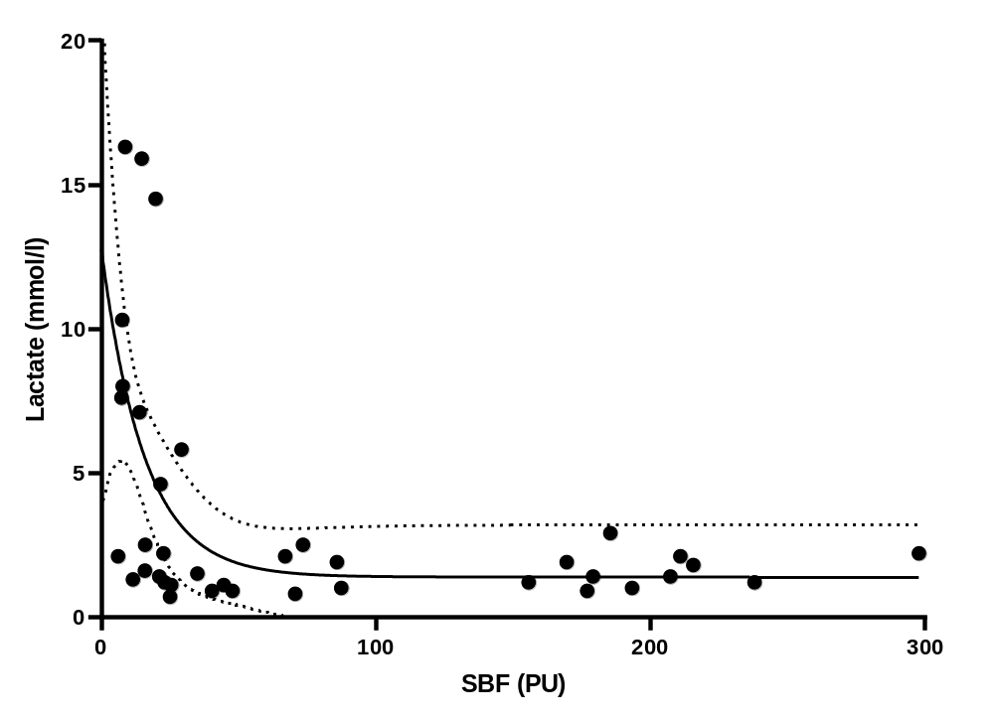
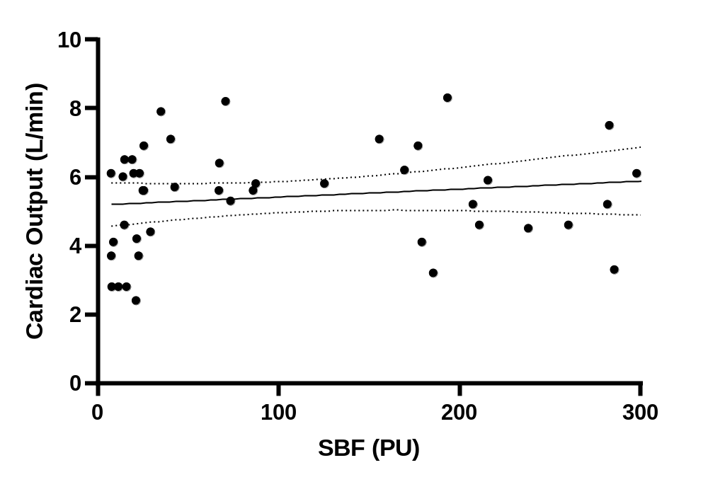
A
B
R² = 0.02
p = 0.30
R² = 0.35
p = 0.02
Supplementary Figure 2. SBF correlation with cardiac output and lactate levels. (A) Correlation between Cardiac Output and index skin blood flow at T0. (B) Correlation between arterial lactate level and index skin blood flow at T0.

Slide 3
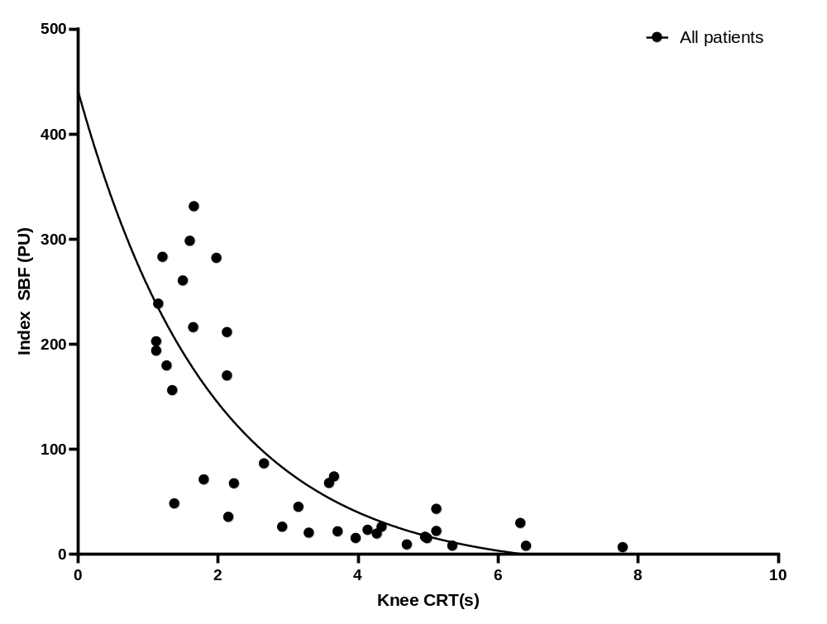
R² = 0.64, p < 0.0001
Supplementary Figure 3. Index SBF correlation with knee CRT at T0. Spearman test.

Slide 4
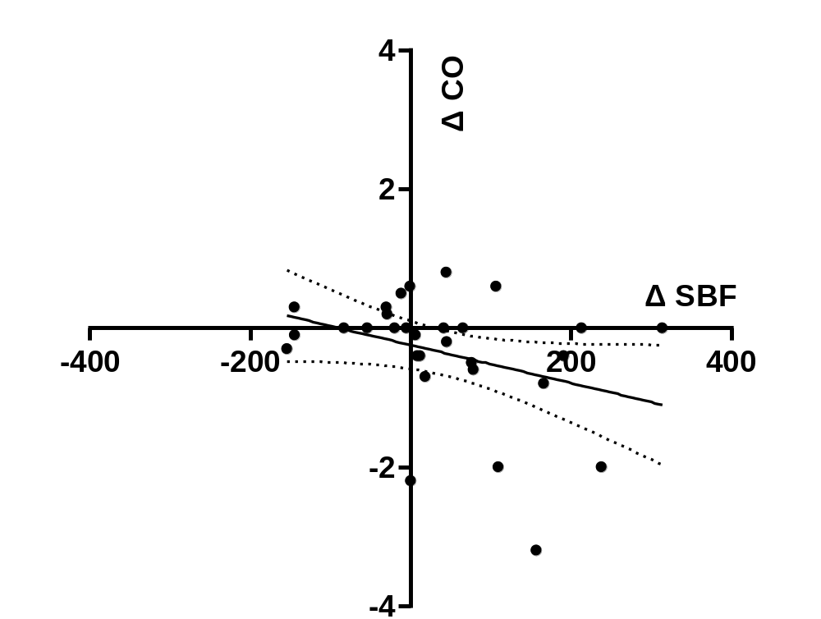
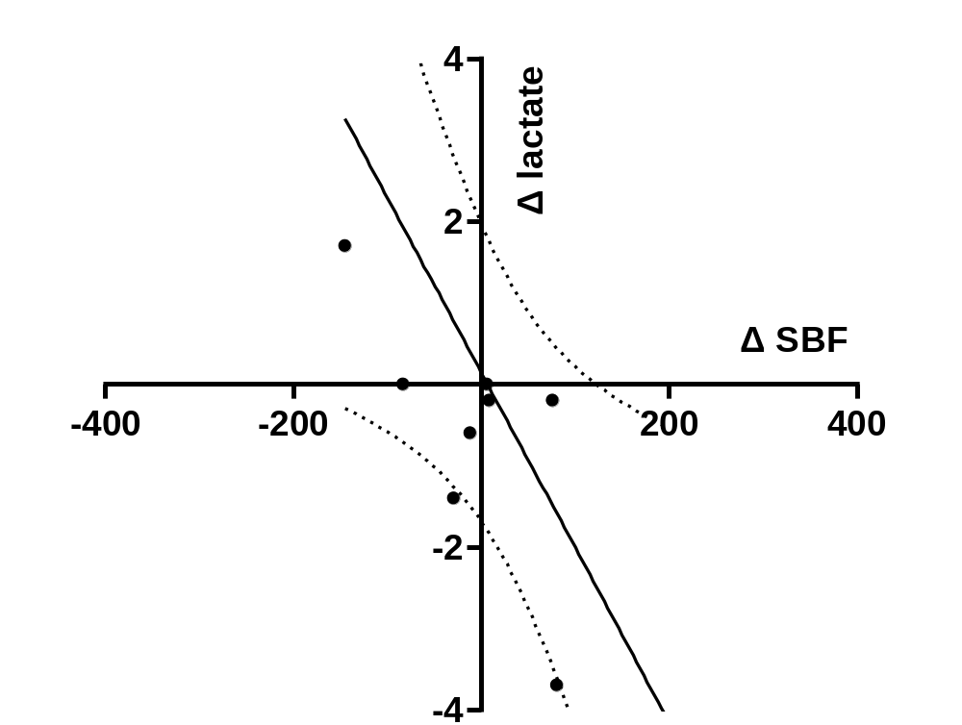
A
B
R² 0.11
p = 0.07
R² 0.41
p = 0.02
Supplementary Figure 4. Correlation of delta SBF with cardiac output variations (A), correlation of delta SBF with lactate level variations (B). Variations between T0 and T1. Pearson test. Delta was defined as T1-T0.

Slide 5
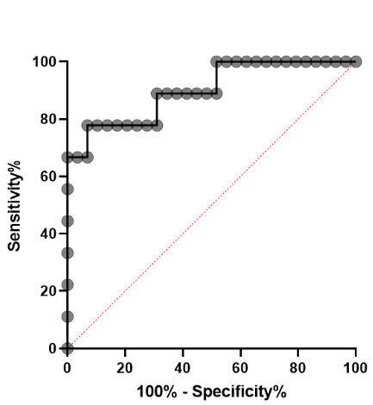
Supplementary Figure 5. Receiver operating characteristic curve. T1 skin blood flow according to ICU survival. The area under the curve was 90% [78 - 100], P=0.0003. Data were recorded 4-6 hours after inclusion.

