Slide 1
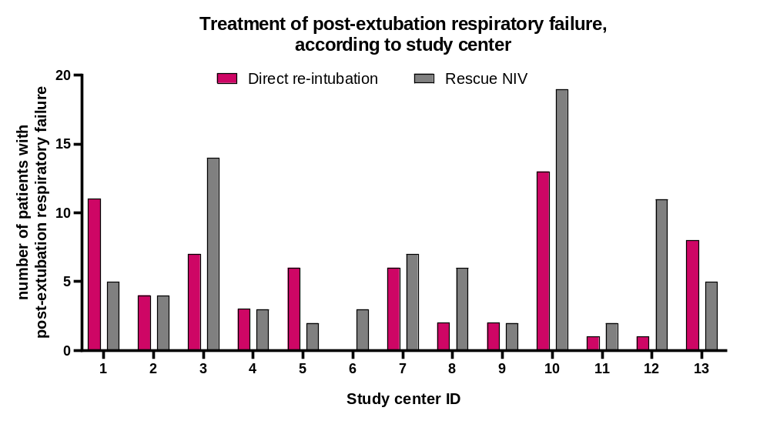
SFigure 1

Slide 2
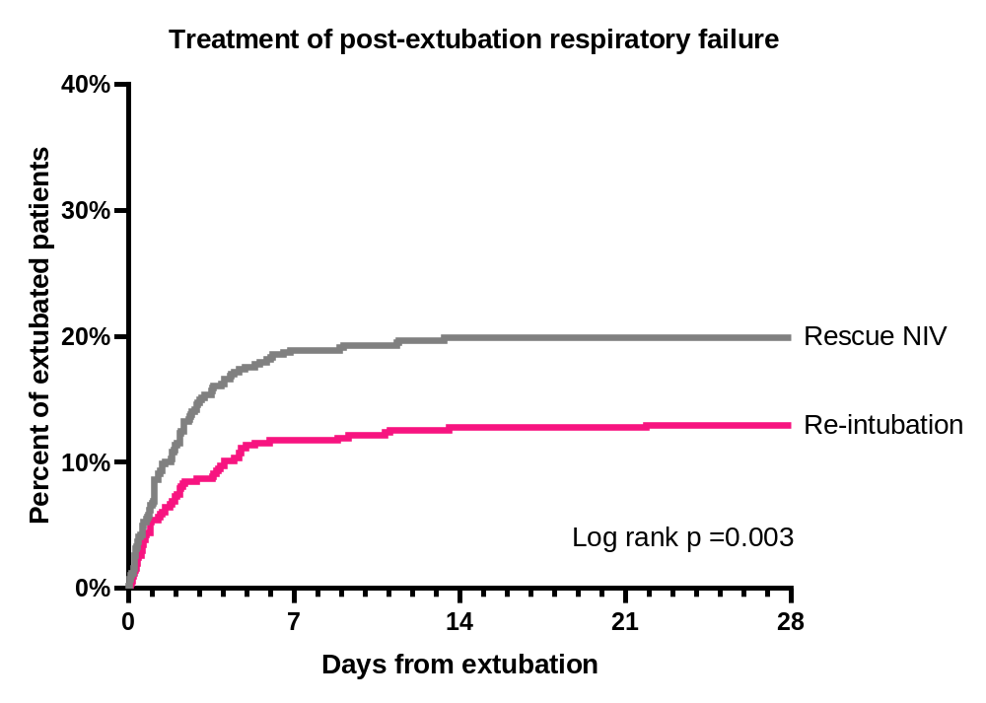
SFigure 2

Slide 3
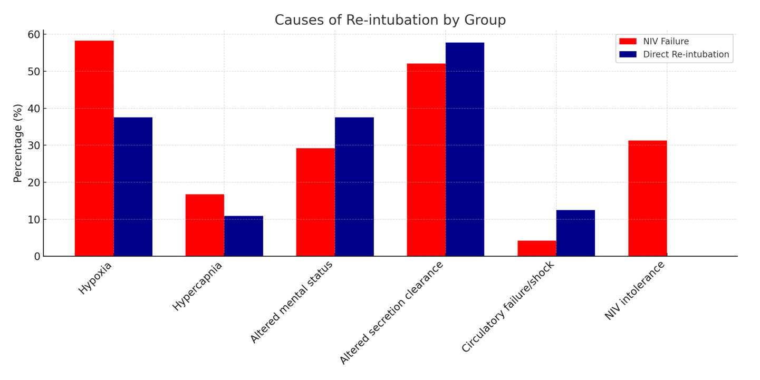
SFigure 3

Slide 4
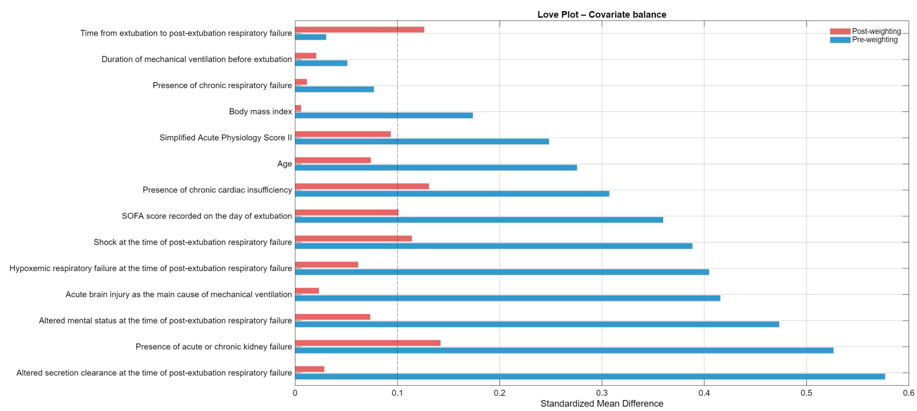
SFigure 4

Slide 5
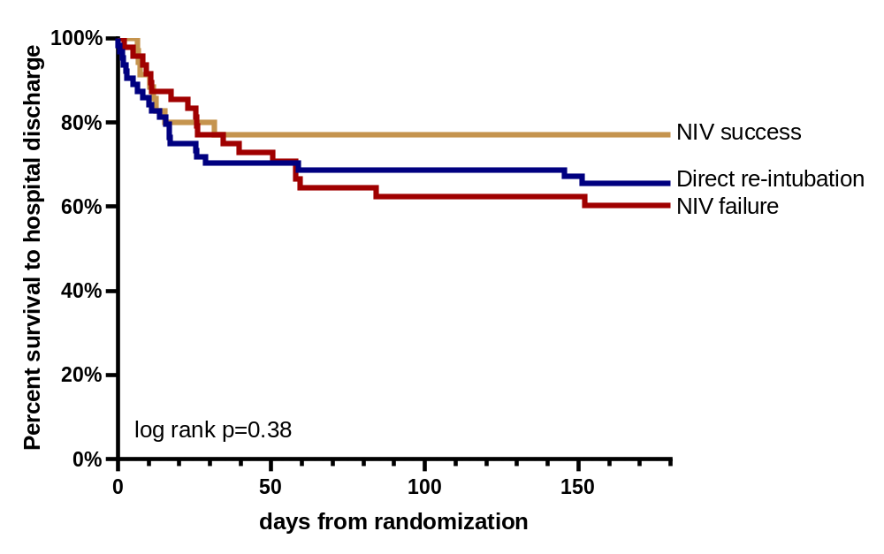
SFigure 5
No. At risk
NIV success
35 | 28 | 27 | 27 | 27 | 27 | 27
48 | 38 | 32 | 31 | 31 | 31 | 29
64 | 46 | 45 | 45 | 45 | 44 | 42
NIV failure
Re-intubation

