Slide 1
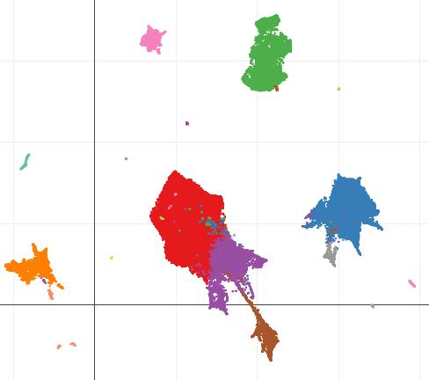
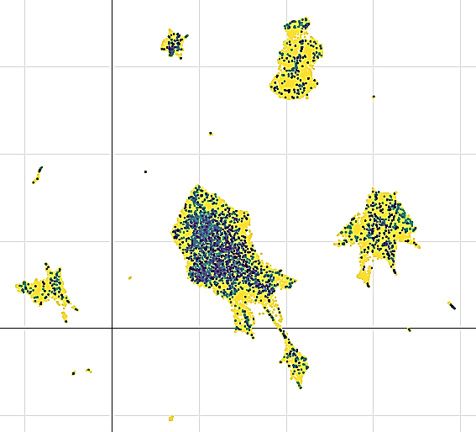
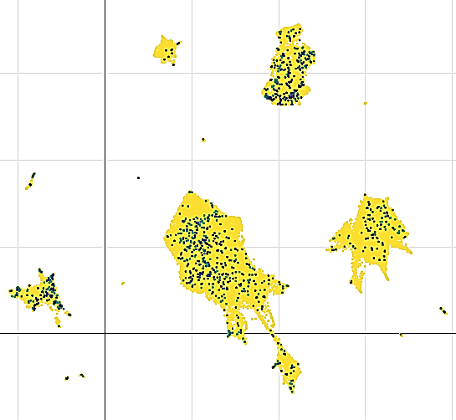
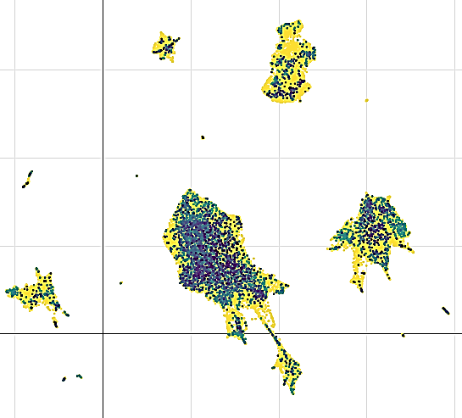
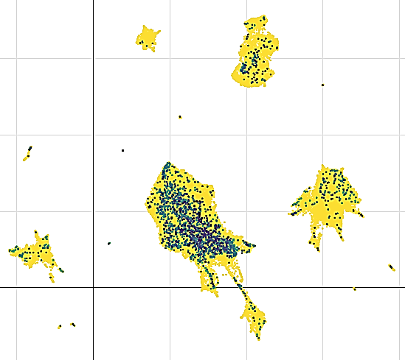
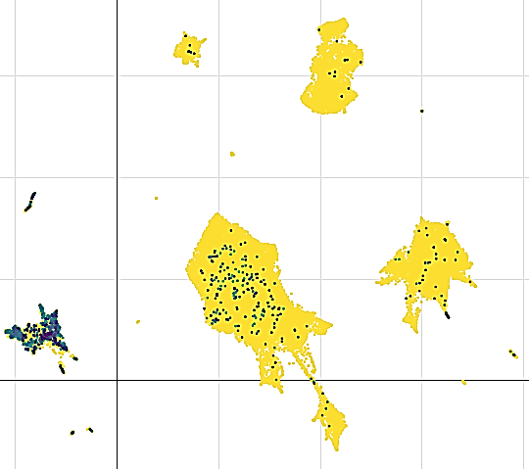
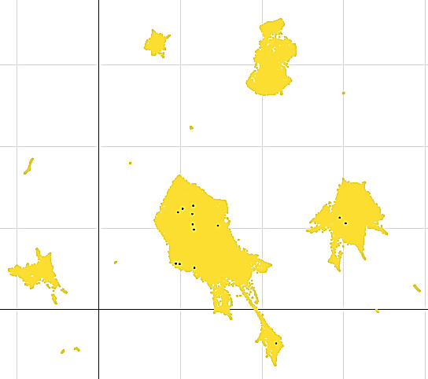
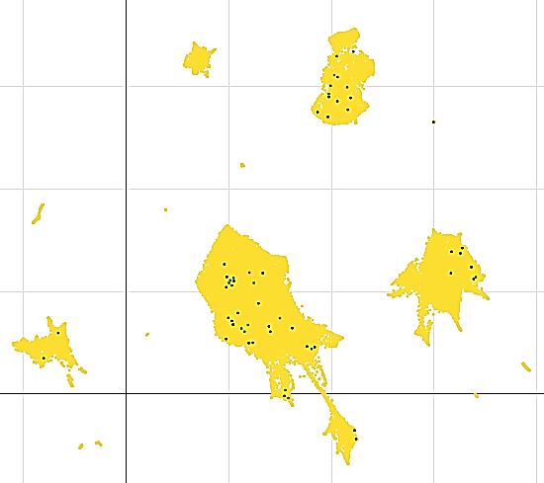
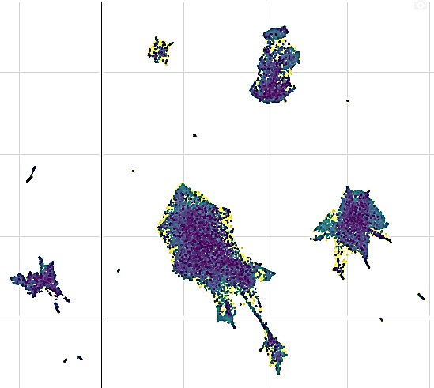
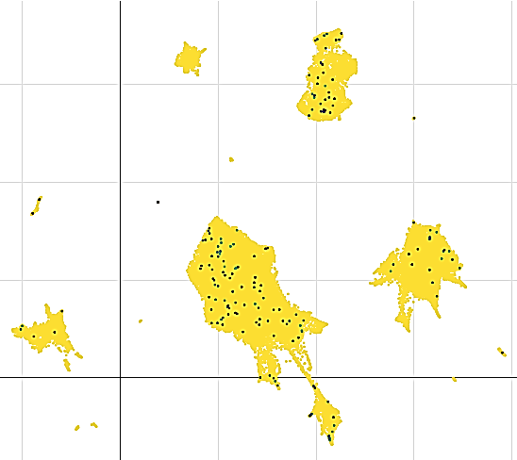
Supplemental Figure S1:A-J
A) B) C)
human ascending/descending aorta
CPNE1
CPNE2
Lymphocyte
Macrophage
Lymphatic
Endothelial
VSMC1
Fibroblast
Endothelial
VSMC2
Pericyte
D) E) F)
CPNE3
CPNE4
CPNE5
CPNE6
CPNE7
CPNE8
G) H) I)
J)
CPNE9
0
1
Figure S1: Validation of CPNE gene family expression in human aortic single-cell datasets. (A–J) t-SNE plot displaying the expression levels of CPNE1–CPNE9 across distinct vascular cell clusters in an independent paired ascending and descending aorta single-nuclei RNA-sequencing dataset. CPNE5 remains the only member specifically enriched in endothelial subpopulations, consistent with results shown in Figure 1.
2
3
4

Slide 2
Supplementary Figure S2
Human Sample Collection
Patients with sepsis
83 patients enrolled between July 2023 and March 2025 (Sepsis 3.0)
Healthy donors
44 age- and sex-matched healthy donors
Excluded
-Over 80 y (n=4)
-Malignancy (n=2)
77 patients
Peripheral blood plasma analysis
Collected on ICU admission and stored for biomarker assays
Figure S2: Flowchart of human sample collection and processing.

Slide 3
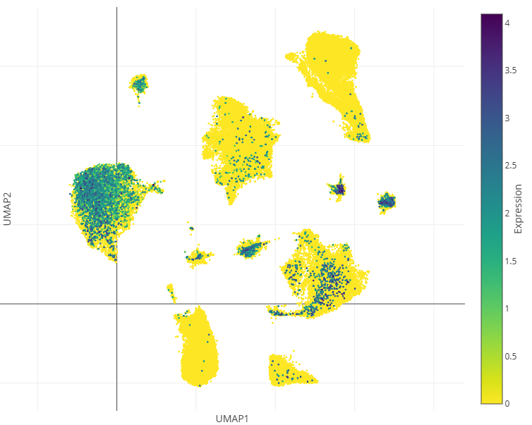
Supplemental Figure S3
Pericyte cell
Fat cell
Smooth muscle cell
Cardiac
fibroblast
Cardiac
myocyte
Mast cell
Endothelial
cell
Cardiac
neuron
Endocardial
cell
Cardiac
endothelial
cell
Macrophage
Lymphocyte
Figure S3: Expression Profile of CPNE5 in different human cardiac cell clusters
https://singlecell.broadinstitute.org/single_cell/study/SCP1303/single-nuclei-profiling-of-human-dilated-and-hypertrophic-cardiomyopathy?genes=CPNE5

Slide 4
Supplementary Figure S4 A-P
Figure S4: Assessment of vascular leakage in additional organs by Evans blue dye extravasation. (A–C) Gross appearance of spleen (A), liver (B), and kidney (C) from WT and CPNE5-KO mice 24 h after CS induction and tail vein injection of Evans blue (EB). (D–F) Quantification of EB accumulation in the spleen (D), liver (E), and kidney (F) was performed by formamide extraction followed by absorbance measurement at 620 nm. No significant differences were observed between WT-CS and KO-CS groups. (G–K) Representative fluorescence images of frozen tissue sections from the aorta (G), heart (H), lung (I), stomach (J), and small intestine (K). Red fluorescence indicates extravascular EB–albumin complexes. CPNE5-KO mice showed markedly enhanced red signal intensity, indicating more severe vascular leakage. (L–P) Quantitative analysis of red fluorescence intensity (mean gray value) in each organ using ImageJ. Compared to WT-CS mice, CPNE5-KO mice showed increased vascular leakage in the aorta (L), heart (M), lung (N), stomach (O), and small intestine (P). Data are presented as mean ± SD. *p < 0.05; ns, not significant.

Slide 5
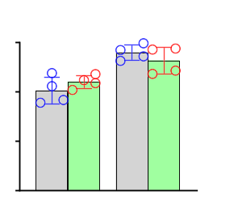
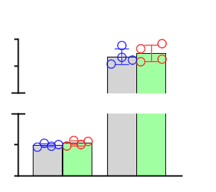
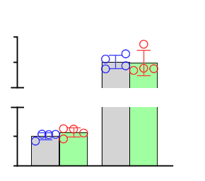
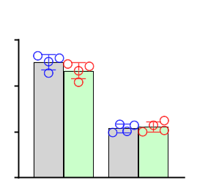
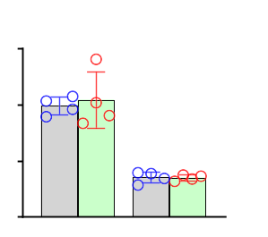
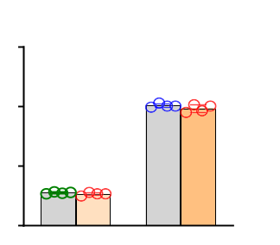
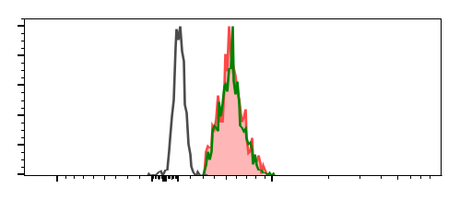
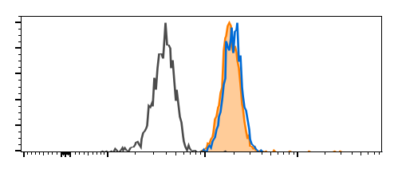
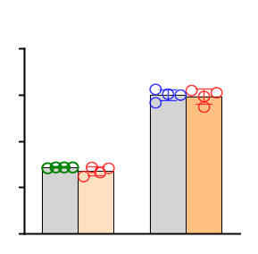
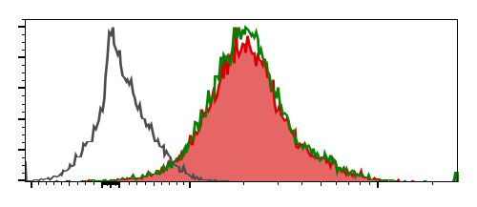
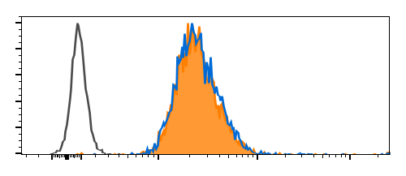
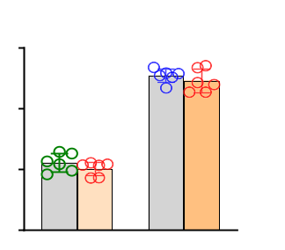
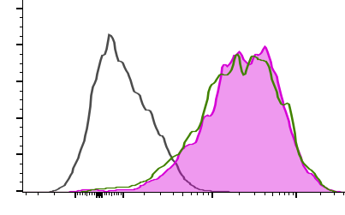
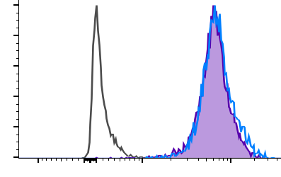
Supplementary Figure S5 A-N
n.s.
n.s.
n.s.
A) B) C)
1.5
n.s.
150
60
1.0
90
40
30
20
Ang-II mRNA Levels (vs. GAPDH)
SDC-1 mRNA
Levels (vs. GAPDH)
n.s.
ICAM-1 mRNA
Levels (vs. GAPDH)
n.s.
0.5
2
2
1
1
0
PBS Cytomix
0
PBS Cytomix
0
PBS Cytomix
D) E)
n.s.
1.2
n.s.
1.5
0.8
n.s.
1.0
siCtrl
VE-Cadherin mRNA
Levels (vs. GAPDH)
Occludin mRNA
Levels (vs. GAPDH)
n.s.
siCPNE5
0.4
0.5
0
PBS Cytomix
0
PBS Cytomix
F) G) H)
100
FMO
100
FMO
3
siCtrl
SiCPNE5
SiCPNE5
siCPNE5
80
SiCtrl
80
SiCtrl
2
60
60
Intensity (MFI X10³)
40
40
1
20
20
Count
Count
0
0
0
VE-Cad Occludin
VE-Cadherin-APC
Occludin-AF488
I) J) K)
100
Heart ECs
FMO
100
FMO
4
WT
80
KO
80
KO
3
KO
60
WT
60
WT
Intensity (MFI X10³)
40
40
2
20
20
1
Count
Count
0
0
0
VE-Cad Occludin
VE-Cadherin-APC
Occludin-AF488
L) M) N)
100
Lung ECs
FMO
100
FMO
9
WT
KO
KO
KO
80
WT
80
WT
6
60
60
Intensity (MFI X10³)
40
40
3
20
20
Count
Count
0
0
0
VE-Cad Occludin
VE-Cadherin-APC
Occludin-AF488
Figure S5: (A-E) CPNE5-knockdown does not alter mRNA expression levels of Ang-II, SDC-1, and ICAM-1, as well as VE-cadherin and Occludin upon basal and inflammatory conditions. RT-qPCR analysis to measure mRNA levels of Ang II (A), ICAM-1 (B), SDC-1 (C), VE-cadherin (D), and Occludin (E) in siCtrl- and siCPNE5-transfected MCECs upon basal and Cytomix insults. No significant differences were observed. (F–H) Representative flow cytometry histograms and their quantifications showing membrane levels of VE-cadherin (VE-Cad) and Occludin in siCtrl and siCPNE5-transfected MCECs upon basal conditions. (I–K) Representative flow cytometry histograms and their quantifications to determine membrane levels of VE-cadherin and Occludin expression in CD31⁺-endothelial cells isolated from the hearts of WT and CPNE5-KO mice upon PBS treatment, which showed no significant difference. (L-N) Representative flow cytometry histograms and their quantifications showed no significant difference in membrane levels of VE-cadherin and Occludin at the surface of pulmonary ECs isolated from the lungs of WT and CPNE5-KO mice upon PBS treatment. Data are presented as mean ± SD; n = 4-6. ns, not significant.

Slide 6
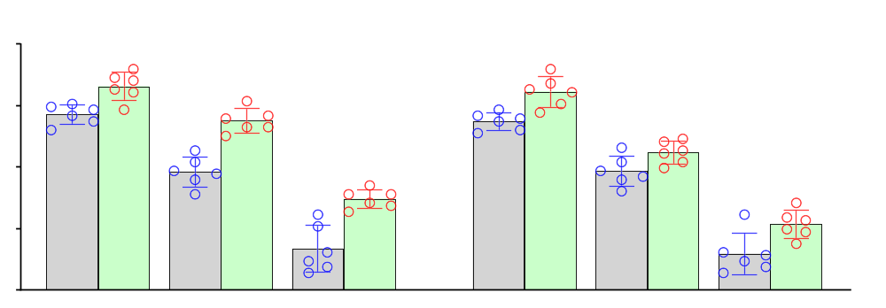
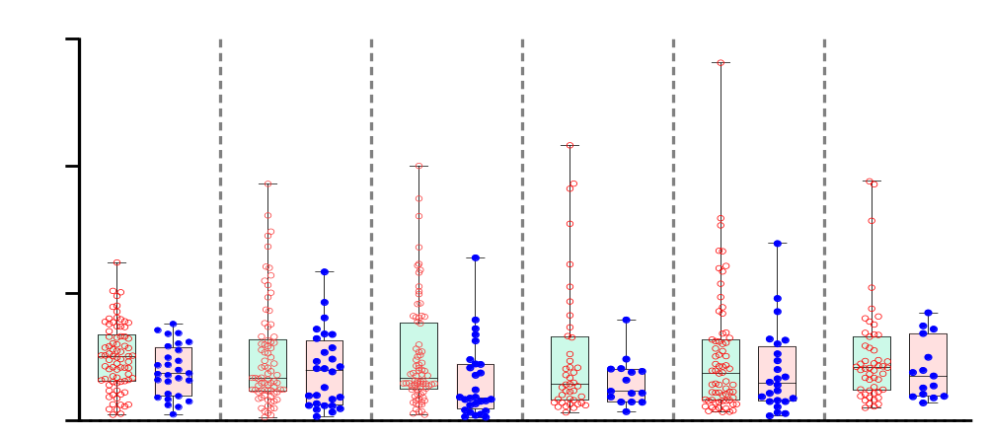
Supplementary Figure S6
BSA
rCPNE5
*
100
*
*
80
*
Relative TEER (%)
*
*
60
40
20
1.5 3 6 (h)
1.5 3 6 (h)
LPS (10μg/mL)
Cytomix (30ng/mL)
Figure S6: Treatment of mouse cardiac endothelail cells (MCECs) with rCPNE5 protein (100ng/ml) attenuates the LPS- and cytomix-caused reductions in the Trans-Endothelial Electrical Resistance (TEER), compared to BSA-controls (n = 6, *, p < 0.05 vs. BSA-cells).
Supplemental Figure S7
6
Sepsis Survivors
Sepsis Non-Survivors
n.s.
p = 0.027
n.s.
n.s.
*
n.s.
4
p = 0.048
*
Normalization Expression Levels
2
0
CPNE2 CPNE3 CPNE5 CPNE7 CPNE8 CPNE9
Figure S7: The expression profile of CPNE family genes in the blood cells collected from sepsis survivors and non-survivors. Box and scatter plots showing the normalized mRNA expression levels of CPNE2, CPNE3, CPNE5, CPNE7, CPNE8, and CPNE9 in peripheral blood cells from sepsis survivors (green, n = 78) and non-survivors (pink, n = 28). Among the COPINE family members analyzed, CPNE5 expression was significantly reduced in non-survivors compared to survivors (p = 0.027), consistent with the plasma levels presented in main Fig. 2D. Data are presented as median with interquartile range; significance was determined by Mann–Whitney U test. p < 0.05; n.s., not significant.

Slide 7
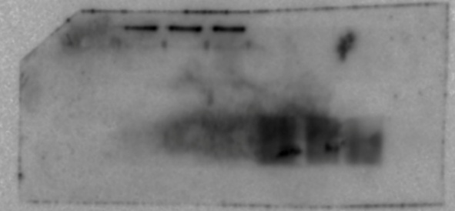
Supplemental Figure S8
siCtrl siCPNE5
A) C)
siCtrl siCPNE5
68kDa
CPNE5
68kDa
CPNE5
siCtrl siCPNE5
B) D)
siCtrl siCPNE5
37kDa
37kDa
GAPDH
GAPDH
Figure S8: Uncropped original Western blot membranes used for Figure 5B and Figure 6D. (A/B) Validation of CPNE5 knockdown in MCECs. (A) Western blot showing CPNE5 protein expression following siRNA transfection. (B) GAPDH was used as a loading control. (C/D) Validation of CPNE5 knockout in mouse heart tissue. (C) Western blot showing CPNE5 protein expression in WT and CPNE5-KO mice. (D) GAPDH served as the internal control. All blots shown here represent the original, uncropped membranes corresponding to the main figures.

