Slide 1
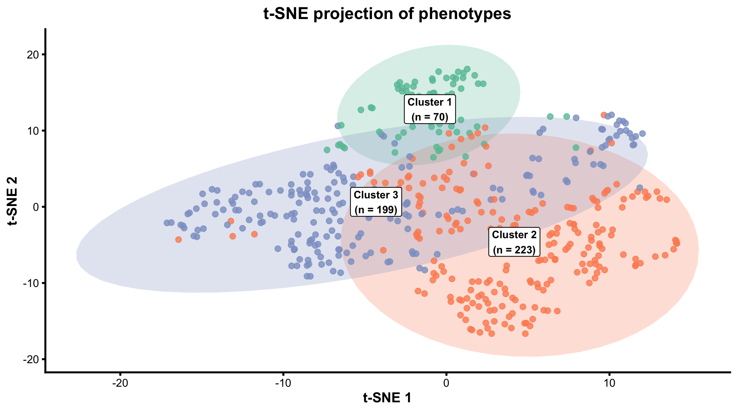
Supplementary Figure 1. t-SNE visualization of candidemia clusters (Two-dimensional t-SNE map showing patient distribution according to cluster membership)

