Slide 1
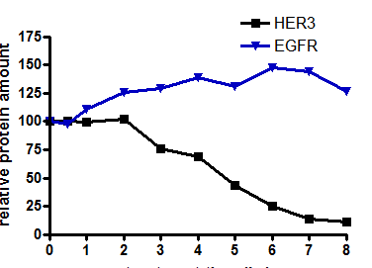


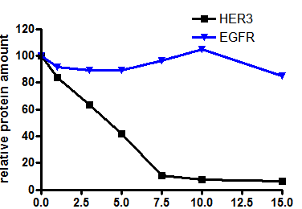



A
B
Perhexiline (hr)
0
0.5
1
2
3
4
5
6
7
8
HER3
EGFR
Relative protein expression
β-actin
C
Perhexiline (µM)
0
1
3
5
7.5
10
15
HER3
Treatment time (hr)
EGFR
D
β-actin
E
6hr treatment
Relative protein expression
Perhexiline(µM)
0 1 3 5 7.5 10 15
HER3
p-HER3
Perhexiline (µM)
β-actin
Supplemental Figure S2

