Slide 1
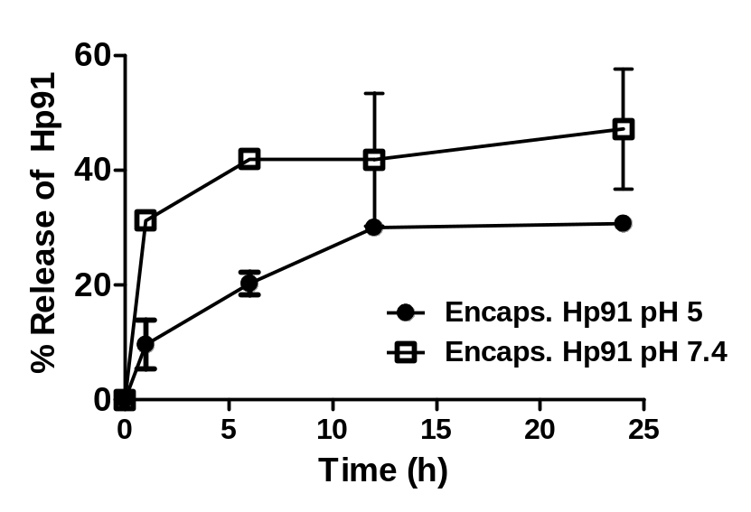
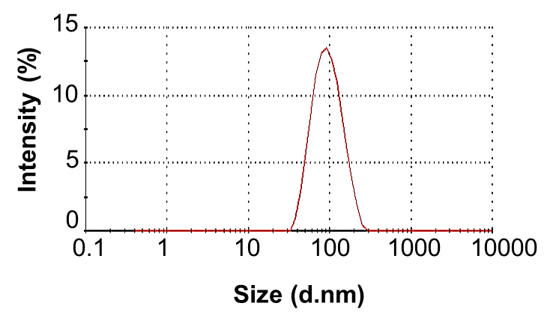
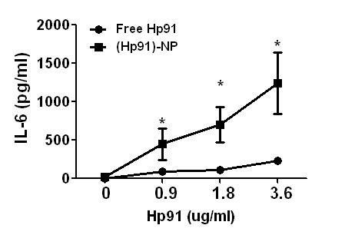
A)
B)
C)
Notes:
Release Kinetics of Nanoparticles
DLS data
Human DC IL-6 data

