Slide 1

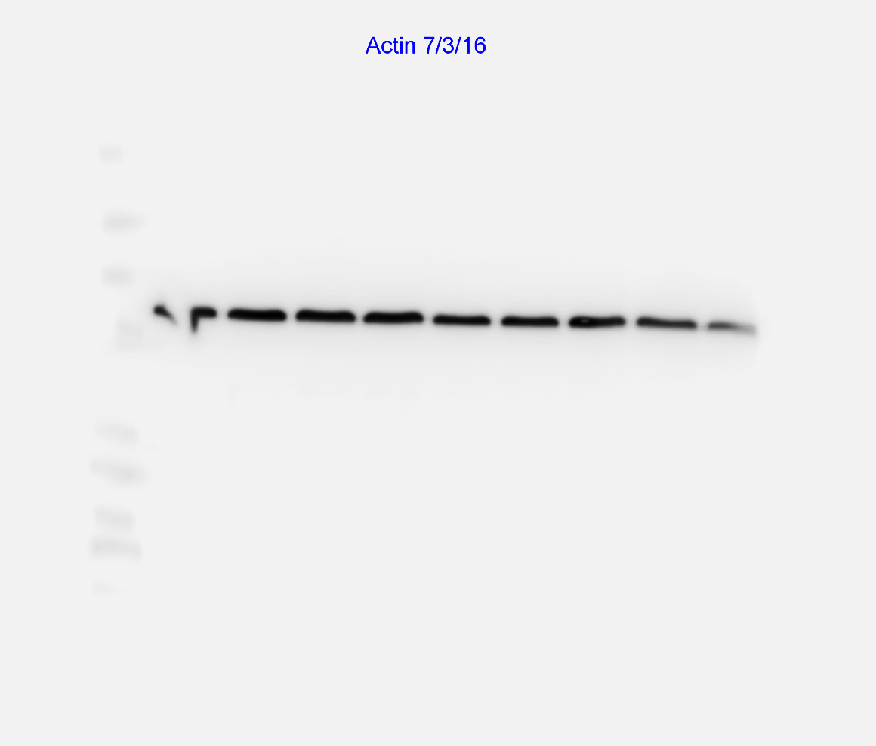
Figure S3
130KDa -
45KDa -
Unstim
Cort 24hrs
Cort 30mins

