Slide 1
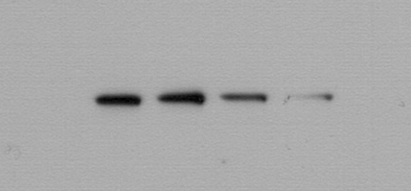
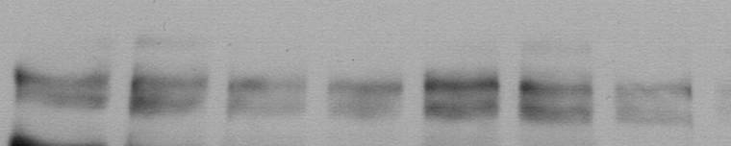
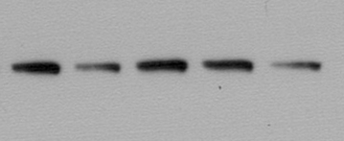
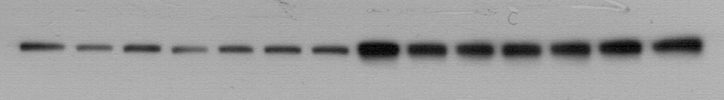
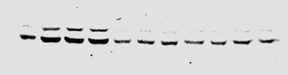
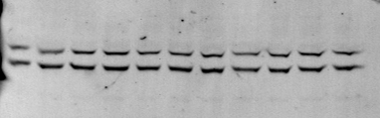
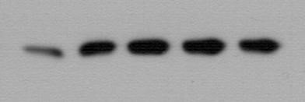
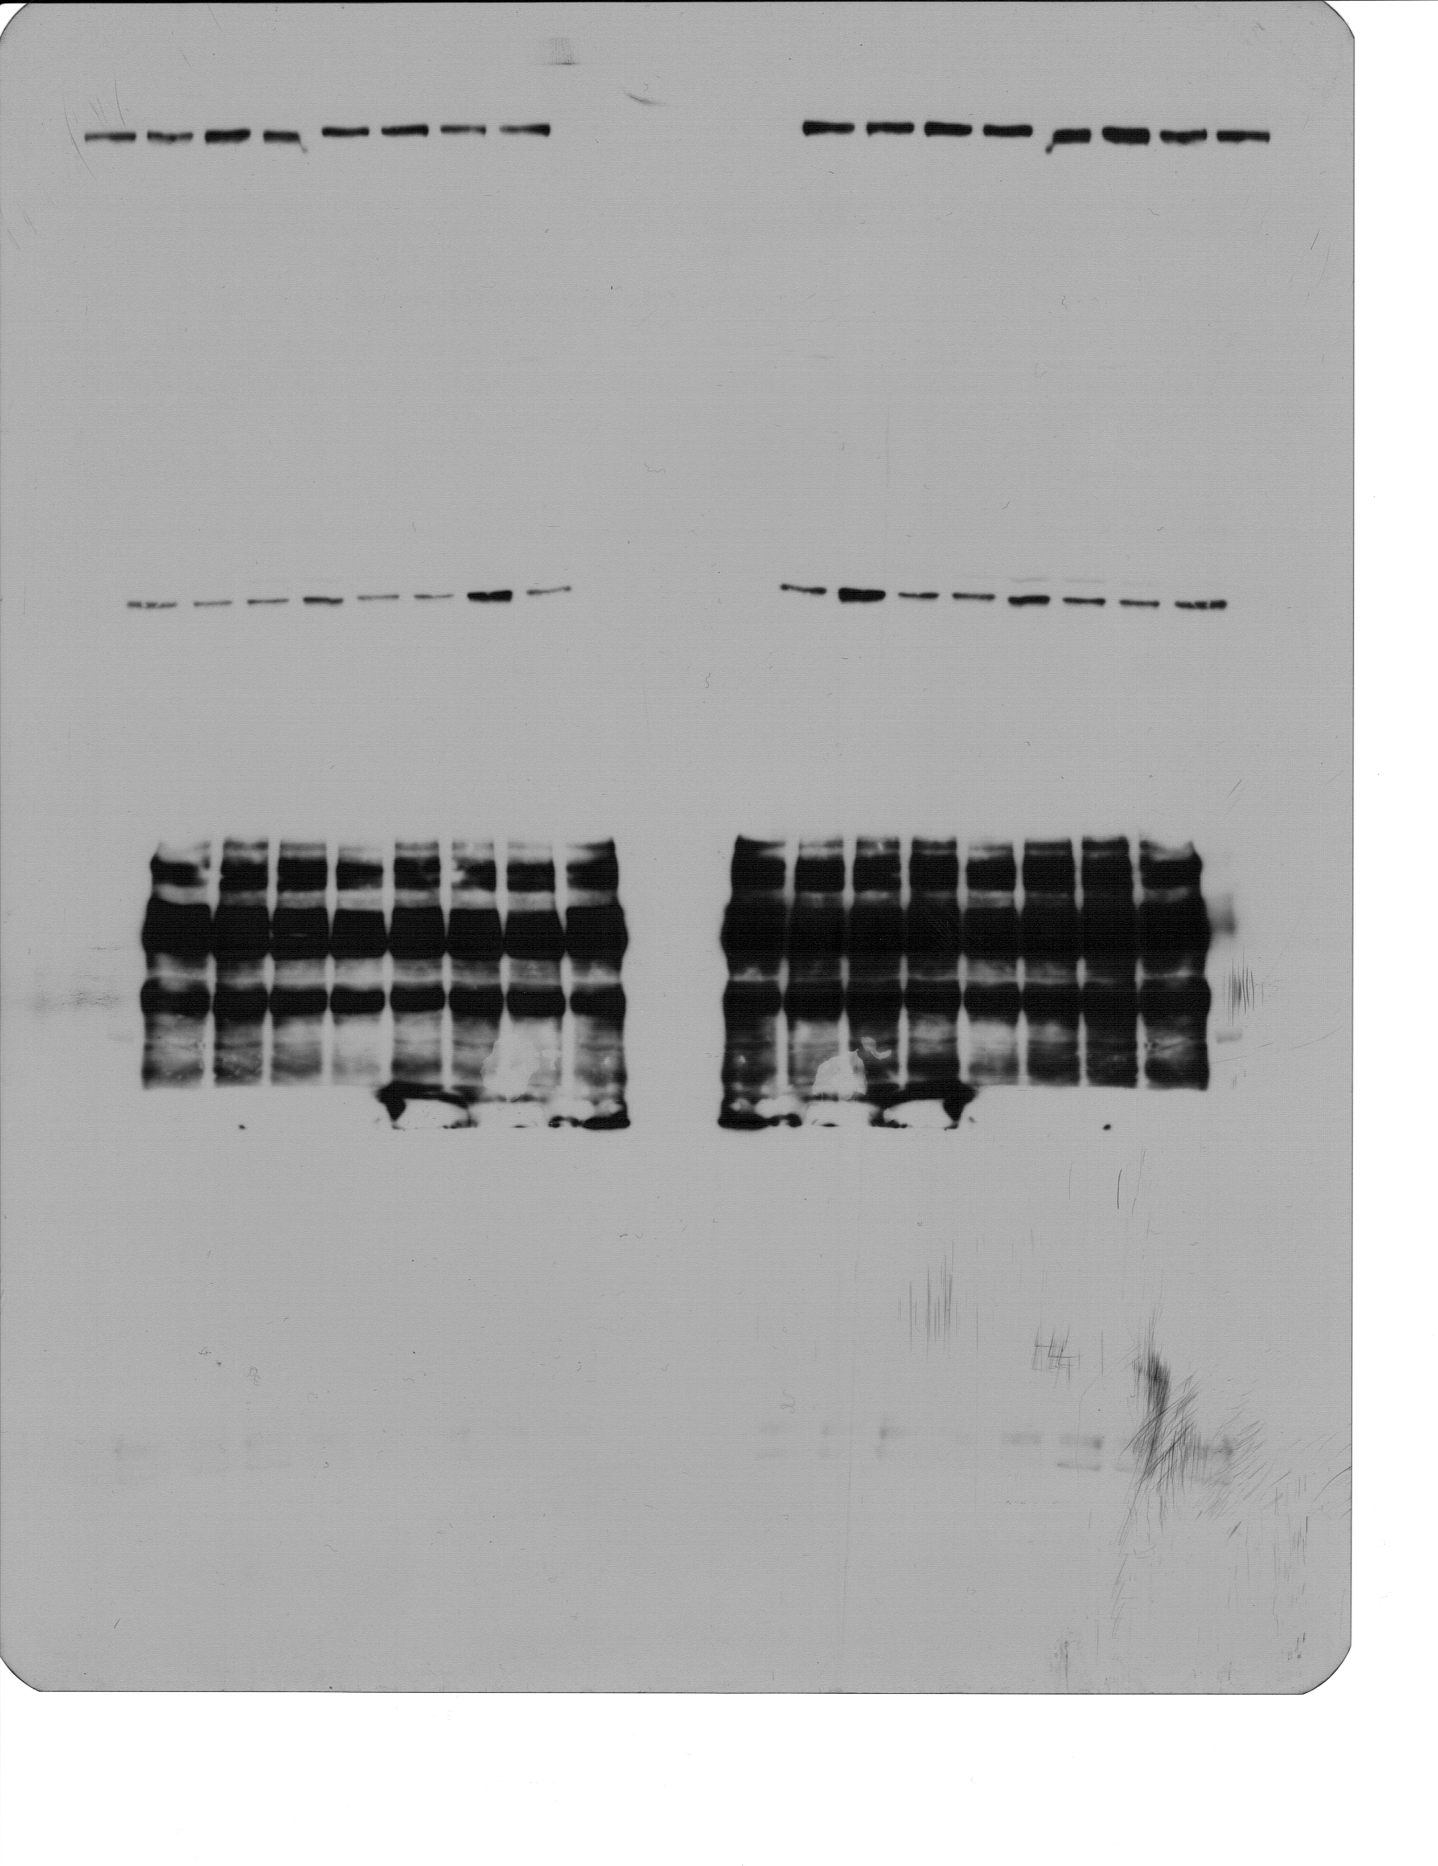
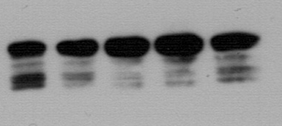
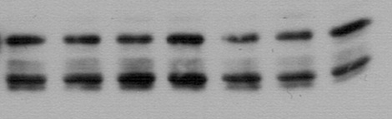
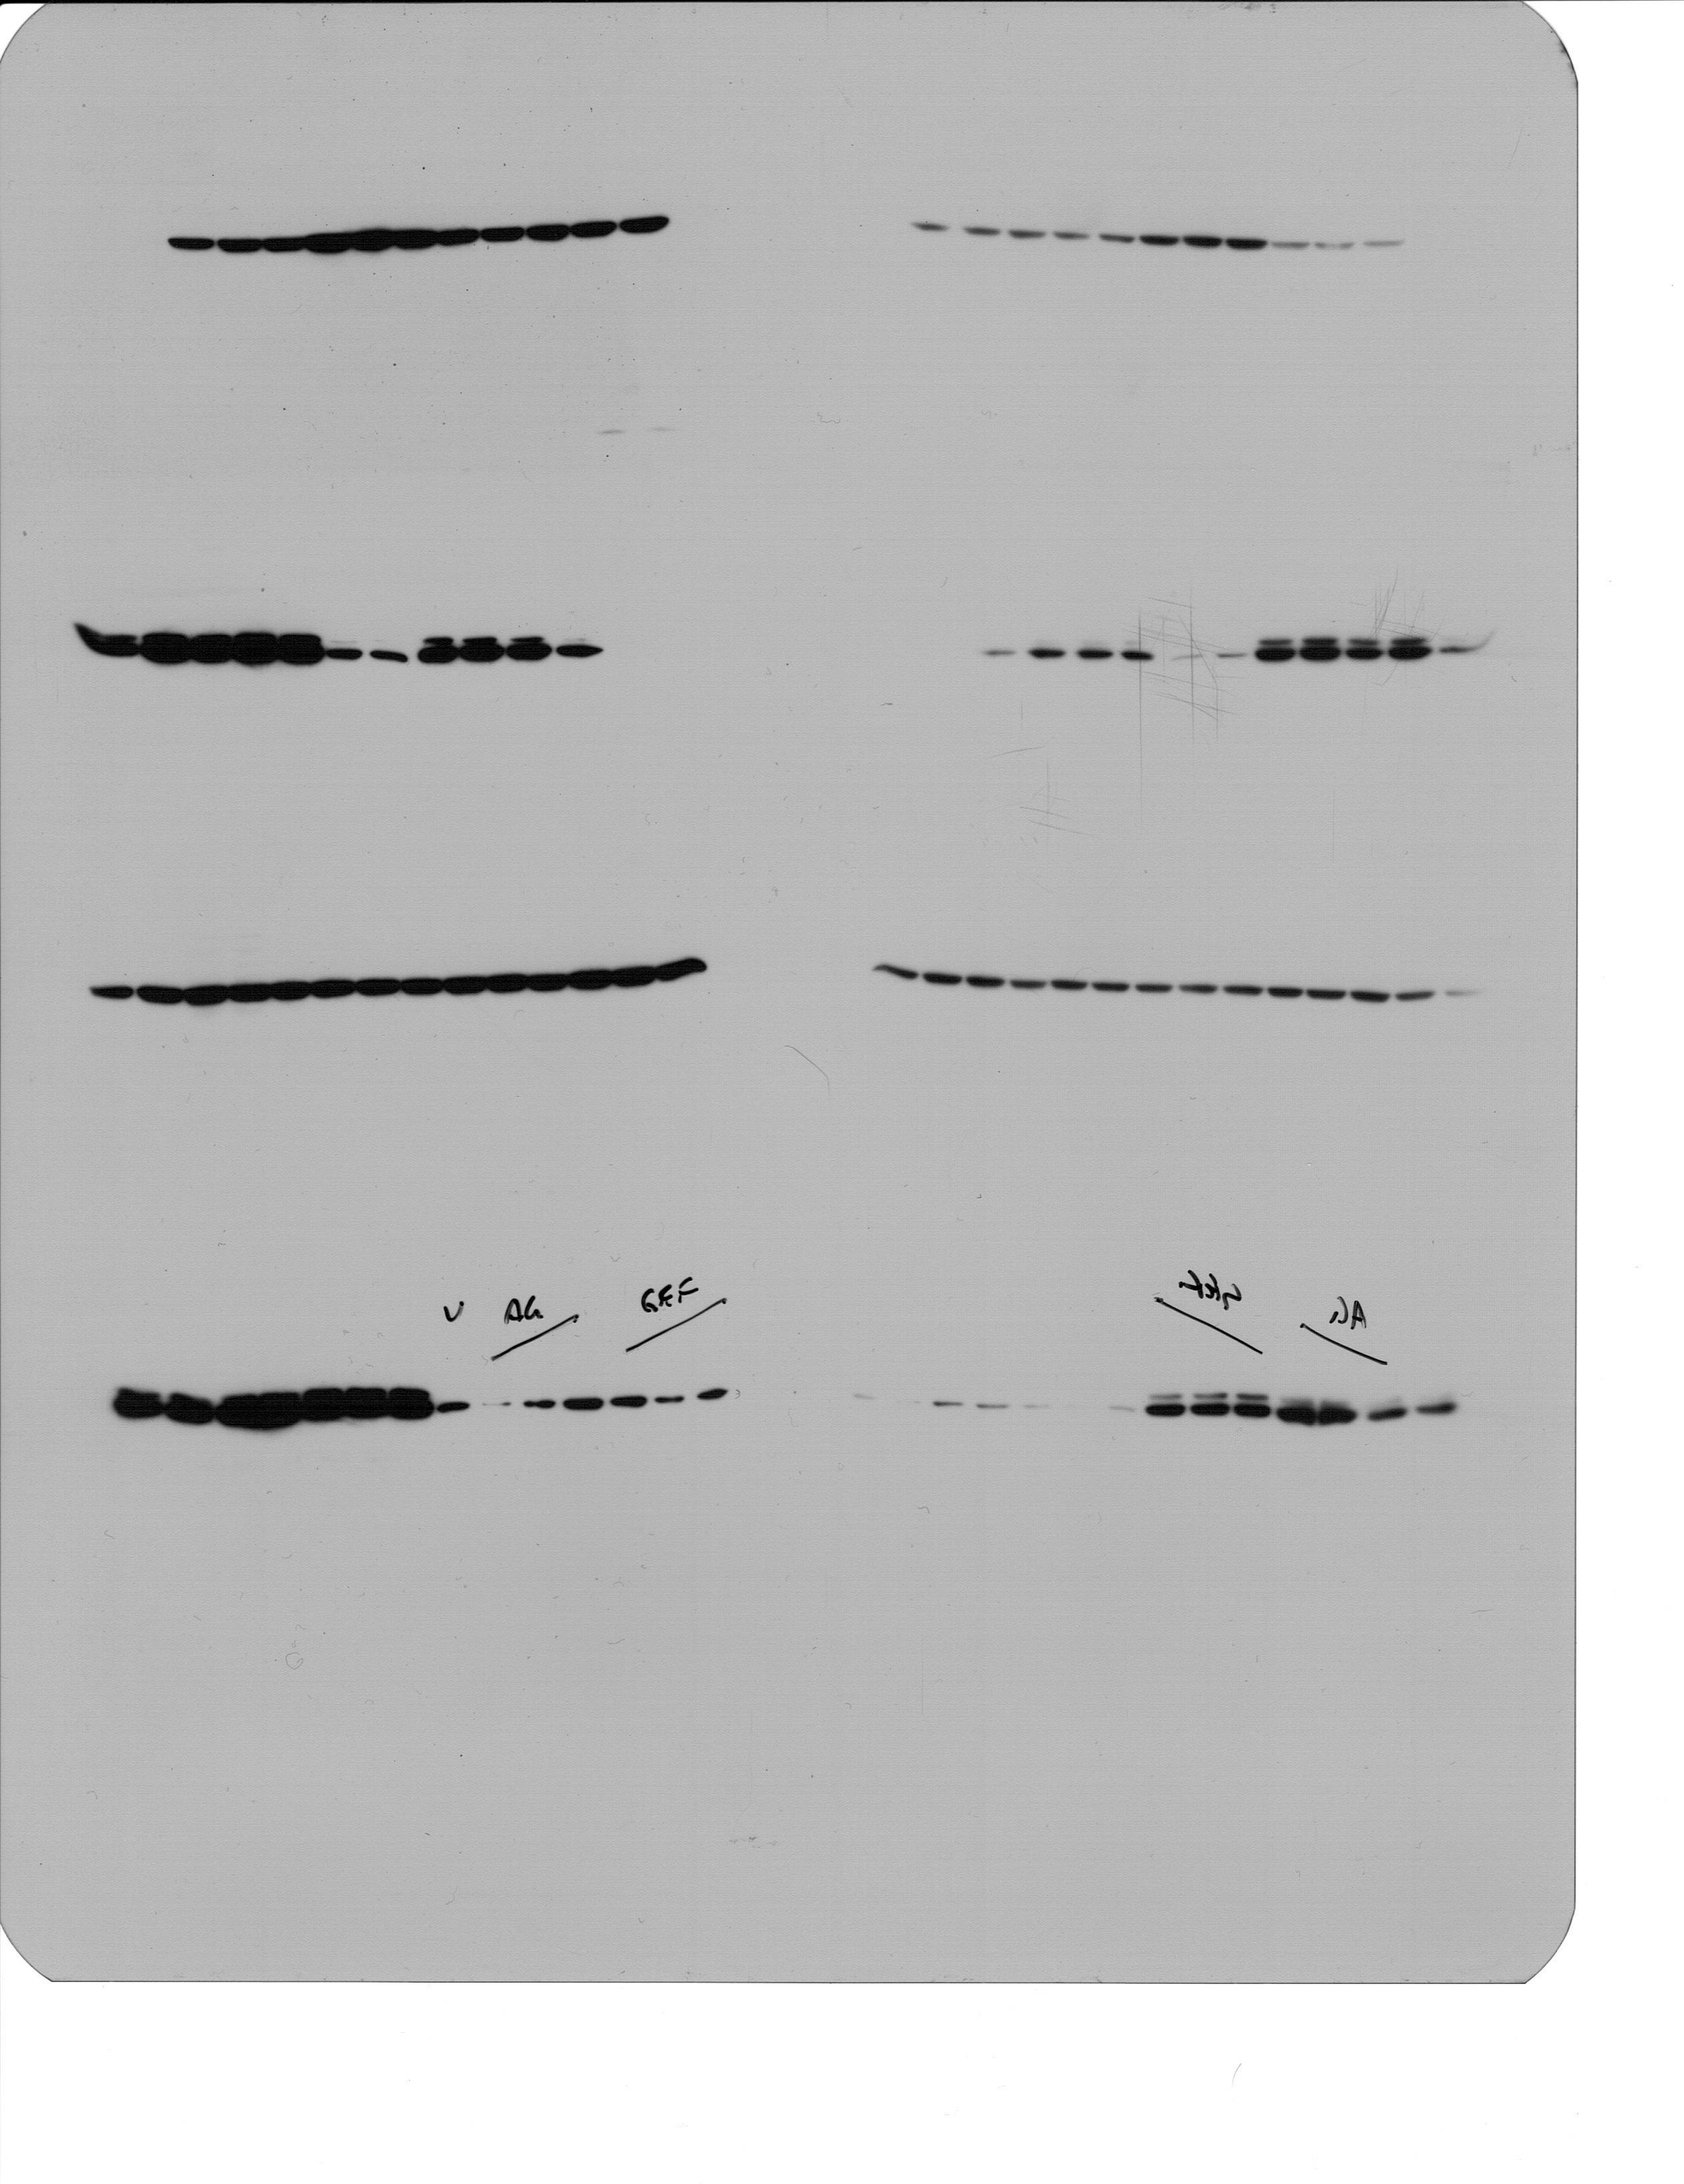
A
BRC31
B
BRC-31
+EGF
AG1478
Gefitinib
U
5
10
30
Time (min)
-
kDa
kDa
pEGFR (Y1086)
150
pEGFR (Y1086)
150
150
EGFR
150
EGFR
pERK1/pERK2
(T202/Y204)
pERK1/pERK2
(T202/Y204)
37
37
ERK1/ERK2
ERK1/ERK2
37
37
37
pFRA-1
37
pFRA-1
37
FRA-1
37
FRA-1
α-Tubulin
α-Tubulin
50
50
Annis et al., Additional File: Fig. S2

