Slide 1
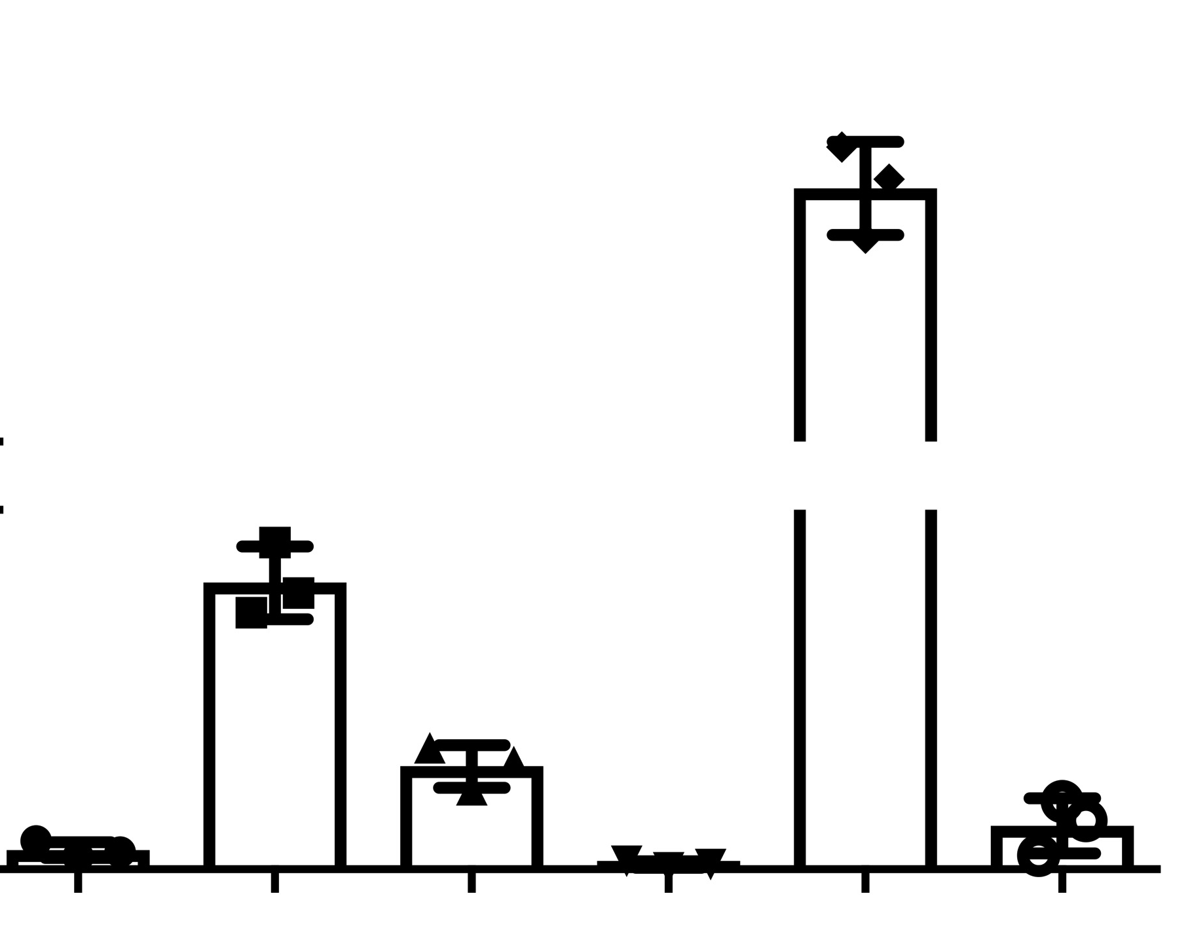
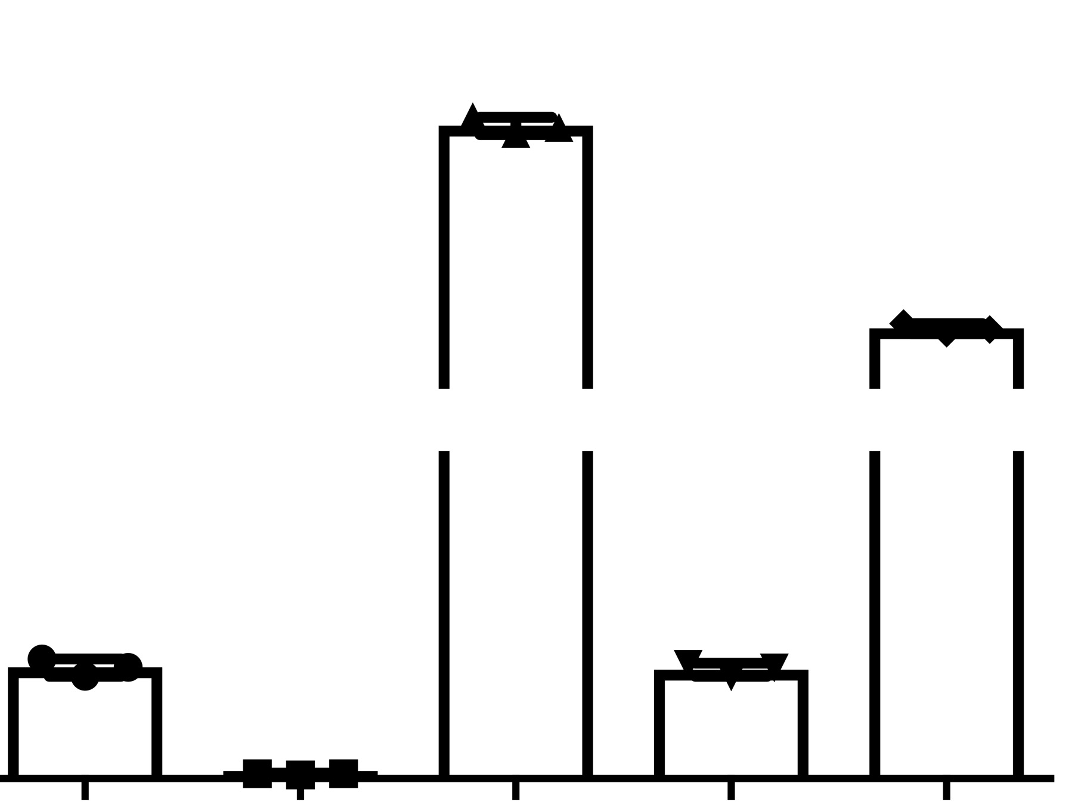
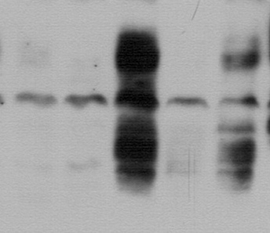

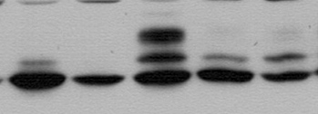

A
Gene Expression Affymetrix
B
ELISA – Conditioned Media
40
600
35
500
PLAU Gene Expression
(Arbitrary Units)
Secreted uPA
(ng/μg of protein in CM/
24 Hours)
30
400
10
75
50
5
25
0
0
BT549
MDA-
231
MDA-
436
MCF-7
BRC-
31
BRC-
36
BT549
MDA-
231
MDA-
436
MCF-7
BRC-
31
BRC-
36
BaB
Lum
BaB
Lum
BaB
Lum
BaB
Lum
C
TNBC PDX
D
ELISA – Tumor Lysates
BCM2665
BCM3107
1200
HCI001
HCI002
HCI010
kDa
700
37
uPA
(pg/μg of protein in tumor
lysates)
uPAR
200
50
25
30
37
pFRA-1
37
10
FRA-1
0
HCI001
HCI002
HCI010
BCM3107
BRC-31
α-Tubulin
50
TNBC PDX
Annis et al., Additional File: Fig. S6

