Slide 1
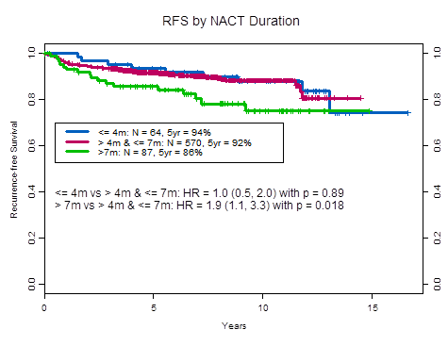
0.0 0.2 0.4 0.6 0.8 1.0
0.0 0.2 0.4 0.6 0.8 1.0
≤ 4 mos: N = 64, 5 yr = 94%
>4 & ≤7 mos: N = 570, 5 yr = 92%
>7 mos: N = 87, 5 yr = 86%
Recurrence-Free Survival
≤4 vs >4 & ≤7: HR = 1.0 (0.5, 2.0), p = .89
>7 vs >4 & ≤7: HR 1.9 (1.1,3.3), p = .018
0 5 10 15
Years

