Slide 1
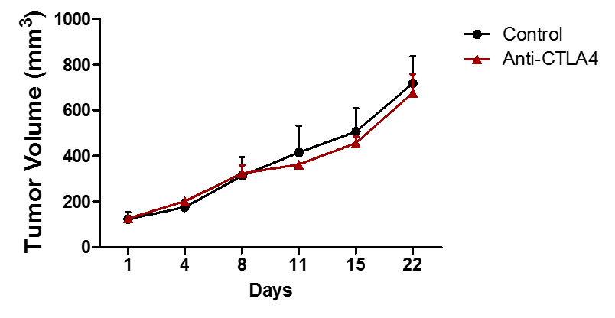
Figure S3
MC1 – hNSG mice
(n= 8)
(n= 8)

