Slide 1
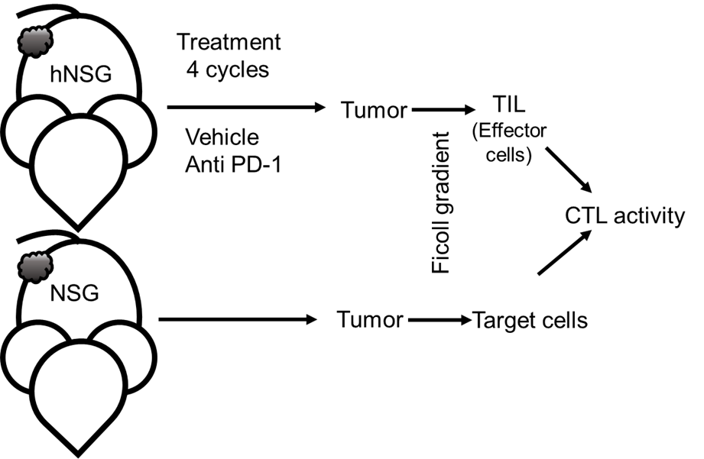
Figure S4
A
0.75 ± 0.29 %
0.70 ± 0.18 %
(n= 8)
(n= 8)
B

